Slide 1
Traditions Old and New
By: Lisandra Garcia
Jourdan Randoly
Jimmy Ninehouser
Ashley Babbitt

Slide 2
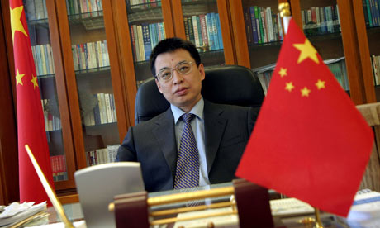
Engaging Religions to Shape Worldviews
Pan Yue
Environmental
Crisis

Slide 3
Contributions to a Culture of Sustainability
Educate about the environment
Educate about consumption
Educate about investments
Express the sacredness of the natural world in liturgies and rituals
Reclaim forgotten assets

Slide 4
Environmentally Sustainable Childbearing

Slide 5
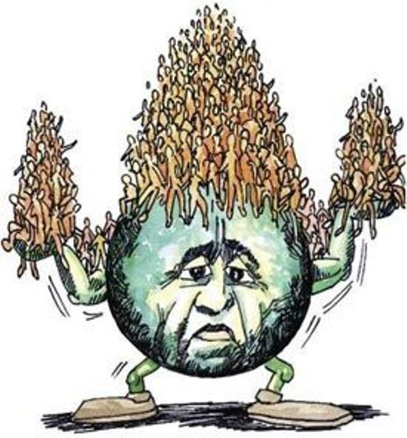
WORLD POPULATION
It is possible that world population at 6.8 billion people today and growing by 216,000 a day, has already surpassed sustainable levels. Humanity is hazardously raising the heat-trapping capacity of the atmosphere, decimating the planet’s biological diversity, and risking future food scarcity by depleting freshwater supplies and degrading soils.

Slide 6
REDUCE POPULATION
Might it then be time, or is it time already, to evolve cultures that actively promote an average number of children born to each woman so low that world population shrinks in the near future? And if so, how could that be accomplished in ethical and acceptable ways?

Slide 7
MODERN CULTURE + CHILD BEARING
The influence of modern culture on childbearing varies widely. The range of modern human fertility suggests this diversity, with women in Bosnia and Herzegovina and in the Republic of Korea having barely more than one child each on average while women in Afghanistan and Uganda average more than six. Women around the world also vary greatly, in their access to family planning which can help them decide whether any given sex act should or should not be open to conception and pregnancy. Yet with the notable exception of China, where shortages justigy the government’s one-child policy, it would be hard to identify a significant culture in which very small families are promoted to assure environmental sustainability.

Slide 8
Summary
Ritual and taboo as ecological gaurdians
This chapter is about rituals in the modern civilized world, that because of huge and carbon footprints and over consumption are hurting the planet.
Also events such as earth day that involve people wanting to make a change to this destruction, and are coming together to make the world more sustainable for future generations.

Slide 9
“Eco-Kosher”
Kosher: A Jewish tradition of dietary laws, to help create respect for God’s creations.
Eco-kosher: “right eating, and right consumption to preserve enviromental health”. Pg. 30
Bal Tashchit: “not to waste” (recycle)
Tzaar Baalei Chayyim: “avoid cruelty to animals” (livestock cruelty)
Shmirat Haguf: “Take care of your body” (pesticide free food)

Slide 10
Weddings
$60 billion annual industry nationally
$22,000 average per event
Major ecological footprint, consisting of goods & services
Travel causes massive carbon footprint
Meat from livestock, and non-locally grown produce served at reception
Tons of earth dug to find gold ore for rings

Slide 11
Funerals
1.5 million tons of concrete, & 14k tons of steel for funeral vaults
90k tons of steel & 3k tons of copper for caskets
Embalming fluid
Elaborate reception parties which cause carbon & other means of waste much like weddings

Slide 12
Earth Day
Founded in 1970
More than a billion people participate annually
Consists of more than 15k organizations in 174 countries
Creates unity within the human race
Bonds all nationalities in a means to help save the world, and educate the problems the earth is having

Slide 13
Refuting
Earth day does not create any significant improvement in the earths health

Slide 14
Related to my biology major
As a biology major, conservation for the planet is very important to me
Biology is the study of life, and without a healthy planet life as we know it will not be able to flourish the way that it does today
By not having elaborate weddings, or using environmentally ways of barrying family members we are doing the earth are great benefit, and sustaining the earth for generations to come.
I am a biology major with hopes of becoming a medical doctor, and I am very interested in finding earth friendly ways of practicing medicine in the future and all of that is related to health, death, and burial traditions

Slide 15
Elders: A Cultural Resource for Promoting Sustainable Development
This section is about the need for younger generations to learn from elders. Throughout the world children are relying more and more on social media such as television and radio programs talking of local opinions and values for knowledge rather than sitting down with a wiser person who has seen and understood more than we have and learning from them. In the past, throughout Africa members of different generations would sit under a large tree in the community to discuss the past, the present, and the future (State of the World pg. 42). Young people today would rather gather around a television to see pictures and hear about what’s going on in other places. A proverb heard widely across Africa states, “What an elder sees sitting on the ground, a younger person cannot see even if he/she is up in a tree.” The section wants you to know that society depends on the knowledge of elders or else it could result in cultural disintegration. This as the section says, “is the primary cause of problems such as the loss of linguistic, historical and spiritual traditions, the breakdown of family support structures and the loss of a locally organized political voice.” (State of the world pg. 43) There is however organizations created to help solve these problems discussed in this section.
Organizations: GMP, World Vision, The Elders

Slide 16
National examples:
The issue of younger generations becoming more and more dependent on media
Traditions have fallen due to lack of communication between young adults and their elders here in the U.S
Lack of communication in families
Lack of respect for adults

Slide 17
Psychology and this topic
Example: In my principles of development class we recently did an essay on how cognition plays a role in a child’s development and how their culture and people they grew up around plays a huge role in the process.

Slide 18
Refute the Concepts
“Mass media and advertising are the major vehicles for diffusion of western values into non-western societies…the predominant force remains the global media beamed into the tiniest of villages (State of the World pg. 42-43).”
“the child-to-child approach used in many developing countries, in which school children are expected to learn and then teach their parents about “modern” health and hygiene practices. This notion is diametrically opposed to the attitude of…nonwestern cultures, in which younger people are expected to learn from their elders, and it undermines their culturally designated role (State of the World pg. 43).”

Slide 19
THE END

