Slide 1
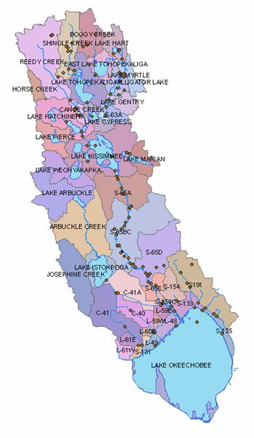
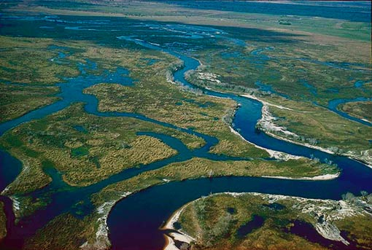
The Kissimmee Chapter 33
Margaret Charron

Slide 2
Conservation is Now a Dead Word
Douglas made this statement in 1982, speaking before the Sarasota Wellesley Club and college alumnae.

Slide 3
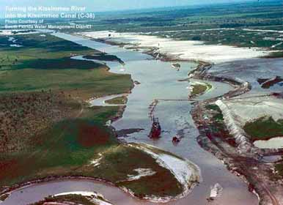
Army Corps of Engineers & the Central and Southern Florida Flood Control District
Everglades replumbing scheme, 1948
Douglas said the natural ecosystem needs to be pieced backed together again

Slide 4
Continued….
“Probably the Worst” undertaking of all
Completion in 1971
Final impoundment of the oxbows of the Kissimmee
Channelization
Justified primarily with an inflated cost-benefit ratio
Ecological Infliction
The corps changed Kissimmee’s name to the bureaucratically sterile C-38, for Canal 38

Slide 5
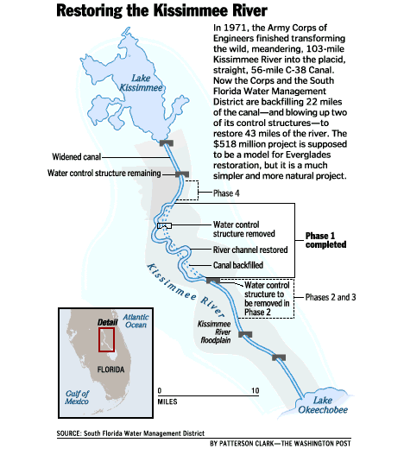

Slide 6
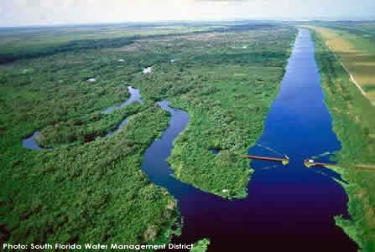
Other Problems
“In the aquatic world, the slightest unnatural stimuli can set off a biological free-for-all that can devastate a prosperous ecosystem.” (p.515)

Slide 7
Tinkering with its works
The corps talked about increasing the height of its Okeechobee dike to store more water for Farmers
Some of the extra sustenance it planned to acquire by back pumping nutrient-rich water from the drainage canals into the lake again

Slide 8
Garald Parker
Douglas’s old friend and mentor
Senior scientist with the Southwest Florida Water Management District
Issued a report 2-years earlier warning against the eutrophic consequences of “reverse-pumping”
Bureaucrats ignored his alarm

Slide 9
National Environmental Policy Act
After the NEP Act passed, the corps saw a new role for itself in environmental problems
The corps began to incorporate “aesthetics and environmental values in project planning and construction.”

Slide 10
Lieutenant General Fredrick J. Clarke
Chief of engineers
“If the people of the country were changing what they wanted, we’d better get in step and find a way to do it.”
1972 – Informed the Environmental Advisory Board with an idea that would facilitate understanding among the corps, the public, and the environmental community.

Slide 11
Robert P. McIntosh
Notre Dame Biologist
1976 – Observed “The essence of the modern environmental movement is that it is now clear at all levels of human concern – Scientific, sociopolitical, and religious – that man’s fate, on earth at least, is intimately and ultimately integrated with the natural and managed ecosystems of the earth, their biogeochemical processes, nutrient cycling, transformation of energy, and productive capacity.”

Slide 12
Art Marshall
A member of a vigorous community of politically minded Florida scientists
Educated the activists and the policymakers
During the jetport affair, he showed environmentalists how to “use the federal process to force greater exposure and more deliberation about federally funded projects.”

Slide 13
WATER! Coalition
A Coalition of Citizens Concerned with Florida’s Water Resources
Douglas created the name, the capital letters & exclamation point as a modern, post-Earth Day movement
15 groups form the WATER! Coalition
Florida Wildlife Federation; the Airboat, Halftrack and Conservation Club; Florida Defenders of the Environment; chapters of the Audubon Society and Izaak Walton League; and the West Palm Beach Garden Club.

Slide 14
WATER! Coalition Continued…
Marshall – program chair
Douglas – headed organization, disseminated educational information, and generated publicity
Agenda
Planning strategy for pushing for the implementation of the 1972 law authorizing the state’s 5 water-management districts

Slide 15
The Rain-Machine Thesis
20 years of watching the breakdown of the healthy ecology of the Everglades went into Marshall’s 18-point blueprint for the repair of the Everglades
Marshall argued that bureaucrats needed to recognize “physical and functional limits to the resources of the Everglades.”

Slide 16
Kissimmee River Restoration Act
Passed in 1976
Marshall said, “was man’s chance to unshackle Mother Nature from human bondage.”
Created the Kissimmee River Coordinating Council
A group of scientists charged with creating the blueprints for a workable restoration plan, which would include redeeming the river and buying back land in the old floodplain.

Slide 17
Friends of the Everglades
Mission Statement –
“To protect, restore, and preserve the Greater Kissimmee-Okeechobee-Everglades Ecosystem, and the water that is the lifeblood of the world’s only Everglades.”

Slide 18
South Florida Water Management District
Motto –
“preserving the Everglades since 1949”
Over time water managers had permitted the loss of nearly half the Everglades

Slide 19
John R. “Jack” Maloy
District’s executive director
Talked about reform but seemed to practice tradition
He started with the district in 1965
Came under the influence of its chief engineer, William V. Storch
He was a true believer in his water-management system

Slide 20
Department of Environmental Regulation
Douglas met with the DER but got nowhere
Lawsuit against the DER, SFWMD, and the Sugar Cane League
DER and SWFMD won their request for a 30-month study free of any mandate to stop the back pumping
Hearing officer stated that the lake was in a “eutrophic state”, that it was getting worse, and that the situation was the product of “man’s activities”

Slide 21
