Slide 1
An Everglades Providence: Marjory Stoneman Douglas
Hurricanes
Chapter 21

Slide 2
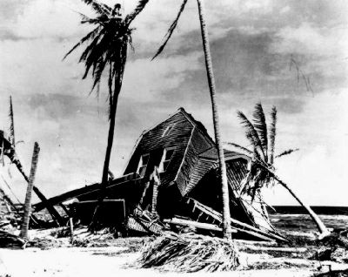
Hurricane of 1926
Miami Beach

Slide 3
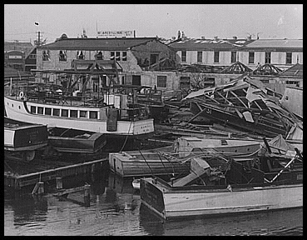
1926 Hurricane
Marjory Stoneman Douglas and Fred W. Gray

Slide 4
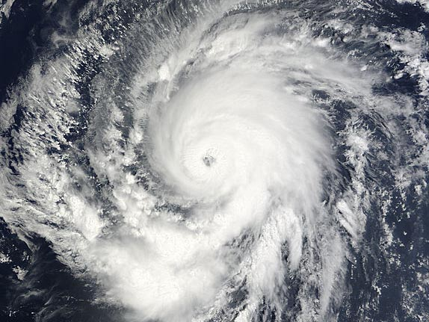
The 1926 Hurricane
Left 150 dead and 25,000 homeless

Slide 5
Hurricanes
Marjory Stoneman Douglas wrote Hurricane, a 400-page book
Between 1900 and 1998 (the year of Douglas’s death), 57 hurricanes stormed the state of Florida
Florida lay in the path of 40% of all hurricanes

Slide 6
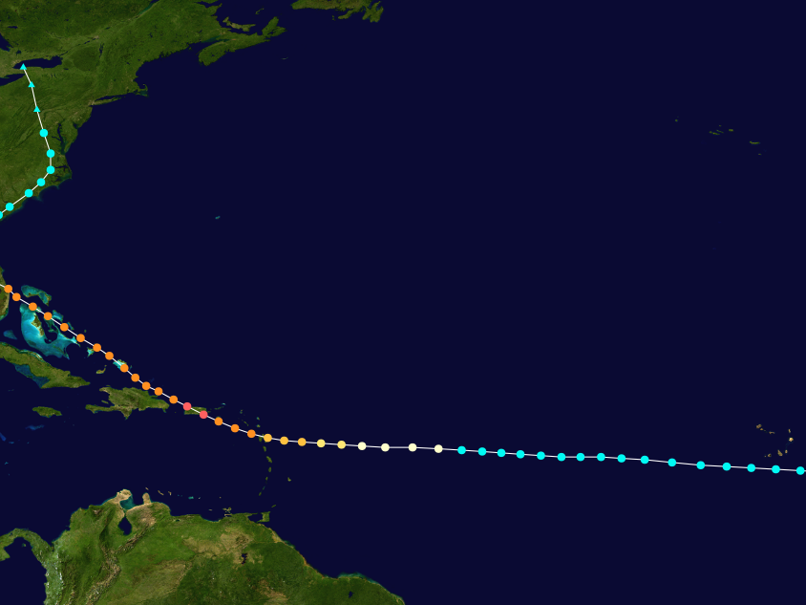
Hurricane of 1928
Devastated Lake Okeechobee and The Everglades

Slide 7
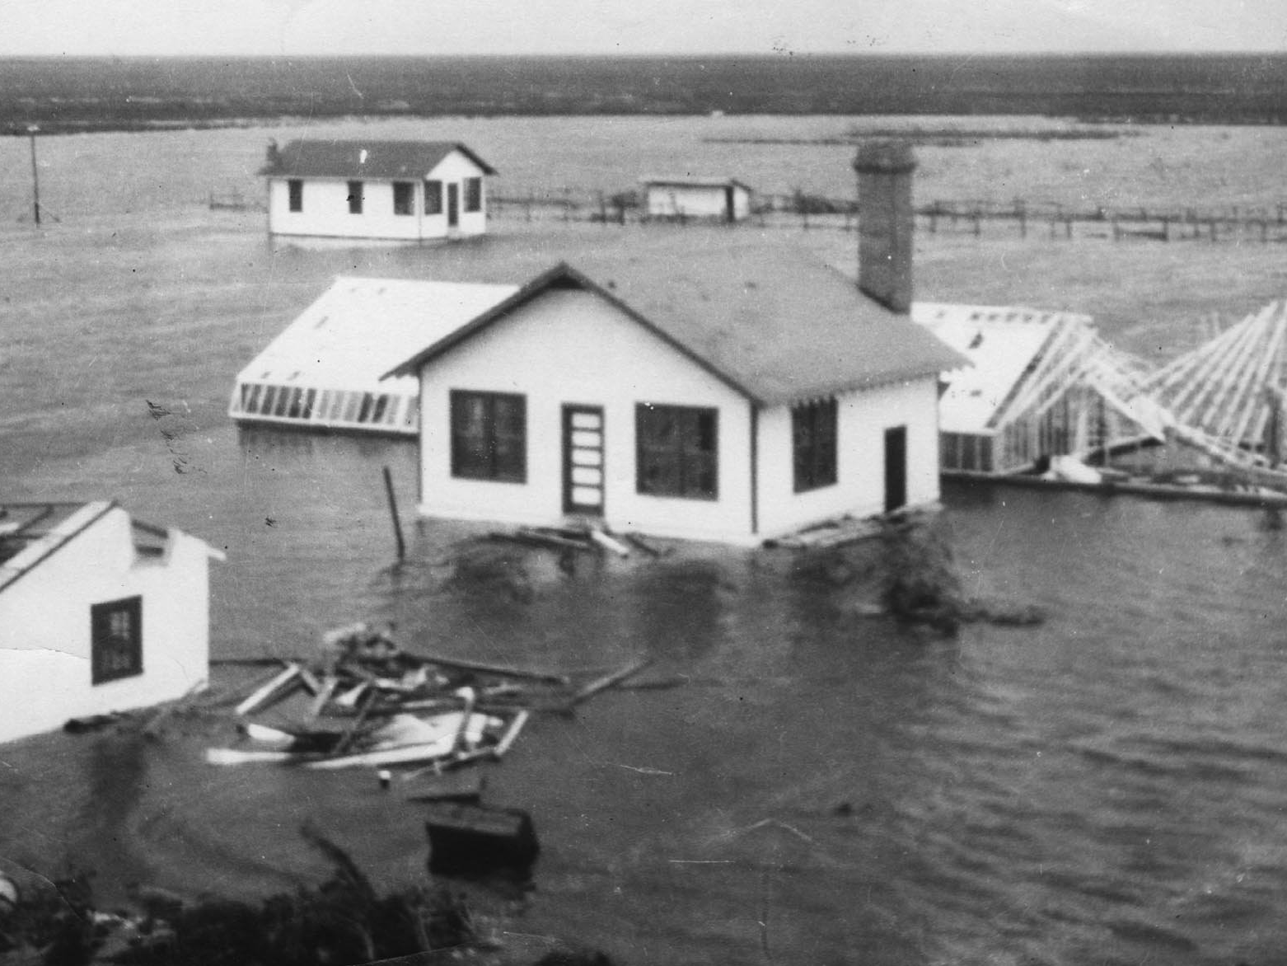
The Hurricane of 1928
“Dis town is full uh trouble and compellment”
Tea Cake in Hurston’s “Their Eyes Were Watching God”

Slide 8
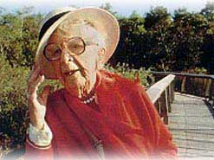
Marjory Stoneman Douglas
“It is time to realize what part these astonishing storms have played in all our history…”

