Slide 1
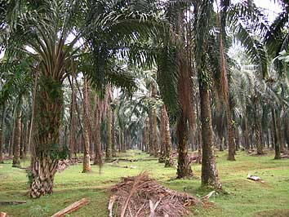
Palm Oil Agribusiness
By: Paul Grewe

Slide 2
Sorry…

Slide 3
In The Beginning
According to The World History of Food, palm oil dates back as far as 3000B.C. (2000). In those ancient times, the oil was used primarily as a dietary supplement, adding essential oils to the diets of Egyptians.
In the 1500s B.C., the oil of the Oil Palm (Arecaceae elaeis) could be found in plentiful amounts all over West Africa, providing the same dietary function for many of the indigenous peoples in the area.
However, once the palm was introduced to the regions of Southeast Asia in 1848 (Kiple & Ornelas, 2000) the base foundation was laid for a modern exploitation

Slide 4
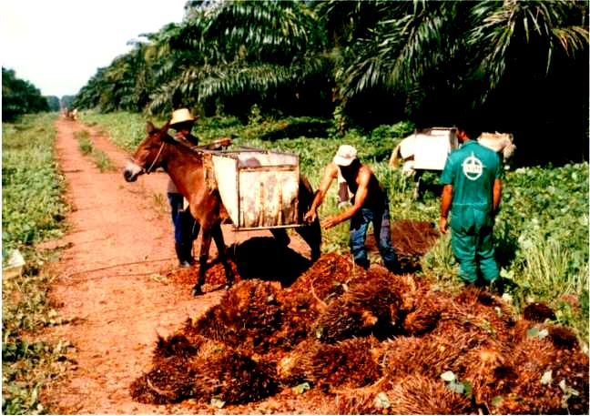
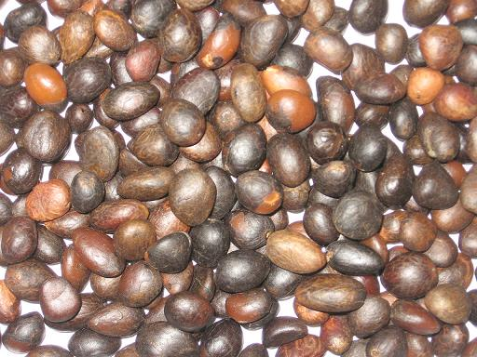
A Look At The Animal
Palm Fruits
Palm Kernels
The Oil Palm

Slide 5
So What’s The Problem
Although the demand for palm oil has risen exponentially throughout the world, it can only be grown on certain plots of land in the tropical regions of the world.
While technological advances for the harvest of this oil have become promising, it has not lessened the impact that this growing agribusiness has had on the environments of many unique ecosystems.

Slide 6
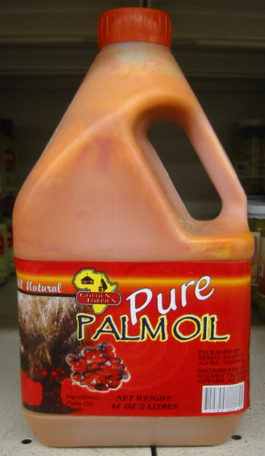
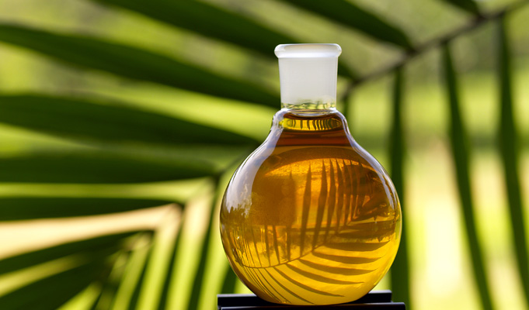
“It’s The Next Big Thing”
Palm oil is an important component of many soaps, washing powders, and personal care products
However, it is still used as a dietary supplement around the globe.
The essential fats that are found in the rich oil still provide nutrition to many parts of Africa, Europe, and Asia.

Slide 7
But That’s Not All
Let’s take a vote…
How many people present have eaten at Burger King in the last 2 years?
How many people have eaten foods with “Zero Trans Fats” in the last year?
If so…you are contributing to oil palm agribusiness.

Slide 8
How We Use Palm Oil
The newest boom for the palm oil industry is the market for “Zero Trans Fats” foods.
Everything from Lay’s Potato Chips to Krispy Kreme Doughnuts are touting the new method of frying food items in oils that contain no trans fats.
Because palm oil can be used for zero trans fats foods, its use has grown exponentially over the past few years.

Slide 9
Major Sources of Trans Fats

Slide 10
Zero Trans Fats Boom

Slide 11
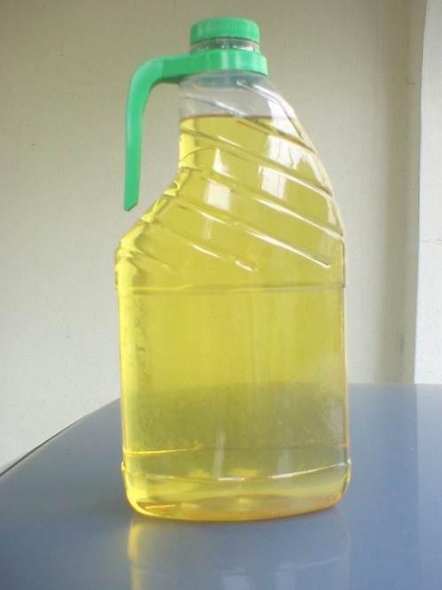
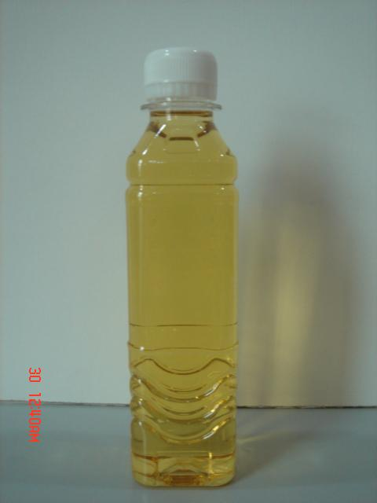
Biofuels
Palm oil is now being researched as another alternative source for the production of biodiesel
As the demand for alternative fuel sources begins to rise, so will the demand for palm oils.
Biodiesel B100.
(Palm Methyl Ester)

Slide 12
So What’s The Big Deal?
With all of the great uses for palm oil, why am I making such a big deal about the product?
Small countries are making large profits, economies are booming when they otherwise wouldn’t, and everyone is becoming healthier.
What’s not to love about this wonderful oil?

Slide 13
Borneo’s Rain Forests

Slide 14
Making Way For Oil Palm

Slide 15
Supply and Demand

Slide 16
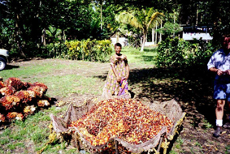
During

Slide 17
During

Slide 18
After

Slide 19
Environmental Impact
Because Oil Palm can only be grown in tropical latitudes, it must compete with other established ecosystems, such as the rain forests of Borneo and Malaysia
While Borneo’s rainforest is a habitat to more than 15,000 species of plants, the money made from tourism is meager compared to the annual profit for producing palm oil.
In a world where money talks, important ecosystems are ruined.

Slide 20
Environmental Impact
“Damage to peatland, partly due to palm oil production, is claimed to contribute to environmental degradation, including four percent of global greenhouse gas emissions and eight percent of all global emissions caused annually by burning fossil fuels, due to the large areas of rainforest that are cleared to make way for palm oil plantations. The pollution is exacerbated because many rainforests in Indonesia and Malaysia lie atop peat bogs that store great quantities of carbon that are released when the forests are cut down and the bogs drained to make way for the palm oil plantations.”

Slide 21
Sustainable Impact

Slide 22
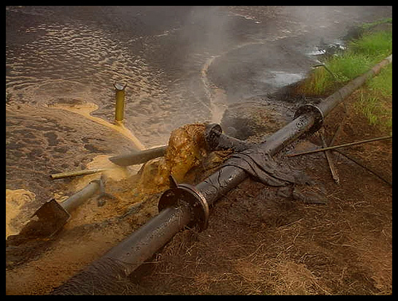
Positive Technological Advances
“Palm oil mill effluent (POME) is a highly polluting wastewater that pollutes the environment if discharged directly due to its high chemical oxygen demand (COD) and biochemical oxygen demand (BOD) concentration.”

Slide 23
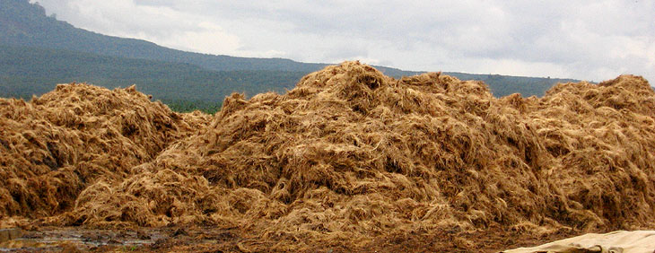
Positive Technological Advances
Biotechnology has been applied to the problem of POME , according to one study, and “It is envisaged that POME can be sustainably reused as a fermentation substrate in the production of various metabolites, fertilizers and animal feeds”

Slide 24
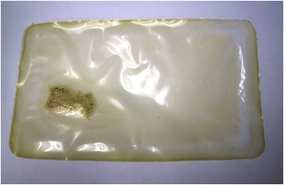
Positive Technological Advances
Yet another breakthrough addresses the effluent as a possible source of waste to energy. “Anaerobic digestion has been widely used for POME treatment with large emphasis placed on capturing the methane gas released as a product of this biodegradation treatment method. The anaerobic digestion method is recognized as a clean development mechanism (CDM) under the Kyoto protocol.
Biodegradable Polymer

Slide 25
Behold…The Future of Palm Oil
With a rush to secure a source of cheap biofuel, palm oil may still be headed upward.
However, with public awareness as to the impacts of agriculture on local ecosystems, rainforests around the world may still have a chance.
With the constant breakthroughs in sustainable science and technology, we have good reason to believe that the impact will be manageable and even beneficial in the future.

Slide 27
References
American Palm Oil Council. (2009). Environmental heading. Retrieved February 23, 2009, from http://www.americanpalmoil.com/environmental.html
Kiple, K.F., Ornelas, K.C. (2000). The World History of Food: Palm Oil. II.E.3. Retrieved February 09, from http://www.cambridge.org/us/books/kiple/palmoil.htm
Palm oil. (2009, February 16). In Wikipedia, The Free Encyclopedia. Retrieved 00:06, February 24, 2009, from http://en.wikipedia.org/w/index.php?title=Palm_oil&oldid=271199622
Poh, P. E., & Chong, M. F. (2009). Development of anaerobic digestion methods for palm oil mill effluent (POME) treatment. Bioresource Technology, 100(1), 1-9. doi:10.1016/j.biortech.2008.06.022
White, M. (2008). Borneo’s Moment of Truth. National Geographic Magazine. Published: November 2008. Retrieved from the World Wide Web February 23, 2009, from http://ngm.nationalgeographic.com/2008/11/borneo/white-text
Wu, T. Y., Mohammad, A. W., Jahim, J. M., & Anuar, N. (2009). A holistic approach to managing palm oil mill effluent (POME): Biotechnological advances in the sustainable reuse of POME. Biotechnology Advances, 27(1), 40-52. doi:10.1016/j.biotechadv.2008.08.005

