Slide 1
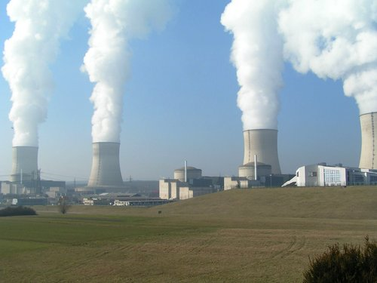
Nuclear Power; More Problematic than anything
Audrey Campbell

Slide 2
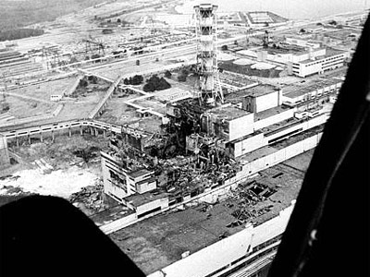
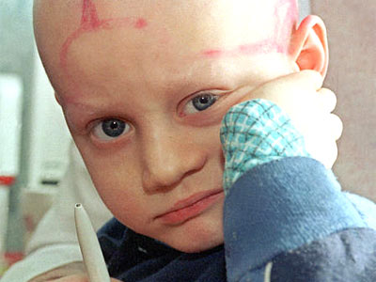
Nuclear power plants are subject to accidents
Nuclear power plants present a hazard to the health and safety of the public because they are subject to accidents.
Example; Chernobyl Disaster

Slide 3
What Happened?
Accident happened because of a combination of basic engineering deficiencies in the reactor and faulty actions of the operators.
Most serious accident in the history of the nuclear industry.
Fires that lasted for 10 days, huge amounts of radioactive materials being released into the environment and a radioactive cloud spreading much over Europe.
28 emergency workers died from acute radiation syndrome.
15 patients died from thyroid cancer
Roughly estimated that the total number of deaths from cancers caused by Chernobyl may reach 4,000 among the 600,000 people having received the greatest exposures.

Slide 4
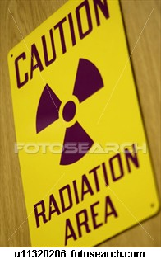
Radioactive Waste
High level and low level radioactive waste is stored either temporarily or permanently at more than 150 locations across the U.S.
“We’re merely sweeping the real problem under the rug”.
The dilemma of high level waste management is still unsolved.
Long-term behavior of radioactive waste remains a subject for ongoing research.

Slide 5
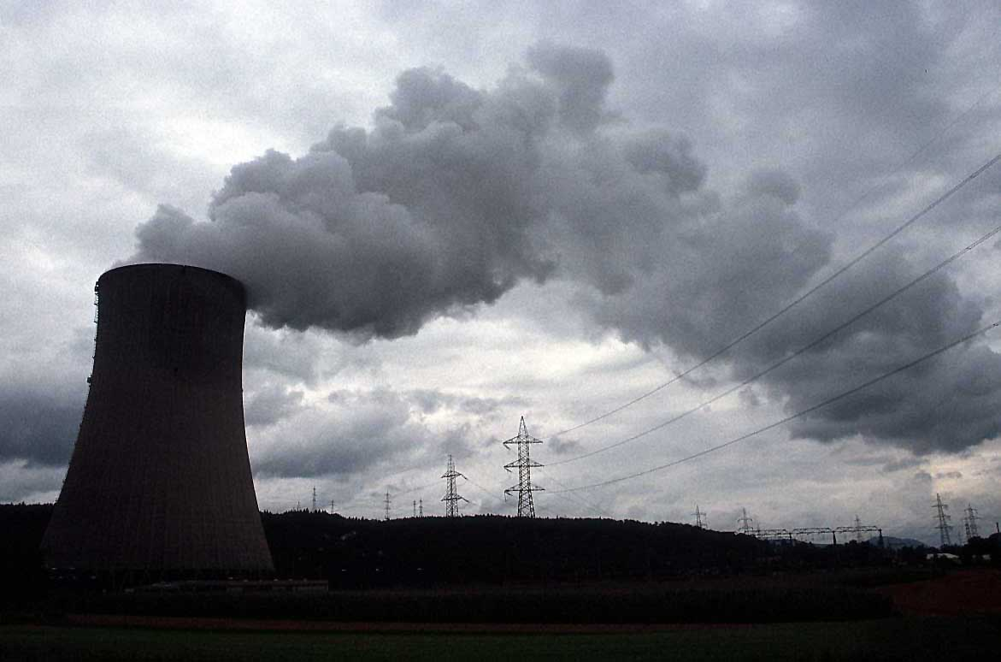
Radiological Consequences
Scientist and researchers know that radiation causes leukemia and almost every type of cancer. It will shorten a person’s lifespan by months, years, or decades.

Slide 6
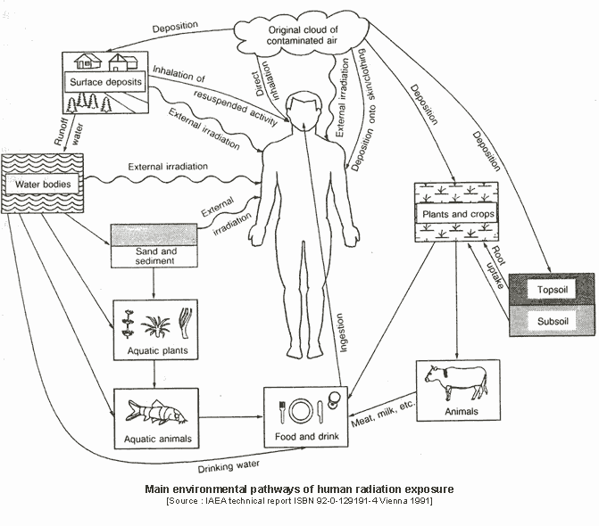
Main environmental pathways of human radiation exposure

Slide 7

Issue of Cost
Nuclear power plants usually have high capital costs for building the plant, but low fuel costs.
Must be carefully guarded against sabotage or theft.
Generally significantly more expensive to build than an equivalent coal-fueled or gas-fueled plant.
Pay for the cost of storing, transporting, and disposing the waste is yet another charge.

Slide 8
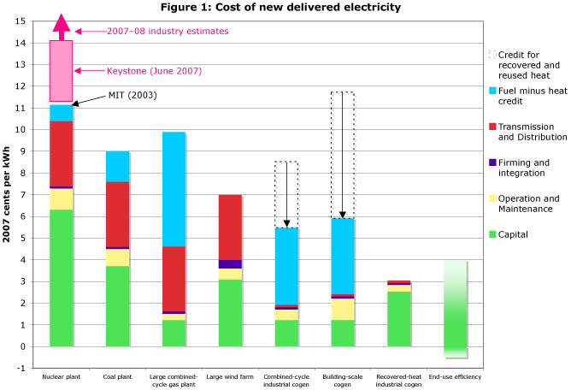
Cost of New Delivered Electricity

Slide 9
What You May Want To Know
The primary waste product of nuclear power, spent fuel rods, remains toxic for thousands of years. We do not yet know how to detoxify these waste products and, despite 20-some years of trying, we have not yet been able to establish a long-term repository anywhere in the United States.
A mistake in a nuclear power plant, however, can cause long-standing, widespread damage to people and ecosystems. Just ask the people who survived Chernobyl. The risk may be low, but the potential impact is high.
No one wants to host the nuclear-waste repository. No one wants a nuclear power plant next door.
The reasons why nuclear power was rejected in most countries decades ago was problems with; waste disposal, reactor accidents, nuclear proliferation, high cost, and terrorism -- these issues remain much the same.
Nuclear accidents: the core of a nuclear power plant could overheat and melt down, releasing massive amounts of radioactivity.
Waste disposal: nuclear power results in large amounts of radioactive waste, some of which remains dangerous for hundreds of thousands of years.
Cost: nuclear power is very expensive.
Nuclear terrorism: nuclear facilities could be targeted by terrorists or criminals.
Alternatives: energy efficiency and renewable energy sources provide a viable alternative to nuclear power.

Slide 10
Food For Thought
In one year's operation, a single nuclear power plant generates as much radioactive poison as one-thousand Hiroshima-type atomic bombs!
Insurance companies -- experts on judging risks -- protect themselves against anticipated claims from private citizens for nuclear plant accidents and radioactive damage by specifically excluding such coverage in contracts.
The AEC--designated as the public's "protector"--is charged with promoting the nuclear industry. This is an impossible conflict of interest.
There is "not a shred of evidence" that AEC radiation standards for peaceful use of the atom are truly safe.
Radiation from rapidly expanding Atomic Energy programs is a far, far more serious hazard to human life than anyone had ever conceived it to be.
Atomic radiation will result in many times more deaths from cancer and leukemia than previously thought possible. The potential damage to future generations from genetic damage has been even more grossly underestimated.

