Slide 1
Mind Over Machine
The Dangers of Humans Interfacing with Bionics
Weston Joslyn
Issues In Science & Technology
March, 2009

Slide 2
Technology Joining with Humans
History
Ancient times: Artificial arms and legs, or prostheses, were made to restore a degree of normal function to amputees. Mechanical devices allow amputees to walk again or continue to use two hands. The most notable one was the simple peg leg.
1452 – 1519: Leonardo da Vinci, an artist, mathematician, engineer, inventor, anatomist, architect,writer and scientist, drew or painted anatomic landmarks and illustrations of the human body.
1864 – 1868 The American Civil War causes a horrific number of cannonball and rifle related amputations, forcing improved efficiency and technique

Slide 3
Baby Steps
1958: The term ‘bionics’ is coined by Jack Steele, a medical doctor in the Air Force.
1958: The first fully implantable artificial pacemaker was inserted in a Swedish hospital.
1961: The MH-1, a computer-operated mechanical hand, is developed at the Massachusetts Institute of Technology.
1961 – 1973: Viet Nam War creates a high number of soldier amputees and other dysfunctional limbs. The Veteran’s Department and Walter Reed Hospital is highly instrumental in creating prostheses for these veterans.
1962: John Chamley creates high-density polythene, which is eventually used in artificial hip joints.
1971: First soft contact lens was developed by Bausch and Lomb.
1987: A deep-brain electrical stimulation system is implanted in a patient with advanced Parkinson’s disease.
1992: The Center for Ethical Bionic is founded by Dr. Steven Caldwell in San Francisco.
1997: The bionic glove is available which was an electrical stimulator garment that proves controlled grasp and hand opening for quadriplegics.
2000: The first Artificial Silicone Retina is implanted in a human eye.
2001: Jesse Sullivan, an electrician with amputations of both arms, receives a fully robotic arm developed by the Rehabilitation Institute of Chicago. A nerve-muscle graft allows him to move his arm by thinking of the movement.
2006: The first Bionic Assessment Tests begin appearing on the internet.

Slide 4
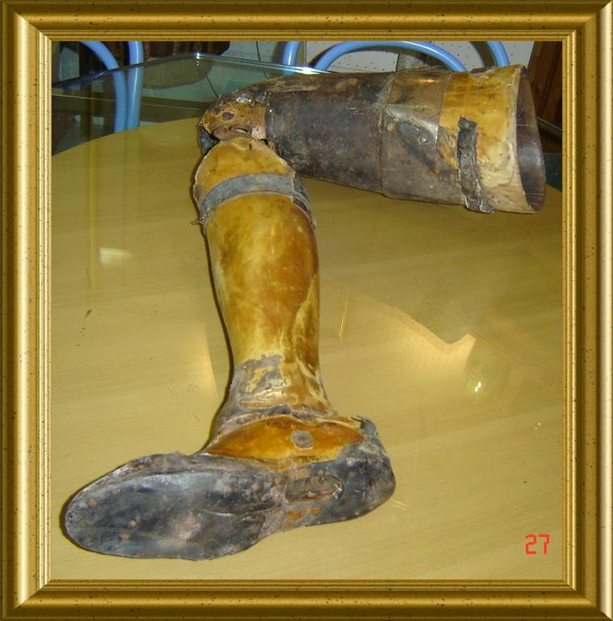
Learning From the Past
Civil War Leg
Wartime injuries prove to be a major reason for the advancement of prosthetic technology.
The American Civil War, both World Wars, and Iraq and Afghanistan in recent years have created a huge demand for new technology.
Prosthetics now give more attention to joint comfort, mobility, discreetness, confidence building,

Slide 5
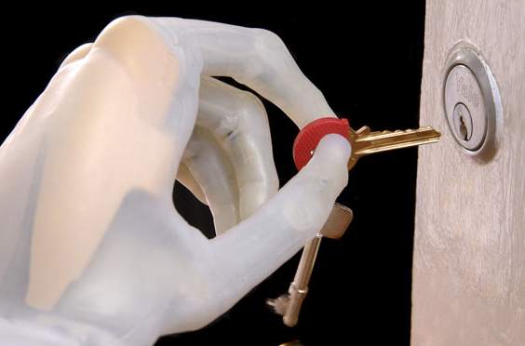
A Limitless Age
Since myopic implants have been used that combine brain activity with mobile bionics the future applications have accelerated rapidly

Slide 6
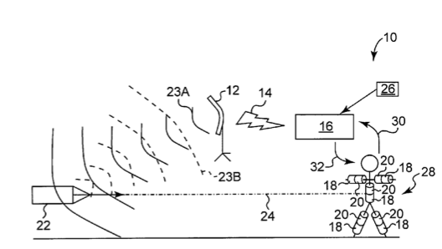
“You’re saying, I can dodge bullets?”
The present invention relates generally to the protection of an individual against a projectile propelled from a firearm. More particularly, the present invention relates to a body armor system and its method of use that is capable of detecting a projectile propelled from a firearm, computing the trajectory of the projectile, and moving the individual out of the path of the projectile to avoid being hit.

Slide 7
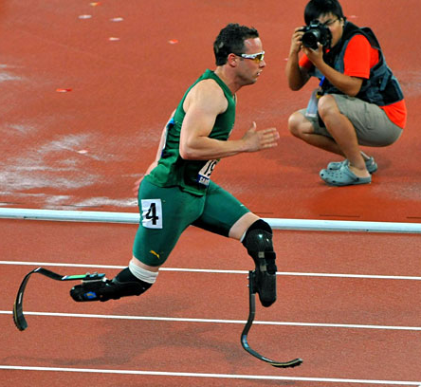
Better, Faster, Stronger
South African Sprinter, Oscar Pistorius wins the Gold for the 200m Paralympics
Though a congenital disorder claimed both his legs, Pistorius nearly qualified for the 2008 Beijing Olympics

Slide 8
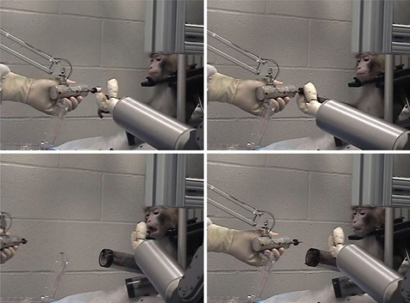
Robo-Chimps
The DARPA program has some competition when it comes to making smarter artificial limbs. Lab monkeys learned to control prosthetic arms with the help of an implant on their motor cortices.
The monkeys needed no help after a couple of days, and over time their brains even learned new uses for the arms. Scientists hope to someday bring the technology to victims of paralysis.

Slide 9
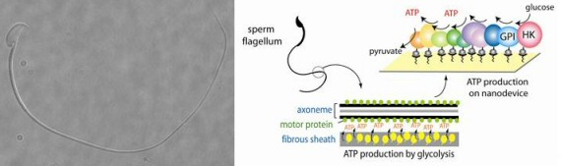
Sperm on a new mission
Perhaps you’ve heard about nanorobots, the tiny mechanical tools that can theoretically enter a human body and treat medical woes.
The problem with these developments, like the microscopic robot submarine, is energy, because it’s not easy for such a tiny device to generate enough power for complicated tasks. The answer, scientists at Cornell University say, is sperm.
The tail of a sperm contains an assembly line for ATP, often called “energy currency” for living cells. If scientists can merge sperm’s biological propulsion system with nanorobots, we might have a viable way to heal ourselves from the inside.

Slide 10
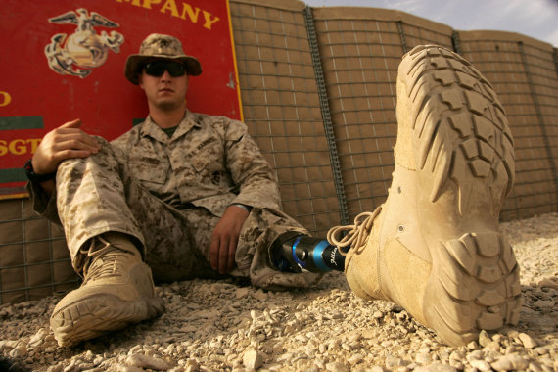
Soldiers of Tomorrow
Combat wounded soldiers of Afghanistan and Iraq now have the opportunity to be fitted with revolutionary prosthetics.
Some soldiers have been able to return to active duty after showing renewed capability with their artificial limb.

Slide 11
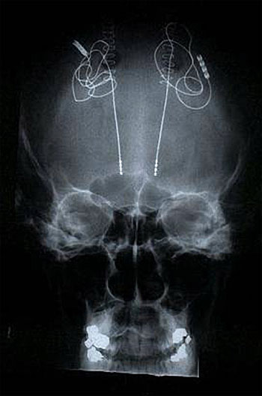
Implants to Cure Disorders
http://www.spectrum.ieee.org/bionic
Implant that is installed to help treat Parkinson’s.
The device has three internal components: a control unit, a wire, and a set of electrodes. The reprogrammable control box is tucked under the skin near the collarbone. It sends high-frequency electronic stimulation through a wire running up the neck and head beneath the skin.

Slide 12
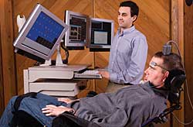
Interfacing the Mind with Machine
Early breakthroughs in technology by Cyberkinetic Neurotechnology Systems in Foxborough, Mass allow for parapelegics to at last communicate by thought alone.
Matthew Mckee is the benefactor of the revolutionary BrainGate Neural Interface System
Algorithms devised from listening into the brain attempt to interpret the many dynamic brain signals to move a cursor on a screen.
The user is then able to concentrate on selecting a desired letter by focusing their intent to use it as part of a sentence.

Slide 13
State of the Science
Today’s state-of-the-art method for connecting to the human nervous system is to deliver electrical pulses near a particular nerve cell to elicit a response, such as a muscle twitch or a sensation.
The trouble is that the electrode that delivers the pulse creates a halo of charge that triggers nearby nerve fibers. The effect is similar to that of crosstalk on telecommunications lines.
Thus, the brain might misinterpret a jolt from a prosthetic arm intended to indicate that only the index finger is pressed against an object as confirmation that the entire artificial hand has grasped the object.

Slide 14
Accuracy in Lasers
Stimulating nerves with lasers, says Anita Mahadevan-Jansen, a professor of biomedical engineering at Vanderbilt and the person who hit upon the idea of using light instead of current, may someday make artificial limbs as dexterous as human arms and might lead to such devices as patches that zap nerves to give relief to chronic pain sufferers.
The result is lasers can stimulate areas of neurons with more accuracy than electricity.

Slide 15
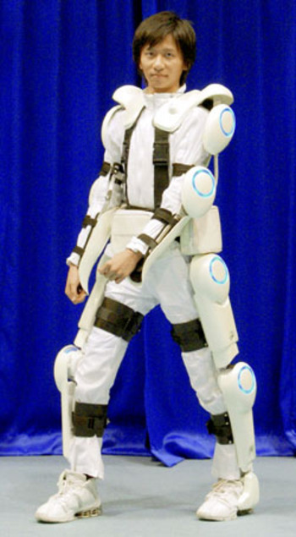
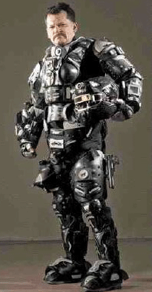
Military Application
Exoskeletons under development and in use aid soldiers in protection, super strength, adapting to weather conditions, and controlling bleeding

Slide 16
Findings
Ethics and foresight in technology is an effort that will continue to protect human equality.
Science should not become a justification for creating dangerous advancements
Military application is perhaps the most dangerous misuse of new technology that will eventually allow human thought to control massive weaponry and guidance systems.

