Slide 1
Medicine at the Lives of
Innocent Animals
Heather Burdick
Spring 2009
Issues in Science and Technology

Slide 2
The Issue
Many animals are dying every year to old techniques of testing drugs.
There are many new ways of testing drugs that have no need for animals.
Computer simulations and stem cells are just two of the other options available today.
Notes:
The main issue here is that there needs to be more availability for these new testing ways, and that the public needs to know more about what is going on in animal testing.

Slide 3
What are animals tested for?
Household products (chemicals)
Things such as toothpaste, shampoo, and body wash
Makeup
MEDICINE ( direct focus on cancer)
Notes:
Medicine is a huge area where animals are being tested for research. New drugs, and also preventitive medicine are just two types.

Slide 4
What types of animals are used?
Cats
Dogs
Guinea Pigs
Non Human Primates
Pigs
Rabbits
Sheep
Mice & Rats
Notes:
Amphibians and fish are also used in animal research, and have just recently been used a lot.

Slide 5
Mice and Rats
Mice and rats are the most used specie of animals in animal testing.
Although mice and rats are the most frequently used they are not accounted for.
This leads to skewed statistics and much of the American public oblivious to the facts.
Notes:
When researchers are reporting the amount of animals that they use, they might report some mice and rats, but they do not have to report them.

Slide 6
Mice and Rats
“Over 90% of the animals used in experimentation are purposely excluded from protection under the Animal Welfare Act (AWA), the only federal law which over sees animal testing. Rats, mice, birds, reptiles, amphibians and fish are not covered and so are expressly eliminated from all safeguards” (The Animal Care Program and the USDA's Authority Under the AWA, 2005).

Slide 7
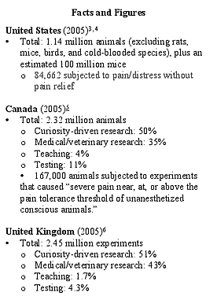
2005 Facts and Figures
The United States
-Killed 1.14 million animals in 2005
-90% of mice and rats are unaccounted for as well as a few other species.
(Government Required Animal Testing, 2000)

Slide 8
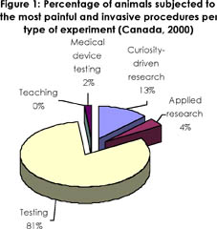
Types of Animal Research in 2000
(Government Required Animal Testing, 2000)
Notes:
These are the types of animal research in Canada in the year 2000. Testing as seen takes up 81 percent of research. The next highest is curiousity driven research, a good example would be scientists testing animals with a certain carcinogen that they think causes cancer, a sort of hypothesis and putting it to test on animals.

Slide 9
Cancer testing
Carcinogens ( cancer causing agents)
“Ames and Lois Swirsky Gold established the Carcinogenic Potency Database in the early 1980s, which now contains 4,000 experiments assessing the carcinogenicity of approximately 1,000 chemicals in rodents.” (Marx, 1990)

Slide 10
How does the induced carcinogenicity work?
“The high doses kill some cells, causing other cells to divide to make up for the cell loss. The increased cell division raises the chances that mutations, or genetic changes, will occur, which increases the risk of cancer. Ames feels that below the toxic dose, cell division would not occur and cancer would not develop.” (Marx, 1990)

Slide 11
Why carcinogenicity test is flawed
More than half of the reported chemicals are supposed to cause cancer
The chemicals are given to animals in a maximum tolerated dose. (MTD’s)
These are the highest doses that can be given without a reaction from the animal
Highly unlikely because a man or woman would not be exposed to these high concentrations of chemicals in the real world.

Slide 12
LD-50 Test
To test toxicity of chemicals, used in carcinogenicity tests
The test is conducted until one half of the animals die, hence the 50
New methods such as the ATC and FDP have been developed so not as many animals die.
Notes:
The LD- 50 test is one of the most inhumane tests, and is still being practiced but many are trying to outlaw it.

Slide 13
Numbers in the US
25-100 Million Animals:
More than 25 million vertebrate animals are used in testing in the United States each year. After the experiments conclude, essentially all of the animals who have survived the research are killed. When invertebrate animals are considered, the estimated number rises to as high as 100 million.
Notes:
After researching over a few websites that have many abstracts of theirs, I found one carcinogenic study in particlar. It was the toxicology study on mice, and after reading through many of the pages I finally got to where they recorded the test outcomes. SHOW PAPER!!! I was then reading more and they talked about necropsies or autopsies of all the mice, and lesions that they had found. The outcome of the actual experiment was that the thought carcinogen had no effects of causing cancer, and every mouse died for the experiment.

Slide 14
Numbers in the US
50 Drugs:
As of 2002, more than 50 drugs tested on animals and approved by the FDA as safe had been taken off the market or relabeled because they had caused serious illnesses and death in humans. The FDA itself estimated in 2006 that 92 percent of drugs that pass animal testing fail in human clinical trials.

Slide 15
Do the drugs tested work?
40 % of drugs that worked in animals, do NOT work in humans.
Strychnine, one of the deadliest poisons to humans, is harmless to monkeys, chickens, and guinea pigs.
A dose of belladonna that would kill a person is harmless to rabbits and goats.
Sheep can consume enormous quantities of arsenic, which is fatal to humans in small amounts.
What we consider poisonous mushrooms are commonly eaten by rabbits.
Hemlock is a deadly poison for humans, but is consumed without ill effect by mice, sheep, goats and horses.
PCP, or "angel dust", which drives humans into a frenzy, is used as a sedative for horses.

Slide 16
Thalidomide Incident
Between the years of 1957-1961 a prescription drug was given out to pregnant women to help with their morning sickness
10,000 babies were born with deformities
Although tested on mice, they never had any complications
Notes:
After this they made more strict regulations, making sure that all drugs were also tested on pregnant animals.

Slide 17
Other drugs tested on animals that have gone wrong
Clioquinol anti-diarrhea 2,000+ deaths [2];
30,000+ blinded
Isoproterenol anti-asthma 3,500+ deaths
Thalidomide sleeping pill 10,000+ birth defects;
anti-nausea 3,000+ stillbirths
DES anti-miscarriage cancer, birth defects
Phenylbutazone anti-inflammatory 10,000+ deaths
(Goldsmith D., 2006)
*
Notes:
Healing cancer naturally also has many more drugs that have gone on there website.

Slide 18
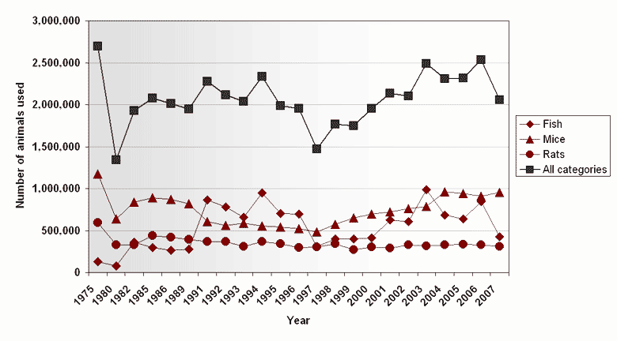
Numbers of animals used from 1975-2007
(Fish, mice, rats, all categories)
(Facts and Figures, 2007)
Notes:
This is a graph of canadas statistics throughout the years.

Slide 19
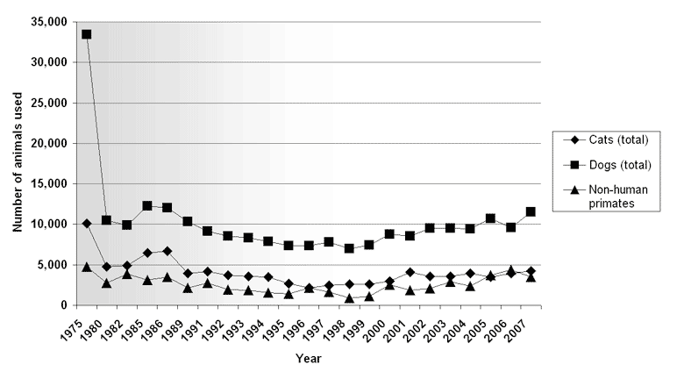
Number of animals from 1975-2007
(cats, dogs, non-human primates)
(Facts and Figures, 2007)

Slide 20
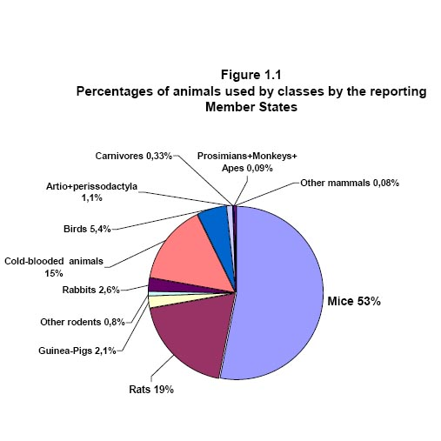
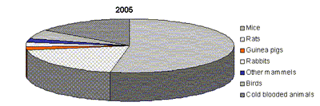
Percentage of Animals Used
Netherlands
United States
Experiment Percentages | 2005
Total number of experiments | 10,730,120
Rodents Rabbits % | 77.1
Coldblooded animals % | 15.0
Other % | 7.8
(Animal Testing, 2008)
(Laboratory Animal Barometer, 2006)
Notes:
As seen the mice and rats in both groups take up more than half of all the experiments that were done.

Slide 21
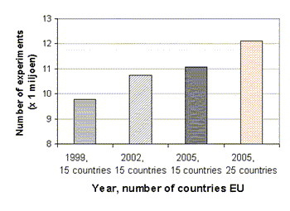
Number of animals used within the European Union
(Laboratory Animal Barometer, 2006)
Notes:
As seen here the number of animal experiments are one the rise, but also there may be more research facilities reporting now.

Slide 22
History
1655- Edmund O’meara said, “ the miserable torture of vivisection surely places the body in an unnatural state." He was one of the first people to speak out against vivisection, and how it was unethical and not good for science
1850’s- Darwin was one of the first people that said animals could be used as models for human beings. This was the real start of animal testing for humans. Many and even Darwin said later that this was unethical in the treatment of animals. (Barnett, 1958)
Notes:
The whole thing on the ethical treatment of animals is the fact that they are living breathing creatures. Is it right for us to kill something else to better ourselves? A great question to ask yourself is if you were dying would you rather another creature to give up its life to further the medicine to save your life. This is why animal testing is so controversial

Slide 23
History
1880’s- Louis Pasteur discovered germ theory by giving anthrax to sheep. This was a monumental mark in medicine, but at the cost of animal’s lives. (Robbins, 2001)
Pro-animal testing believe that many new treatments can come from animal testing. Although today we have the technology and do not need animals anymore.
Notes:
Louis Past discovering germ theory is something very monumental for medicine, and we might not be where we are today from fighting against diseases. Now though in the future we can develop new ways to test for medicines and diseases.

Slide 24
History
1968- The Medicine Acts were adopted in the United States. “states that all new pharmaceutical products must be tested on at least two different species of live mammal, one of which must be a large non-rodent.” Things such as the Thalidomide incident and many others, have also helped make animal testing a way to save human lives. Instead of not studying the drug and side effects they are now made to immediately test them on animals. (Safety Trials, 2009)
Notes:
A large non rodent can be characterized as sheep, horses, cats, dogs, and non human primates.

Slide 25
Pro-animal testing
Many argue that animal testing is the way to further medicine in the future.
That the only way to know if there are going to be side effects of a drugs, is to test it on an animal or living organism.
Computer models work, but don’t always prove accuracy

Slide 26
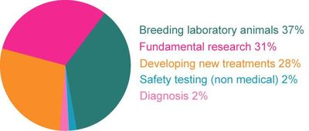
Pro-animal Testing
-Developing new treatments for diseases or ways of preventing disease 28%
-Basic biological and medical research 31%
-Breeding of laboratory animals (mostly for research and developing new treatments) 37%
-Developing new methods of diagnosis 2%
-Safety testing of non-medical products used in the home, agriculture and industry (no cosmetic or toiletries after 1998) 2%
(Animal Testing, 2008)

Slide 27
The three R’s of helping animals
Replacement means the substitution for conscious living higher animals of insentient material.
Reduction means reduction in the numbers of animals used to obtain information of a given amount and precision.
Refinement means any decrease in the incidence or severity of inhumane procedures applied to those animals which still have to be used
Notes:
These three R’s are here to help protect the animals being tested, and to also use less animals. As seen by the statistics many animals are still being used. These are just guidelines for the research facilities to follow, it doesn’t mean that they have to follow them.

Slide 28
Funding
The government
Private companies
Organizations
Discrete donations from people
Notes:
Animal testing is one of the biggest industries out there, it recieves over 7 billion dollars a year from the government, our tax money.

Slide 29
Funding
“Since its beginning in 1946, the American Cancer Society's Research and Training Program has funded about $3.1 billion in cancer research and health professional training. As the largest source of non-federal funding of cancer research in the United States the Society funds approximately $107 million in grants annually” (Stakeholder Participation, 2009).
Notes:
While researching on this website the other day, looking at the organizations funding animal research an example of one would be Susan G. Komen. They funded a research group to do tests on mice.

Slide 30
The future
Animal testing hopefully will stop
People are trying to push for more computer modeling
More money should be put into in vitro research
Limiting the number of animals allowed for research, or just cutting down on the numbers used.

Slide 31
The Alternatives
Cell cultures- the most promising to ending animal testing
Human based- by testing humans
Computer Simulation
Notes:
Computer simulation is really the future, so that there wouldn’t be any controversy surrounding it. Human based research can hurt people, stem cell research is still trying to pull forward. The best way for the future is to develop computer models.

Slide 32
Bibliography
1. The Animal Care Program and the USDA's Authority Under the AWA. (2005, July). Retrieved March 4, 2009, from US Department of Agriculture: http://www.aphis.usda.gov/publications/animal_welfare/content/printable_version/faq_awusda.pdf2
2. Animal Testing. (2008). Retrieved March 16, 2009, from APBioStoga: http://images.google.com/imgres?imgurl=https://apbiostoga.wikispaces.com/file/view/chart-2.jpg&imgrefurl=https://apbiostoga.wikispaces.com/Animal%2BTesting%2BRights%2BPd.%2B1&usg=__HA2vb5A3T7zu-Tn_uvXUKxLx9OM=&h=507&w=507&sz=49&hl=en&start=1&um=1&tbnid=2n
3. Areas of Research. (2009). Retrieved March 16, 2009, from Understanding Animal Research: http://www.understandinganimalresearch.org.uk/about_research/areas_of_research
4. Facts and Figures. (2007). Retrieved March 16, 2009, from CCAC: http://www.ccac.ca/en/Publications/New_Facts_Figures/trends/trends_intro.htm
5. Goldsmith, D. (2004). Animal Experimentation and Human Medicine. Retrieved February 2, 2009, from Healing Cancer Naturally: http://www.healingcancernaturally.com/animal-testing-vivisection.html
6. Government Required Animal Testing. (2000). Retrieved 16 2008, March, from PETA: http://www.peta.org/mc/factsheet_display.asp?ID=125
7. Laboratory Animal Barometer. (2006). Retrieved March 16, 2009, from NCA: http://www.vet.uu.nl/nca/documents/proefdierbarometer
8. Marx, J. (1990). Science . American Association for the Advancement of Science.
9. Stakeholder Participation. (2009). Retrieved March 4, 2009, from American Cancer Society: http://www.cancer.org/docroot/RES/content/RES_4_1_Background_Information_Regarding_Stakeholder_Participation_on_Grant.asp?sitearea=RES
10. The Animal Care Program and the USDA's Authority Under the AWA. (2005, July). Retrieved March 4, 2009, from US Department of Agriculture: http://www.aphis.usda.gov/publications/animal_welfare/content/printable_version/faq_awusda.pdf

