Slide 1
Lasers: The Military’s New Toy
By: Bethany Ahnert
April 7, 2009
Issues in Science and Technology
Spring 2009 CRN 11119

Slide 2

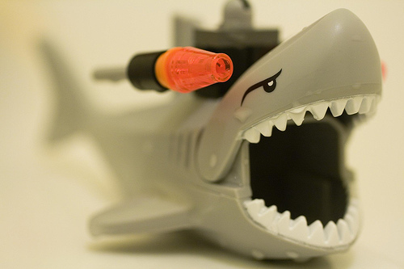
LASERS?
“I have one simple request. And that is to have sharks with frickin' laser beams attached to their heads!” said by Dr. Evil found in the Austin Powers movie International Man of Mystery

Slide 3
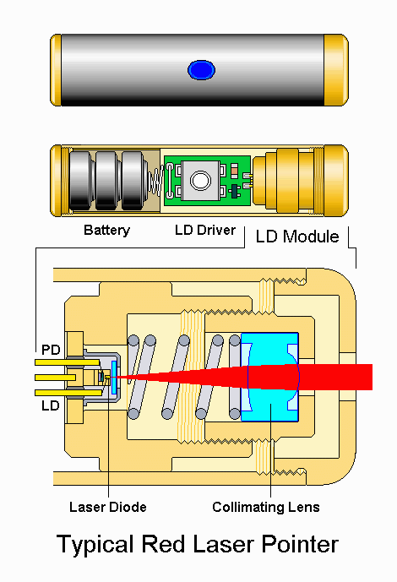
Lasers Are….
Lasers are monochromatic waves of light meaning one color, and that the lights combine in a coherent fashion, which create a good amount of energy
Atoms heat up to create photons then the photons are directed in one location to create lots of energy

Slide 4
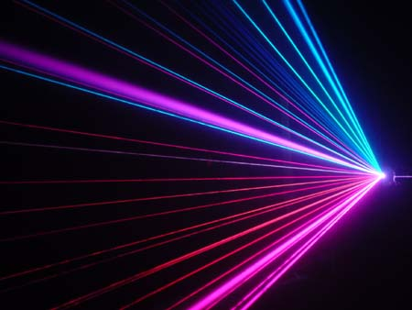
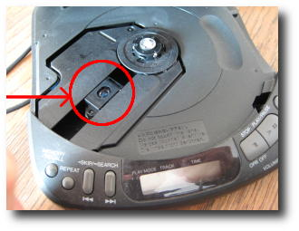
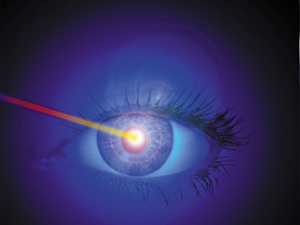
Uses of Lasers in everyday life
Lasers are found in almost all places in today’s society
Found in the grocery store
In computers and CD players
Laser eye surgery

Slide 5
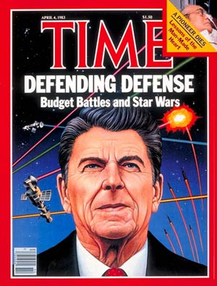
Connecting the U.S. Military with Lasers
In the 1940’s the U.S. was attacked with missiles and started the search for a good missile defense system
Ronald Reagan introduced the “Star Wars project” in the 1980’s
Research and development is still in progress

Slide 6
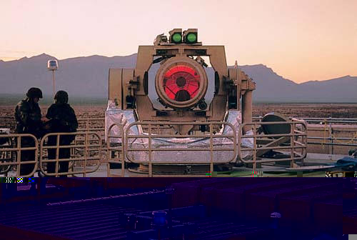
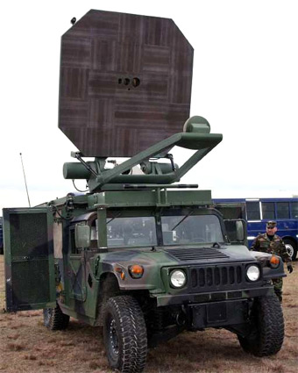
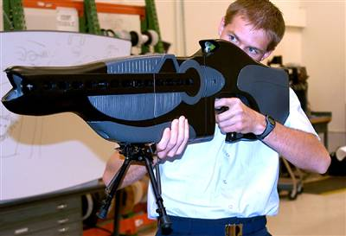
The Laser stuff in Military
THEL
MTHEL
Ray guns
Infrared Pain beam
http://www.youtube.com/watch?v=LThD0FMvTFU&feature=PlayList&p=21057EC36EB5B61D&playnext=1&playnext_from=PL&index=19

Slide 7
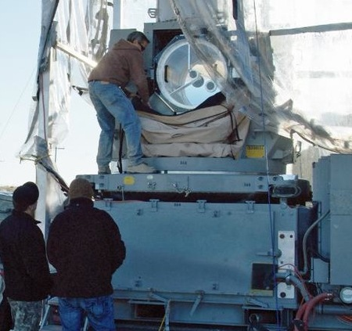
White Sands New Mexico
The Centurion Demonstrator
Fry enemy mortars before it gets to its destination
Very precise so can be used in heavily populated areas
Currently doing tests

Slide 8
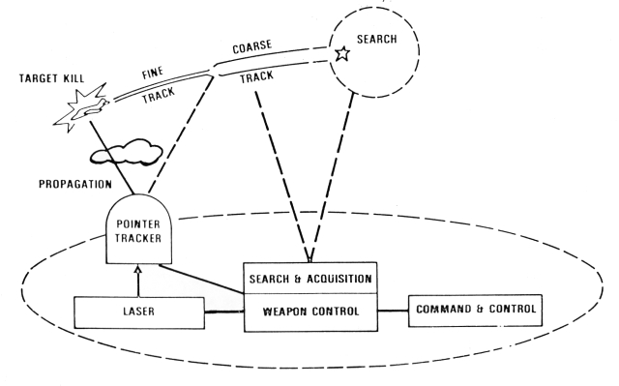
Pros of lasers in military
New development
Have the newest technological advantage
Can be safer because it can be precise
Defend against missiles, mortars, and rockets

Slide 9
Cons of lasers in the military
Costs
  Department of defense estimates of the High energy Laser Test Facility
    2007:16,135,000
    2008: 8,746,000
    2009: 2,835,000
    2010: 2,874,000
    2011: 1,911,000
Ethical issues
  If you don’t die from a laser attack you can become blind
  People may think it is just a game or a movie so won’t feel bad about lasering a city or person

Slide 10
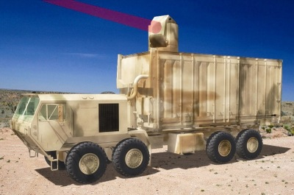
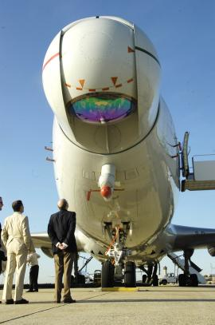
Future…
The Airborne laser
3.8 billion dollars
The 100 kilowatt blaster
cost 100mil and will take about 4 years

Slide 11
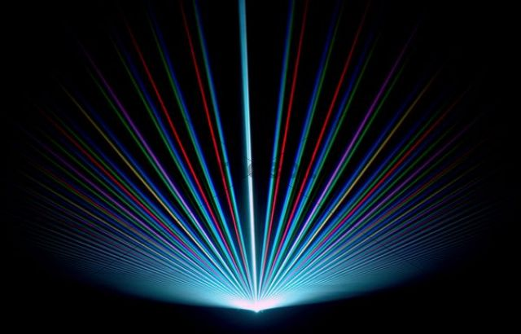
Lasers Good or Bad?
Lasers are a fun and interesting technology, but is it safe for military use?
Good for missile defense
Bad for attacking cities
New and better technologies come with great responsibilities

