Slide 1

Breaking Our Ethics:
Human Cloning
^{Sarah Penfold}
^{March 19th, 2009}
^{CRN 11119}
^{Nora E. Demers, Ph.D}

Slide 2
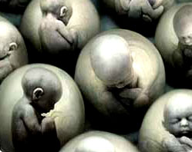
Once upon a time…
1885: August Weismann developed a new theory on genetics.
1888: Germ plasma theory developed-Roux.
1894: Theory is refuted by Hands Dreisch.
1901: Success in embryo research.
1902: Weismann-Roux theory disproved.
1944: DNA discovered.
1950: First successful artificial insemination.
1952: First animal cloned.

Slide 3
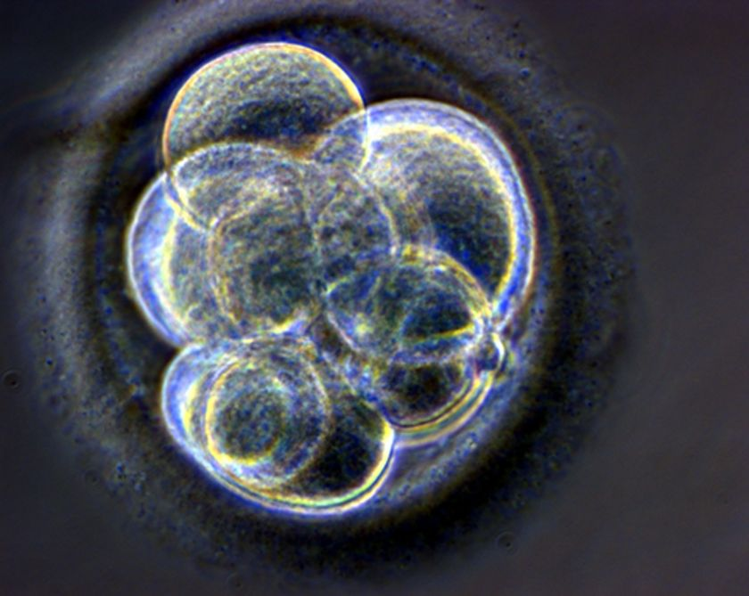
The Essentials of Cloning
Three Types:
  DNA Cloning
  Reproductive Cloning
  Therapeutic Cloning
Risks in Cloning:
  How will clone affect the person?
  Will the clone have a soul?
  Will the clone have a stable psychological state?
  Is anyone being subjected to the risk of unnecessary trauma?

Slide 4
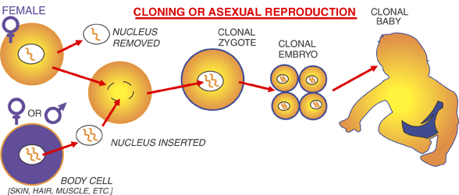

Slide 5
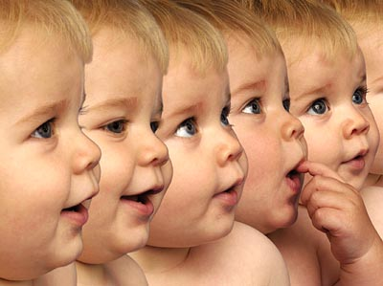
CLOtechnologyNING
Somatic Cell Nuclear Transfer (SCNT)
Chemicals OR electric currents used to stimulate egg
Reprogramming of adult cells
Mass production of animals

Slide 6
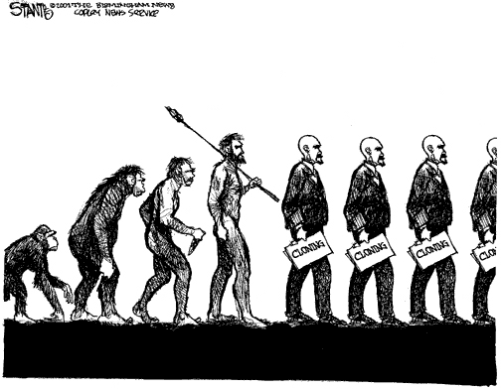
ISSUES
Larger amounts of cloned embryos fail.
High risk of severe birth defect, deformity, disability and death.
Psychological state of resulting clone.
Parent of clones’ psychological and emotional state after process.
Early experiments are likely to result in failure or miscarriage during pregnancy.
Sudden and unforeseen death.
Aspects that cause a negative impact.
To have, or to not have a soul?

Slide 7

Laws
Prohibition laws only at state level.
15/50 states prohibit human cloning.
California: first to prohibit issue.
Arkansas, Connecticut, Indiana, Iowa, Maryland, Massachusetts, Michigan, Rhode Island, New Jersey, North Dakota, South Dakota, and Virginia

Slide 8
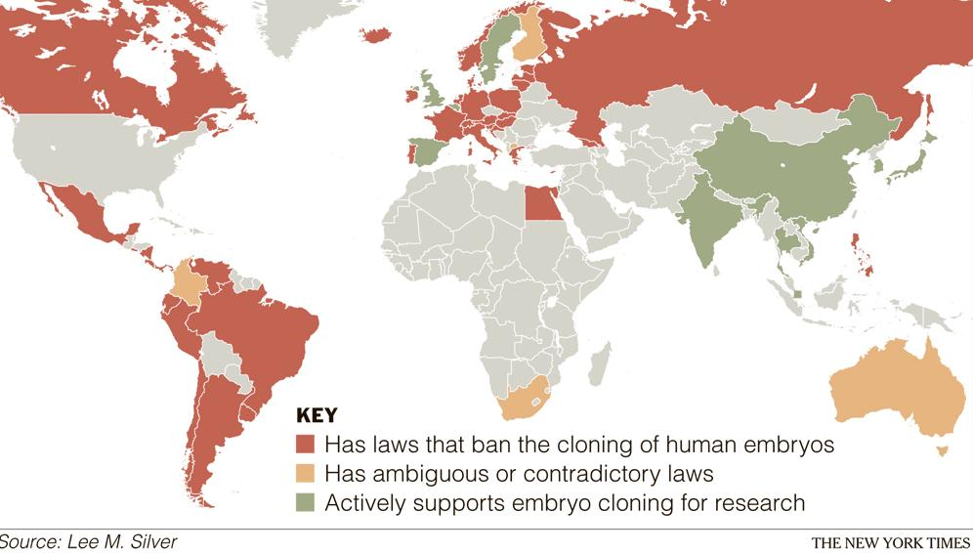
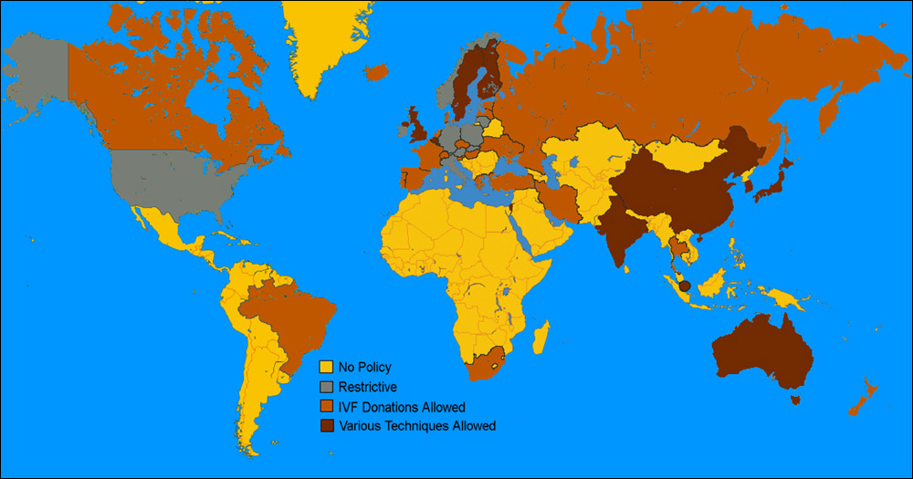
Human Cloning…
…Around the Globe

Slide 9

Religion and Science
Most common religion in the United States.
Are scientists playing God?
Twin argument
Science vs. Faith
A bigger purpose than research.

Slide 10
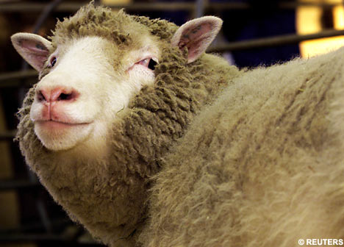
The End.
Endless controversies
Idea of human cloning soon to become reality
Over half the states allow cloning
Violation of ethical, moral, and social norms.
Do the benefits outweigh the risks?
Better way to spend the funds used to attempt human cloning.
http://www.youtube.com/watch?v=cbwekqzhbcY

