Slide 1
Genetic Modification to Create Super Humans
By Donna Snow

Slide 2

Stance
Genetic modification, as already done to mice to extend life and increase performance should not be done to humans.

Slide 3
Introduction
A group of Scientists at Case Western University in Cleveland, Ohio have genetically modified a group of mice to create a line of “super mice.”
These scientists altered a single metabolism gene and this dramatically changed the mice.
The super mice could run faster, longer, live longer, reproduce to an older age, had a much faster metabolism, and much more.

Slide 4

History
Selective breeding goes back for centuries. Selective breeding of animals was mentioned in the Bible, in Genesis 30:25-43. In this Jacob selectively breeds black sheep with white sheep to create black and white streaked sheep.
1953- Watson & Crick discover the double helix structure of DNA. This discovery opened the door for all kinds of experiments.

Slide 5

History Continued
1973- The first recombinant DNA experiments took place. Recombinant DNA is when a piece of DNA is taken and inserted into another piece.
1996- The first mammal is successfully cloned. She was named Dolly the Sheep.

Slide 6
History Continued
2004- Preimplantation genetic diagnosis (PGD) can now be used for children who are not at risk for disease. PGD is normally used to produce a child free of disease. The embryo is screened for disease that the parents are at risk of passing on to the child, then it can be corrected. In 2004 it was decided that it could be used for any child. So, this is one step closer to creating “designer humans.”

Slide 7
The Modification
The modification was done so that the scientists could gather a better understanding of the metabolic and physiological function of phosphoenolpyruvate carboxykinase (PEPCK-C).
The scientists constructed a chimeric gene and inserted it into the embryos of 34 different mice, both male and female. This gene contained the DNA for PEPCK-C.

Slide 8
A Chimeric gene is an artificially created gene, made by putting together pieces of other genes.
They inserted the chimeric gene using standard microinjection techniques.
Microinjection is basically using a micropipette to insert a substance into a cell.

Slide 9
  Video on Microinjection:
http://www.youtube.com/watch?v=Q5-OR87fqac

Slide 10
PEPCK is used in the body as an enzyme for the conversion of Pyruvate to Phosphoenolpyruvate.
Pyruvate is vital in the body because it is involved in many metabolic pathways to supply energy to living cells in the citric acid cycle.

Slide 11
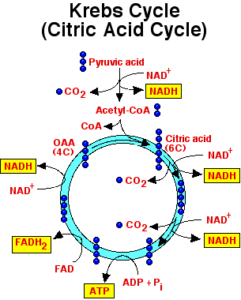
The Citric Acid Cycle

Slide 12
The citric acid cycle takes place in the Mitochondria of cells.
It is a process which creates Adenosine Tri Phosphate (ATP), which is energy for the cell.
To sum it up, PEPCK is important in the production of energy in the body.

Slide 13
Mice Selection
Once the original mice were born, each one was tested to find out how much PEPCK-C was in their livers, hearts, kidneys and skeletal muscle.
This test was conducted using Western Blotting which is a test used to detect proteins in specific tissue areas.

Slide 14
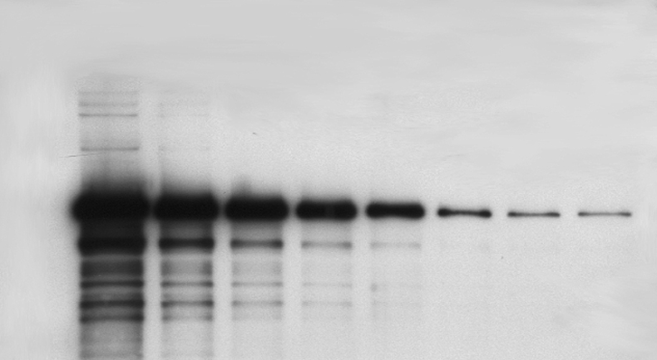
Example of Western Blotting

Slide 15
Mice Selection
6 Mice which had the highest levels PEPCK-C were selected to continue the experiment.
These 6 mice were labeled A, B, C, D, E and F.
It was concluded that C and D had the highest levels of PEPCK-C and they were then bred together to create a new line, named CD.
The new CD mice were then used in a majority of the tests and experiments.

Slide 16
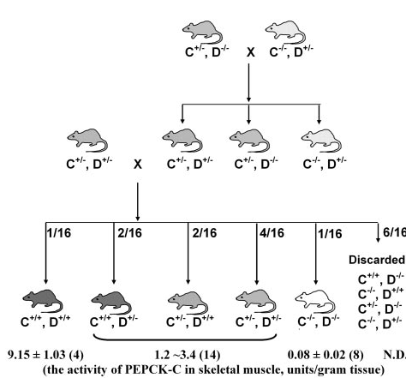

Slide 17

Tests Conducted
The first test conducted was the ability of untrained super mice (the CD mice) and control mice to run distance.
The mice were acclimated to the mouse treadmill room for 30 minutes, after that they were placed on the treadmills for a warm-up.

Slide 18
The warm up consisted of the mice running at a speed of 10 meters per minute for 30 minutes.
Once completed the speed was increased to 20 m/min and they were required to run until exhaustion.
Exhaustion was defined as the time when the mice stopped or were unable to continue, even though they were shocked with a mild electric stimulation.

Slide 19
Second Test
This test was used to determine the VO2 Max, or Aerobic capacity of the mice.
Again, the mice were first acclimated to the treadmill room for one hour.
During this acclimation hour, tests were conducted to determine the whole body oxygen consumption VO2, carbon dioxide production and the respiratory exchange ratio.

Slide 20

After the acclimation the mice were placed on the treadmills for warm up.
The warm up consisted of the speed at 5m/min at a grade of zero percent.
Once warmed up the grade was upgraded twenty-five percent and the speed increased by 2m/min every 2 minutes until exhaustion.

Slide 21
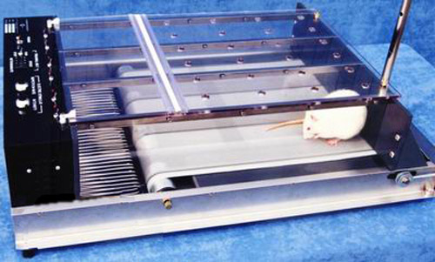
The aerobic capacity and the carbon dioxide production was monitored throughout the test.

Slide 22
Third Test
This test was used to determine the maximum speed of the mice.
The mice were acclimated to the test room for 30 minutes followed by a 30 minute warm up at 10m/min.
Once the warm up was complete the speed was increased by 1m/min every minute until exhaustion.

Slide 23

Additional Testing
Aside from the physical tests these mice also had to go through tests which showed how their muscles and tissues were modified.
Magnetic Resonance Imaging (MRI) was done to show the total body fat of the super mice and the control mice.
The MRI’s were conducted over a three week span.

Slide 24

Histological and Electron Microscopy analysis was completed on skeletal muscle tissue to analyze and compare.
This was accomplished by isolating skeletal muscle in Formalin solution (an aqueous solution of formaldehyde), in liquid N2 or in Tissue-Tek compound.

Slide 25
Results
The super mice had around 9 more units/g of PEPCK-C activity in their gastronemius (calf muscle) and diaphragm.
The same muscles were tested in control mice and they only possessed .08 units/g of PEPCK-C.
The hearts from the super mice contained .74 units/g.
As for control mice, usually PEPCK-C cannot even be detected in their hearts.

Slide 26
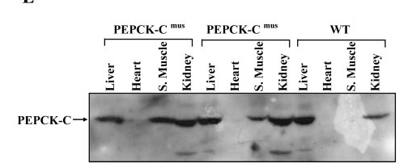
Levels of PEPCK-C

Slide 27
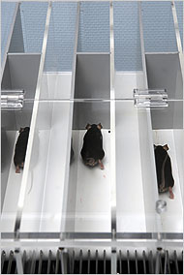
Treadmill Testing
The super mice ran at a speed of 20m/min for up to 6 km.
The control mice could only run for .2km at this speed.

Slide 28
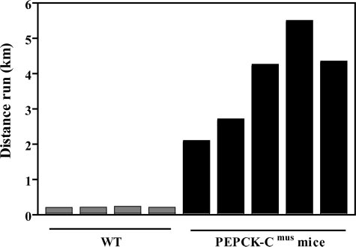
Ability to Run Long Distances

Slide 29
In the 2nd treadmill test, the aerobic capacity of the mice was tested. They ran for as long as they could until exhaustion.
The super mice ran for a period of 32 minutes and the control mice only lasted 19 minutes.

Slide 30
Video of Mice Running
http://www.scientificblogging.com/news_account/video_rise_of_the_pepck_c_enhanced_super_mice

Slide 31
What This Means
The super mice are more active, and they are physically healthier than control mice.
They can consume more food but have less body weight than control mice.
The super mice ate on average 60% more than control mice.
Yet, through MRI comparisons it was found that for a 6 month old super mouse the volume of adipose tissue was .4+-.2.
For a 6 month old control mouse it was 1.2+-.4.

Slide 32
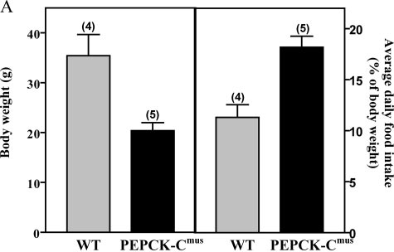

Slide 33
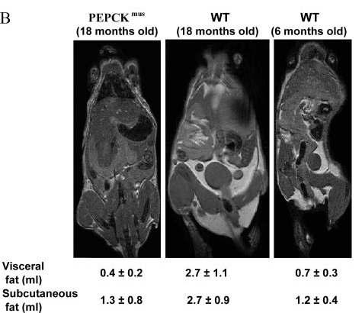

Slide 34
More Results
The muscles of super mice contain higher numbers or mitochondria than control mice.
Mitochondria are located inside a cell and they are responsible for the production of ATP.
This is one of the reasons why the mice have increased performance and endurance.

Slide 35
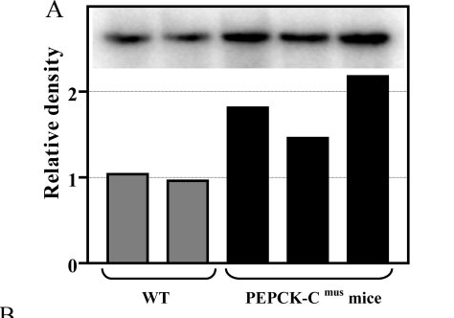

Slide 36
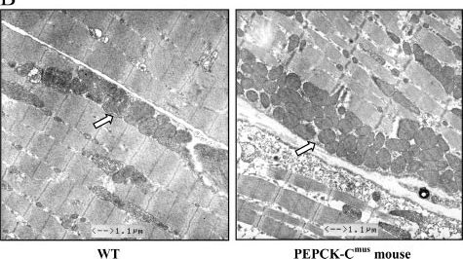

Slide 37
Life Span
The super mice live longer than control mice.
In addition, they have higher energy levels at an older age.
For example, a 30-month old female super mouse gave birth to normal sized healthy babies.
Control mice live on average for 1-2 years, at the most for 3 years. Normally female mice breed at 3-4 months old, but not after 5 months of age.

Slide 38
Potential Problems
Money Problems- This would be a very costly procedure if it is done to humans. Only the wealthy class will be able to afford it at first, creating an even bigger gap between the rich and the poor.

Slide 39
Inequalities in schools- Since only the wealthy will be taking advantage of this modification, the children of these wealthy people will have increased performance, therefore better at sports.
Example: A school sports team will chose the best players to be on the team. The genetically modified children will be faster, stronger, and have more endurance, and be chosen for the team.

Slide 40
Overpopulation- As estimated by the United Nations, China has the largest population. Followed by India and then the US. The US and China are both in the top three riches countries in the world for 2009.
So, with China and the US having money, they will be the ones taking advantage of this modification, creating an even larger population.

Slide 41
Sports- Professional athletes all possess certain qualities including: determination, natural talent, dedication and skills and they have to work hard and train to be where they are.
If we genetically engineered people to be good at sports, we would lose all of those qualities and we would lose sports.
A quote from Bill McKibben who is against this modification being done to humans, “We won’t simply lose races, we’ll lose racing: we’ll lose the possibility of the test, the challenge, the celebration that athletics represents.”

Slide 42


Slide 43
References
1. Albright & Stern (1998). Adipose Tissue. Encyclopedia of Sports Medicine and Science. Retreived from www.sportssci.org on 9/16/09.
2. Campbell & Reece (2005). Biology, Seventh Edition. Pearson Education Inc: California.
3. Dayal & Zarek (2008). Preimplantation Genetic Diagnosis. Retreived from http://emedicine.medscape.com/article/273415-overview on 10/04/09.
4. Hakimi, Yang, Casadesus, Massillon, Tolentino-Silva, Nye, Cabrera, et al. (2007). Overexpression of the Cystolic Form of Phosphoenolpyruvate Carboxykinase (GTP) in Skelatal Repatterns. The Journal of Biological Chemistry, 282, 45, 32844-32855
5. King & IU SChool of Medicine (2009). Gluconeogenesis: Synthesis of New Glucose. Retreived from www.themedicalbiochemistrypage.org on 10/11/09
6. Kuure-Kinsey, M. & McCooey, B. (2000). The Basics of Recombinant DNA. Retrieved from http://www.rpi.edu/dept/chem-eng/Biotech-Environ/Projects00/rdna/rdna.html on 10/04/05

Slide 44
7. McKibben (2003). Enough. Henry Holt and Co: New York.
8. Workman (2009). GDP Estimates for Richest Countries in 2009. Retrieved from http://global-economy.suite101.com/article.cfm/gdp_estimates_for_richest_countries_in_2009 on 10/03/09.
9. The American Association for the Advancement of Science (2007). "Experts Warn Gene-Doping in the Horizon, Urge Public to Discuss Ethical Implications." US Fed News Service: Washington D.C.

