Slide 1
Issues With rBGH and Milk Labeling
Tara Atwood
Arianne Paul
Brandon Wright

Slide 2
Introduction
Considering the unknown and potential health effects of rBGH, dairy products containing hormones should be labeled so that consumers may make an informed choice when purchasing dairy goods.

Slide 3
What is rBGH?
Recombinant bovine growth hormone or recombinant bovine somatotropin (rBST).
Synthetic protein hormone that is intended to increase milk production in cattle.
Created by the Monsanto Company using recombinant DNA technology, named it Posilac

Slide 4
Well What Does That Mean?
rBGH is an offshoot of the naturally occurring bovine somatotropin hormone.
All animals have a version of this hormone, important to their growth and development.
A synthetic version of the bovine somatotropin hormone can only be created using recombinant DNA technology.

Slide 5
Recombinant DNA Technology
The technique by which genetic material from one organism (cow) is inserted into a foreign cell (Escherichia coli) in order to mass produce the protein encoded by the inserted genes (The Body, 2000).
The product of this procedure is purified and injected into the cow in order to increase milk production.

Slide 6
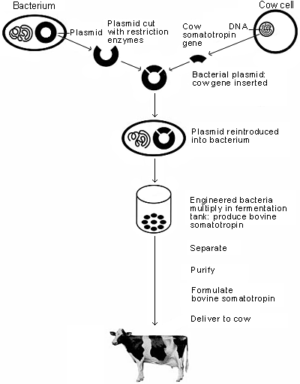
Making rBGH
(Patton, 2005)

Slide 7
How Does rBGH Increase Milk Production?
Artificial growth hormones do not physically produce more milk; allows cow to produce milk for an extended period of time.
When cows begin to lactate, the number of mammary cells increase, and then decrease throughout the lactation process.
The growth hormones are injected when the mammary cell count peaks.

Slide 8
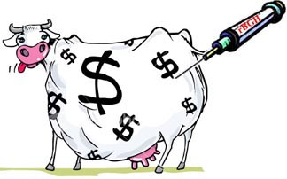
Increasing Milk Production Cont’d
The injection of rBGH causes the mammary cells to die off at a slower rate than they naturally would, therefore resulting in higher milk yields over a production period.
Milk production is increased by only 10 to 15%.

Slide 9
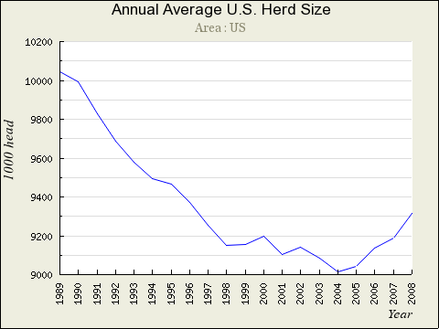
Herd sizes have decreased over time as the use of artificial growth hormones have become more common in the diary industry.
(Gould, 2008)

Slide 10
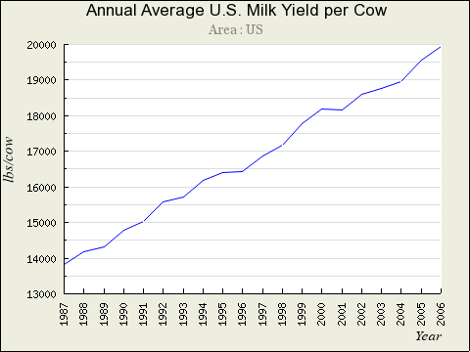
Milk Yield per cow has increased as the use of rBGH has become more prevalent.
(Gould, 2008)

Slide 11
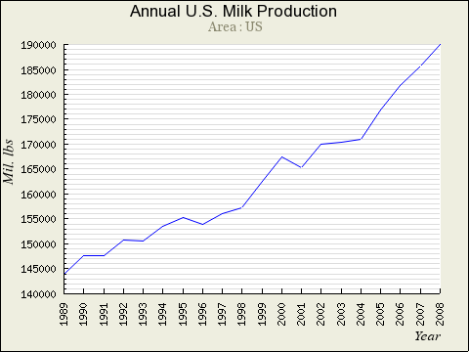
Growth hormone use continues as the amount of milk produced increases.
(Gould, 2008)

Slide 12
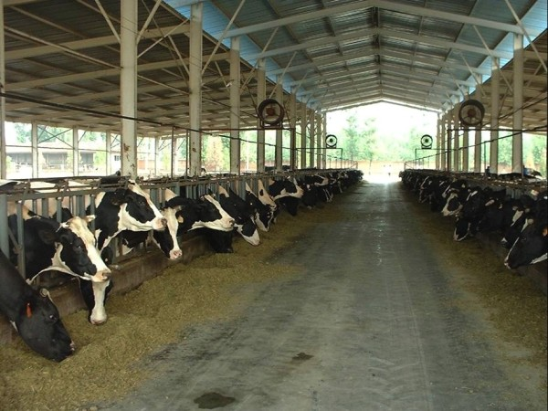
Use of rBGH in the U.S.
Of the 9 million dairy cows in the U.S, one third are supplemented with Posilac

Slide 13
How did this happen? History of Milk and rBGH
9000 B.C. - It is assumed that milk consumption as a beverage probably began with the domestication of animals, which began in Iran and Afghanistan around this time (How Milk is Made, 2007).
1790 A.D. - Population centers such as New York, Boston, Philadelphia were large enough to become a market for large-scale dairy operations. To meet the increased demand, cattle that produced better milk such as Holstein-Friesens, Ayrshires and Guernseys were imported (How Milk is Made, 2007).
1856 A.D. The dairy industry is growing and so is the technology being used to process milk. “Gail Bordon patented a method for making condensed milk be heating it in a partial vacuum. This method removed much of the water so the milk could be stored in smaller volumes and protected the milk from germs in the air. During the Civil War, condensed milk was used by the Union troops”.

Slide 14
History of Milk
1863 A.D. - Louis Pasteur developed pasteurization but widespread use of pasteurizing milk did not occur until the early 1900s (How Milk is Made, 2007). This allowed for the safe production of milk and would reduce the transmission of infections and diseases passed through the cow.
1901 A.D. - Monsanto was founded in St. Louis, Missouri, by John Francis Queeny, a 30-year veteran of the pharmaceutical industry. He funded the start-up with his own money and capital from a soft drink distributor, and gave the company his wife's maiden name. His father in law was Emmanuel Mendes de Monsanto a wealthy sugar factor. (Monsanto.com, 2009) This was the start of a long road to controlling major biotechnology in today’s world.
1930 A.D. - It was realized that cows injected with material drawn from bovine (cow) pituitary glands (hormone secreting organ) produced more milk. (Consumer Concerns about Hormones in Food, Cornell University. 2000)

Slide 15
History of Milk
1935 A.D. - Consumers will have delivered to their doorsteps milk, cream and buttermilk in bottles with cap labels which was determined to prevent the sale of stale milk. (Chicago Tribune. 2009)
1979 A.D. – Monsanto obtains the rights to develop fully and commercialize Genentech’s recombinant BST process. (History of BST, 2001) This is the start of the mass production of hormones for cows.
1994 A.D. - United States Food and Drug Administration approves rBGH for commercial sale in the United States. This will start the mass hysteria with the problems associate with Monsanto and with milk health problems.
2008 A.D. – The drug Posilac is sold to Elanco by Monsanto following controversies surrounding the use of the hormone in dairy cows (Monsanto.com, 2009).

Slide 16
Human Health Risks
rBGH increases the concentration of insulin-like growth factor-1 (IGF-1) in the milk
One study shows an increase from 1-5 ng/ml to 6-20 ng/ml in the milk treated with rBGH
Monsanto’s study reported a tenfold increase of IGF-1 in rBGH treated milk
This is a problem because many studies have found correlations between IGF-1 levels and several types of cancer

Slide 17
IGF-1 and Cancer
IGF-1 is naturally produced in the body in the liver and regulates:
  Transport processes
  Cell growth
  Replication and
  Differentiation
IGF-1 in cows and humans is identical, leading scientists to believe that it could lead to cancer

Slide 18
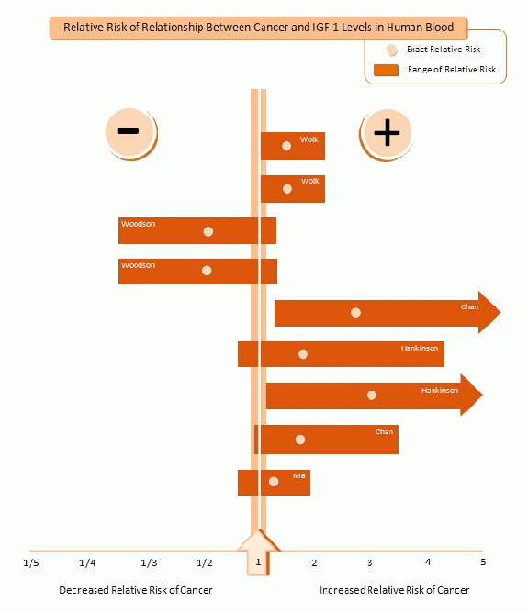
This diagram clearly shows a relationship between IGF-1 levels in human blood and cancer

Slide 19
IGF-1 Studies
The FDA says that IGF-1 cannot be absorbed when taken orally, however this information comes from the pharmaceutical companies that profit from making Posilac.
Also, the studies were done for very short time periods (2-4 weeks)
Results stated that the rats studied did not have enlarged livers, thymuses and epiphyseal plates of their tibias, but this is too small a set of effects to base decisions on

Slide 20
More Studies
The FDA approved the use of rBGH in 1993 with information from an unpublished study done by Monsanto
Upon further inspection, the Health Protection Branch of Canada found that 20-30% of the rats absorbed this hormone into their bloodstream
  They also found evidence of cysts and increased hormone levels in the blood

Slide 21
IGF-1
IGF-1 is usually degraded in the intestines when administered alone
However, when it is introduced with casein, a protein found in milk, the degradation was inhibited

Slide 22
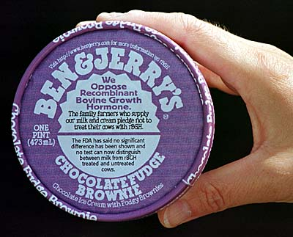
rBGH free Companies
There are several companies that only use rBGH free dairy products including:
  Kroger
  Prairie Farms Dairy
  Publix
  Ben & Jerry’s
  Starbucks
  Wal-Mart

Slide 23
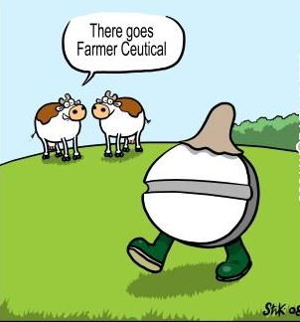
Infections & Antibiotics
Since the use of rBGH in cows creates health problems in the cow such as mastitis, antibiotics must be used to treat it
The use of antibiotics could lead to human allergic reactions and the development of antibiotic-resistant bacterial strains

Slide 24
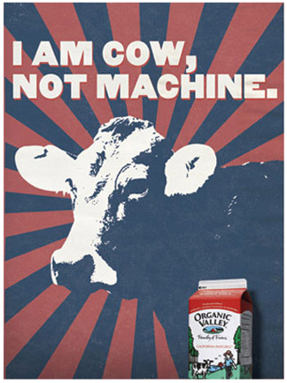
Health Problems for the Cows
rBGH is like crack for cows
  Revs their systems and forces them to produce more milk
A study done in Canada found that there was a 25% increase in the risk of mastitis in cows treated with rBGH

Slide 25
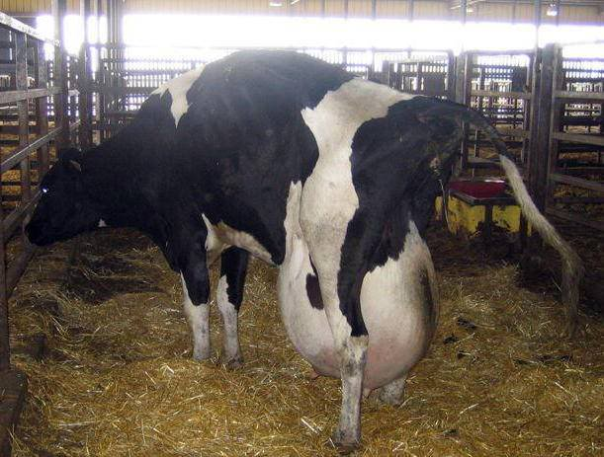
Mastitis
Symptoms
  Inflamed udders
  Secretions of blood and pus in the milk
Cow with mastitis

Slide 26
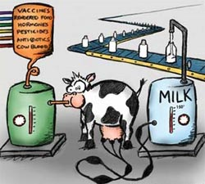
Other Risks to Cow’s Health
Use of rBGH substantially decreases the cow’s chances of being able to conceive
50% increase in the risk of clinical lameness
Reduces life span of dairy cattle
The conclusion of this Canadian study led the government to banning rBGHs because the implications these hormones have on the cow’s health is not worth the increased dairy production

Slide 27
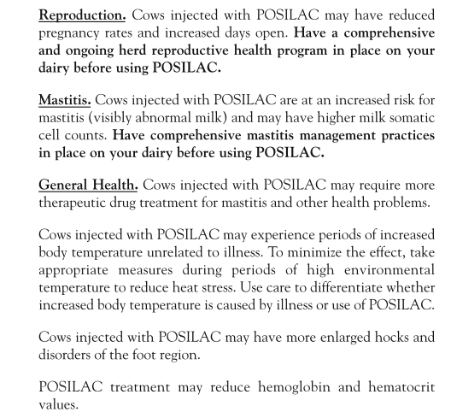
The label of Posilac

Slide 28
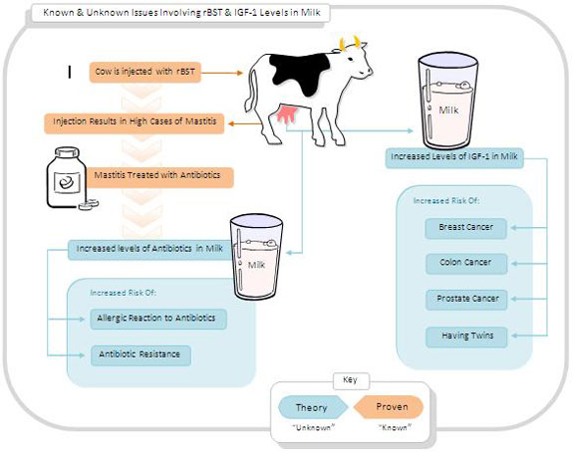
Health Implications

Slide 29
rBGH Around the World
The use of rBGH in dairy production has been banned in:
  Australia
  Canada
  Japan
  All 27 countries in the European Union
These countries see no reason in putting cows and humans at health risk to produce milk that will not even get consumed
They are also aware that the only ones who benefit from this are the corporate owners of the drug and large farms.
  Small scale agriculture is preferred

Slide 30
http://www.youtube.com/watch?v=3SXVpvgXo9Q

Slide 31
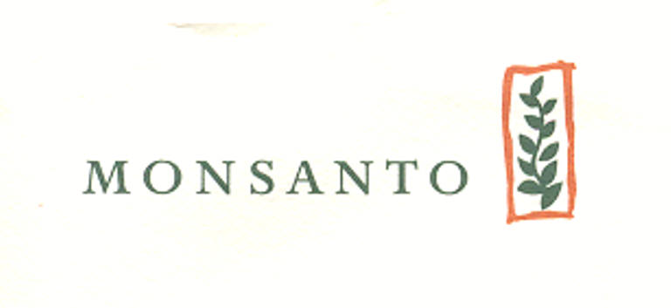
The Monsanto Company
In 1960 the Agricultural Division is established
  Original company produced agricultural chemicals and other herbicides and pesticides.
Cell biology was not established until 1975
  Before this the majority of the research was toward finding improvements on chemicals.
Leader in the field of agriculture and biotechnology
  Posilac (rBGH, rBST) are our main focus

Slide 32

Posilac Corruption
90 day study of rats to determine health risk
  Funded by Monsanto
  Ended the day before commercial sale
Widespread criticism
  Government officials
  Farmers and scientist
Monsanto workers and the FDA
  Michael Taylor
  Margaret Miller
  Suzanne Sechen

Slide 33

Corruption cont.
Margret Miller
  Former chemical laboratory supervisor for Monsanto, now Deputy Director of Human Food Safety and Consultative Services, New Animal Drug Evaluation Office, Center for Veterinary Medicine in the United States Food and Drug Administration (FDA)
  FDA approval for Posilac
    Monsanto scientific report written by Miller
    Miller shortly after leaves Monsanto to work for FDA
      First job was to decided whether or not to approve the report that she wrote

Slide 34

More FDA Corruption
Michael Taylor
  Legal advisor to (FDA)'s Bureau of Medical Devices and Bureau of Foods,
  Executive assistant to the Commissioner of the FDA
  Partner of King & Spaulding lawyer group for Monsanto Agricultural Company twice
  Deputy Commissioner for Policy at the (FDA)
  Head of the Washington, D.C. office of Monsanto Corporation.
  Hired by FDA after leaving King and Spaulding law group and wrote the guidelines for rBGH labeling.
Notes:
Taylor ended up writing the rBGH labeling guidelines that prohibit the dairy industry from stating that their products either contain or are free from rBGH. Even worse, to keep rBGH-milk from being "stigmatized" in the marketplace, the FDA ruled that the labels of non-rBGH products must state that there is no difference between rBGH and the natural hormone.

Slide 35
Labeling Issues
According to the FDA’s “Voluntary Labeling of Milk and Milk Products From Cows That Have Not Been Treated With Recombinant Bovine Somatotropin” it is illegal to label dairy products that are misleading to consumers.
  The proper context stated by the Guidelines could be in many forms this being a good example “from cows not treated with rbST'' with the statement that “No significant difference has been shown between milk derived from rbST-treated and non-rbST-treated cows.”
  These guidelines were all written by Michael Taylor during his time at the FDA.
In the state of Pennsylvania dairy producers are using these guidelines for the advantage of their consumers.
  Governor Rendell stated that Consumers can have greater confidence in milk labels and that labels can say milk is rBST or growth hormone free, as long as they are uniform.

Slide 36


Corporate influence with the News
Fox News Whistleblowers
  Jane Akre and Steven Wilson
    Monsanto influence dealing with Fox news
    Credibility of our news

Slide 37
Future Implications
It is important that dairy products are properly labeled so that the consumers can make informed decisions about what they are buying. The labels should not be misleading but contain factual information that is backed by scientific research.

Slide 38
Works Cited
Akre, J. (2001). Got milk? get fired. InTheseTimes.com, 25(13), Retrieved from http://www.inthesetimes.com/issue/25/13/akre2513.html
Bryson, J.M., and Hurley, W.L. (June 1, 1998). Roles of Cell Loss in Mammary Gland Function. Retrieved from http://www.livestocktrail.uiuc.edu/dairynet/paperDisplay.cfm?ContentID=151
Burke, T. (1999). Bananas are only the warm-up act. New Statesman, 12. Retrieved Oct 10, 2009 from http://www.newstatesman.com/199903120022.
Butler, G. (2003). The Truth About Milk. Enzyme University. Retrieved Oct. 10, 2009 from http://enzymeuniversity.com/artman/publish/article_20.shtml
Consumer Concerns about Hormones in Food. (2000). Retrieved Oct. 5 from http://envirocancer.cornell.edu/Factsheet /Diet/fs37.hormones.cfm
Davey, G. (2000). Cancer and insulin-like growth factor-1. British Medical Journal. Retrieved Oct. 10, 2009 from http://www.yourhealthbase.com/database/a109h.htm.
Donohoe, M, Hansen, M, & North, R. (Ed.). (2009). Frequently asked questions about recombinant bovine growth hormone (rbgh or rbst). Portland, OR.
Elanco. (2009). POSILAC. Retrieved Oct 10, 2009 from http://www.elanco.us/products/posilac.htm
Gould, B. (Designer). (2008). Annual average u.s. milk yield per cow [Web]. Retrieved from http://future.aae.wisc.edu/data/annual_values/by_area/95?tab=production
Gould, B. (Designer). (2008). Annual u.s. milk production [Web]. Retrieved from http://future.aae.wisc.edu/data/annual_values/by_area/96?tab=production
Gould, B. (Designer). (2008). Annual average u.s. herd size [Web]. Retrieved from http://future.aae.wisc.edu/data/annual_values/by_area/94?tab=production
"Governor Rendell Says Consumers Can Have Greater Confidence in Milk Labels." US Newswire 17 Jan. 2008. Communications and Mass Media Collection. Web. 3 Nov. 2009. <http://find.galegroup.com.ezproxy.fgcu.edu/gtx/start.do?prodId=PPCM&userGroupN ame=gale15690>.
Health Canada (1998). Report of the Canadian Veterinary Medical Association Expert Panel on rBST. Retrieved Oct. 10 2009 from http://www.hc-sc.gc.ca/dhp-mps/vet/issues-enjeux/rbst- stbr/rep_cvma-rap_acdv_tc-tm-eng.php
How Milk is Made. (2007. Retrieved Oct. 5 from http://www.madehow.com/Volume-4/Milk.html.
Iowa State University (December, 1993). Bovine Somatotropin. Retrieved from http://www.biotech.iastate.edu/biotech_info_series/Bovine_Somatotropin.html
Think Before You Pink (2002). rBGH & Breast Cancer. Retrieved Oct. 10, 2009 from http://thinkbeforeyoupink.org/?page_id=6.
Kronfield D. Recombinant bovine somatotropin and animal welfare. Journal of the American Veterinary Medical Association 216(11):1719-1720, 2000.
McKenzie, J. (1998). Is Cow's Milk Additive Safe? ABC News. Retrieved Oct 10, 2009 from www.purefood.org/rBGh/abcrbgh.cfm
Monsanto Company. (2006, June 02). Monsanto company: who we are?. Retrieved from http://www.monsanto.com/who_we_are/default.asp

Slide 39
Monsanto Company History. (2009) Retrieved Oct. 5 from http://www.monsanto.com/who_we_are/history.asp#original.
Montague, P. (1994). Hormones in milk: no right to know. Rachel's News, (381), Retrieved from http://www.rachel.org/en/node/4064
Morris, K. (1999). Bovine somatotropin -- Who's crying over spilt milk? The Lancet. Retrieved Oct 10 from http://www.organicconsumers.org/rBGH/spiltmilk.cfm
Organic Consumers Association (2008). rbgh & rbst Free Milk Producers. Retrieved from http://www.organicconsumers.org/rBGH/rbghlist.cfm
Patton, V. (Designer). (2005). How Posilac is made [Web]. Retrieved from http://www.mindfully.org/GE/2005/Monsanto-Posilac-rBGH18feb05.htm
Pure Food (1999). rBGH Consumer Warning. Retrieved Oct 10, 2009 from http://www.organicconsumers.org/text5.html
rbSTFacts.org, c/o Washington Dairy Products Commission. (2007, September 27). rBST Facts. Retrieved from http://rbstfacts.org/rbst-facts
rbSTFacts.org (2000). How it’s used. Retrieved from http://rbstfacts.org/rbst-facts
Recombinant DNA technology. (n.) In HIV Vaccine Glossary. Retrieved from http://www.thebody.com/content/art6531.html#R
Sustainable Table (2009). Artificial Hormones. Retrieved from http://www.sustainabletable.org/issues/hormones/index_pf.html
Tells of regulations. (1935) Retrieved Oct. 5 from http://pqasb.pqarchiver.com/chicagotribuneaccess/4435772.html?dids=443545772:443545772&FMT=CITE&FMTS=CITE:Al&type=historic&date=FEB+16%2C+1935&author=&pub=Chicago+Tribune&desc=Tells+of+Regulations&pqatl=google.
The History of BST and its Manufacturing and Administration. (2001) Retrieved from http://www.monsanto.com/dairy.8_m&moa.html
The Present Tense. (2008). Relative risk of relationship between cancer and igf-1 levels in human blood [Web]. Retrieved from http://www.uwec.edu/english/ThePresentTense/topic_reports/rbgh_and_milk/evidence_summary.html
The Present Tense. (2008). Known & unknown issues involving rbst & igf-1 levels in milk [Web]. Retrieved from http://www.uwec.edu/english/ThePresentTense/topic_reports/rbgh_and_milk/evidence_summary.html
Thom, M. (1994). rBGH, Monsanto and Corporate Agriculture Information . Institute for Agriculture and Trade Policy , Retrieved from http://www.mindfully.org/GE/Monsanto-rBGH-Corporate-Agriculture.htm
Wade, G. (2007). BOVINE GROWTH HORMONE (rBGH). Gary Wade Collection of Articles, Retrieved from http://www.rifeenergymedicine.com/BGH.html
Wilson, S. (2000). How murdoch gave in to monsanto. New Statesman, 129(4468), 22.
Zea, M. (2002). The Cancer Cow: A study of the risks associated with milk from rbGH treated cows. Nutrition Bytes, 8(1). Retrieved Oct. 10 2009 from http://escholarship.org/uc/item/5wh0g46z

