Slide 1

Attention Deficit Hyperactive Disorder:
Drug Treatment verse Behavioral Treatment and Over diagnosed in Children
Brittany Brown, Desiree Santiago,
and Wendy Stephens

Slide 2
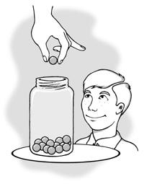

Our Stance
Attention Deficit/Hyperactive Disorder is being over diagnosed and improperly treated. Drug Therapy is a good form of treatment for the short term, while Behavioral Therapy is better for long term treatment.
verse

Slide 3
Symptoms
Attention Deficit Hyperactive Disorder (ADHD)
One of the most common disorders in children.
Symptoms include:
  Difficulty staying focused
  Difficulty paying attention
  Difficulty in controlling behavior
  Hyperactivity

Slide 4
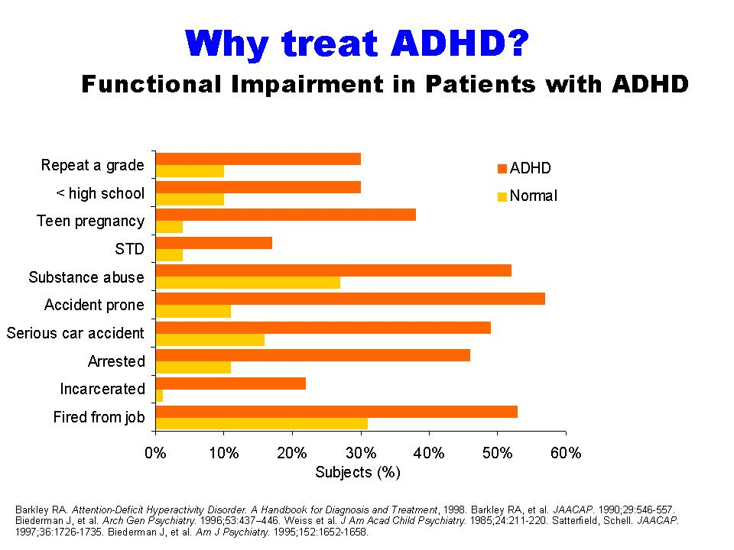

Slide 5

Diagnosis
Predominantly Hyperactive-Impulsive:
  Six or more symptoms in the Hyperactive-Impulsivity category are present
  Fewer than six symptoms of Inattention category are present
Predominantly Inattentive:
  Six or more symptoms in the Inattention category are present
  Fewer than six symptoms of Hyperactive-Impulsivity category are present
Combined Hyperactive-Impulsive and Inattentive:
  Six or more symptoms in both categories are present
  Most children have combined Hyperactive-Impulsive and Inattentive ADHD
In children these behaviors have to be severe and occur more often than not, for a period of 6 months and in more than one setting, to be diagnosed with ADHD.

Slide 6

Diagnosing
To be diagnosing with ADHD they must be out of the normal range for the child’s age and development.
ADHD is the most common studied and diagnose psychiatric disorder in children, affecting three to five percent of children globally with the symptom starting before seven years of age.
Almost 6% of the student population in the United States has been diagnosed with ADHD.
ADHD-a disease being diagnosed by primary care physicians

Slide 7
Causes
Causes of ADHD:
  Genes- Your first degree relative has a 25% chance of having ADHD if you do. In adoption studies, children resembled their biological parents through hyperactivity rather than their adopted parents.
  Environmental Factors- There is a potential link between cigarette smoking and alcohol use during pregnancy and children born with ADHD. Also preschoolers that are exposed to lead are at a higher risk to ADHD.
  Food Additives- British research has proposed a possible connection between food additives (food coloring and preservatives) and ADHD.
http://www.youtube.com/watch?v=ZJHT5XROrBA

Slide 8
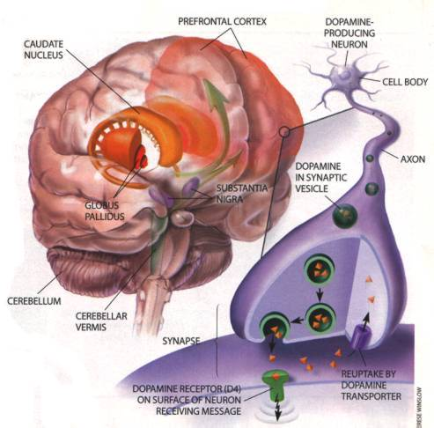

Slide 9
Drug Therapy
Stimulants have a calming affect on children with ADHD.
Pill, capsule, liquid, or skin patch
Short-acting, long-acting, and extended release
Side effects include:
  Decreased appetite
  Sleep problems
  Less common side effects- tics, lack of emotion
There is no cure, but with the addition of Behavioral Therapy it is easier to cope with the disorder.

Slide 11

Behavioral Therapy
Aims to help change behavior
Aims to help organize tasks or work through emotionally difficult events
Aims to help teach them to monitor their own behavior
Give praise or rewards when they do something correct.
Parents and teachers need to give positive feedback and a structured lifestyle needs to be created for the child.
  Positive Reinforcement
  Negative Reinforcement
Therapists might teach the child social skills, to read facial expressions and tone of voice, and how to respond appropriately.

Slide 12
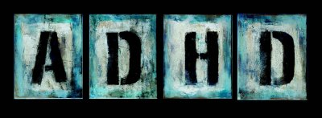
Combination Therapy
This is the mixing of drug therapy and behavioral therapy in the treatment of ADHD.
In recent studies it has been found to be a more effect form of treatment than either Drug or behavioral therapy by themselves.

Slide 13
1840s-1900s
In 1848 there was a German physician, Heinrich Hoffmann that wrote a children’s poem, “Fidgety Philip,” which describes the symptoms of hyperactive behavior before it was coined as a disorder.
In 1902 a British Doctor, Dr. Still, created documented cases that involved impulsiveness. He named this diagnosis “Defect of Moral Control” and believed that it was a medical diagnosis not a spiritual one.

Slide 14
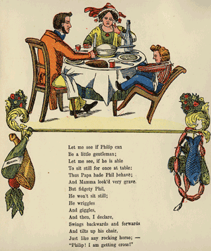

Slide 15
1920s-1930s
In 1922 ADHD received a new documented name, “Post-Encephalitic Behavior Disorder,” which encompassed all of the symptoms that are now associated with this disorder. It was coined this name after the encephalitis epidemic during 1917-1918. The brain damage that resulted after the epidemic was thought to cause the hyperactivity in ADHD. “Minimal Brain Damage” is another name that was used to describe the disorder.
In 1937 Dr. Charles Bradley introduced the use of drug therapy to treat children with ADHD.

Slide 16
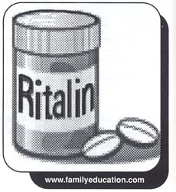
1950s-1960s
In 1956 Ritalin was introduced as a treatment for ADHD, hyperactive children.
Drug Therapy became a more widely used form of therapy for ADHD. The main symptom of the disorder was hyperactivity, and this is what everyone usually treated the patients for. In 1968 The American Psychiatric Association (APA) established a diagnosable category for “Hyperkinetic Reaction of Childhood,” which was the new name for ADHD, in the Diagnostic and Statistical Manual of Mental Disorders (DSM-II).

Slide 17
1970s-1980s
Lack of focus and daydreaming are added as additional symptoms associated with impulsiveness for ADHD in 1970’s. Impulsiveness was also expanded to include things such as verbal, cognitive, and motor impulsivity.
In 1980 APA gave the current name of Attention Deficit Disorder to the new DSM III. ADHD and ADD became two different diagnosis.

Slide 18

1990s-2000s
In 1995 Eli Lilly and Company sponsor the first study of the new drug Strattera for ADHD, which was conducted at Massachusetts General Hospital. In 1996 Adderall was introduced as the second medication for the treatment of ADHD. In 1997 the first study using Strattera on children with ADHD began. In 1998 The American Medical Association stated that ADHD was one of the best researched disorders out of DSM-III. In 1999 the National Institute of Mental Health published results from a study of multimodal treatment for ADHD. In 1999 Concerta and Metadate were introduced as a new medication for the treatment of ADHD.
In 2001 Focalin was introduced as a new medication for the treatment of ADHD. In 2002 Strattera gained approval as a new medication for the treatment of ADHD also.

Slide 19
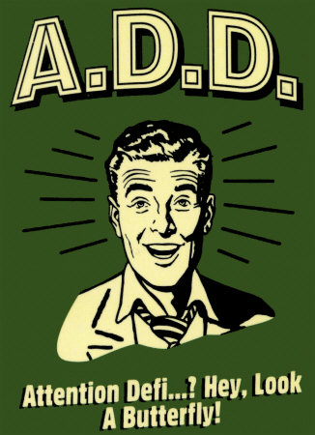
Are Stimulants Overprescribed?
The objective of the study is to address the concerns about possible over diagnosis and overtreatment with stimulants of ADHD.

Slide 20
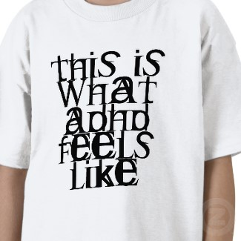
ADHD Treatment Practices
Elementary students increase from 1.07%-5.96%
Middle school increase from 0.59%-2.98
High school increase from 0.22%-0.70%

Slide 21
Methods
During first 6 months of 1992, sampled youths 9-17
Atlanta, Georgia; New Haven, Connecticut; Westchester, New York; and San Juan, Puerto Rico
Children and their primary caretaker interviewed by 2 lay interviewers

Slide 24
Instruments and Measures
Computer-assisted interview used by all sites
They reported services data concerning medication prescribed
Parents were asked simple yes and no questions

Slide 26
Discussion
First, the sites of four different communities
Second, relatively small number of children on medication that has ADHD
Third, the differences between the communities
Fourth, inappropriate prescription

Slide 28
Data Analyses
Examined the number of children that has ADHD
Provided 3 types of treatment services
Examined children in 3 groups

Slide 30
Results
12.5% of the children with ADHD are treated with stimulants
Some children that were on meds have not even meet the full ADHD diagnostic criteria
They still think that medicine was appropriately prescribed

Slide 31
Multimodality Treatment of Attention Deficit Hyperactivity Disorder
MTA Study
National Institute of Mental Health (NIMH)
5 years
University of Pittsburgh, Universities of California at Irvine and Berkeley, Duke University, Columbia University, and Long Island Jewish Medical Center with McGill University
First large, randomized clinical trial for a childhood mental health disorder

Slide 32

MTA Study
Four Treatments for ADHD:
  Behavioral Treatment
  Medication Management
  Combination Therapy
  Community Treatment/Control Group
7-9 year old children with ADHD
Randomly assigned to 1 of 4 treatment groups
Assessed at 9, 14, and 24 months.

Slide 33

MTA Questions
1) What are the relative efficacies of behavioral and pharmacological treatments for ADHD?
2) What is the incremental benefit of combining these treatments over either alone?
3) How do these evidence-based treatments compare with treatments routinely given in the community?

Slide 34
MTA Findings
all 4 treatment groups had dramatic improvement from baseline to 14 months, with changes from baseline on parent and teacher symptom ratings (BT and Control were similar and MM and Combined were similar)
MM was superior to BT on parent and teacher ratings of inattention and teacher ratings of hyperactivity, but not on any of the other 16 measures, including classroom observed behavior, parent- and teacher-rated social skills, parent-rated parent–child relationships, peer sociometric ratings, and academic achievement
combined treatment and MM did not differ on any dependent measure

Slide 35
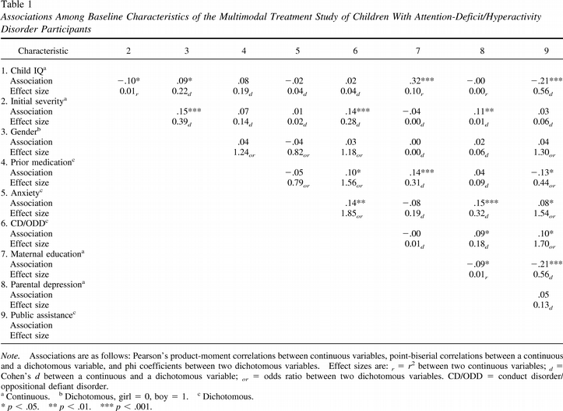

Slide 36
MTA Findings
combined treatment was better than BT on parent and teacher ratings of inattention and parent ratings of hyperactivity–impulsivity, parent-rated oppositional behavior, and reading achievement, but not on any other measure
both MM and combined treatments were generally superior to community treatments on parent and teacher ADHD-symptom ratings and teacher-rated social skills, while BTs were generally equivalent to community treatments
only combined treatment was superior to community treatments for parent ratings on oppositional and internalizing symptoms and for academic achievement

Slide 37
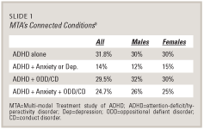

Slide 38
MTA Findings
only the 2 conditions with BTs were superior to community treatment on parent-child relationships
parents preferred the 2 BT groups to the MM group or the community treatment group
when order of means across different measures is examined, combined treatment is first considerably more often than the other treatments, with MM (4), BTs (2), and community treatment (1) following

Slide 39
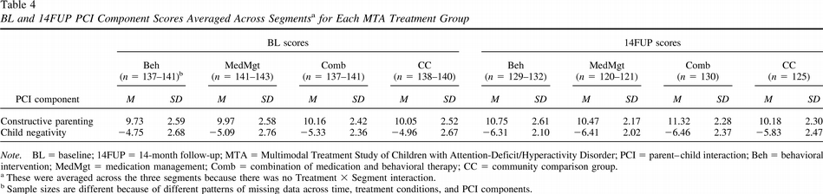

Slide 40
MTA Results
1) active medication for ADHD is better than withdrawn BT
2) combined treatment adds modestly to active medication but is superior to behavior management alone
3) study treatments that include active medication are better than community treatments that include medication, while BT is comparable to medication as delivered in the community
4) concurrent BT results in at least 20% lower and non increasing medication dosages relative to treatment with medication alone

Slide 41
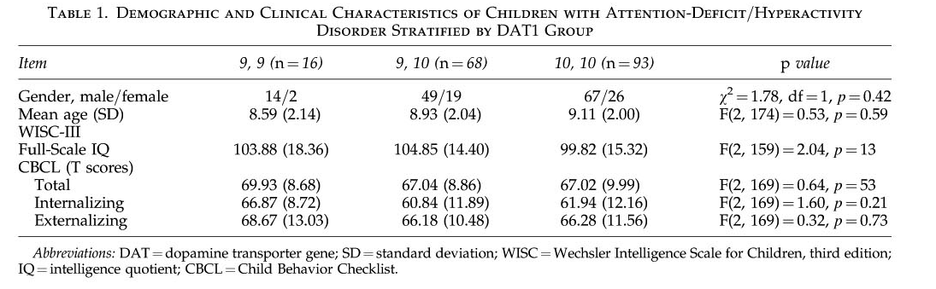

Slide 42
Works Cited
http://www.nimh.nih.gov/health/publications/attention-deficit-hyperactivity-disorder/complete-index.shtml
http://www.myadhd.com/causesofadhd.html
http://server03.cpa-apc.org:8080/French_Site/Publications/Archives/CJP/1999/Dec/pelham.htm
http://vnweb.hwwilsonweb.com/hww/results/getResults.jhtml?_DARGS=/hww/results/results_common.jhtml.33

