Slide 1

An in Depth Look at the Use of Illegal Steroids and Performance Enhancing Drugs in Baseball: Why All Steroids and Performance Enhancing Drugs Should be Banned.
Notes:
We’re going to talk to you today about steroids in baseball.
We have a quick little video to show you as an introduction,
and then were going to start by discussing what steroids are, terms you should know, the history of steroids, government regulations, and side effects and health risks involved because
its important to understand all of those things before making a decision about whether you believe steroids should be allowed in baseball or not.
Then, after we’ve introduced steroids and explained all that we have another video that discusses some of the scientific aspects of steroids, and then we will get into the actual topic of steroids in baseball.

Slide 2
(1)
Video contains some profane language and controversial, potentially offensive, photos.

Slide 3
Important Terms
Performance-Enhancing Drugs (PED’s)- various substances, chemical agents, or procedures designed to provide an advantage in athletic performance(2)
Anabolic Steroids- a synthetic derivative of testosterone, sometimes used by athletes to help increase weight and strength(3)
Doping- To administer a performance-enhancing substance to (an athlete)(4)
Stacking- using two or three different substances at the same time in order to increase the effectiveness.(5)
Notes:
These are some important terms for you to know about steroids.

Slide 4
History of Performance-Enhancing Drugs
776B.C. to 393 A.D.- the first recorded attempt to enhance athletes’ performance(6)
1889- the first known substance containing testosterone was made from a liquid extract from the testicles of guinea pigs and dogs(7)
1896- First recorded death due to PED’s(6)
1921- Male hormone, testosterone, was isolated by Fred Koch(6)
1931- Exact chemical formula of testosterone is isolated(6)
1935- Injectable testosterone was first introduced(6)
1960’s- The anti-doping movement began(8)
Notes:
Bullet 1: This was during the ancient Olympics in Greece
Bullet 2: This was developed by French Physiologist Charles Brown-Sequard, and marketed as a rejuvenating elixir
Bullet 3: Welsh cyclist Andrew Linton died during a race after reportedly drinking Trimethyl
Bullet 4: All up there
Bullet 5: Adolf F.J. Butenandt followed Fred Kock, further isolating testosterone in male urine making it possible to determine its exact chemical
formula
Bullet 6: . Using Butenandt’s formula, Leopold Rozicka transformed chemical cholesterol into synthetic testosterone in 1935, which was also the year that injectable testosterone was first introduced giving birth to the modern “doping” era ₍₁₎.
Bullet 7: In the early 1960’s the anti doping movement began with the help of anti-doping campaigners and the International Olympic Committee.

Slide 5
Government Involvement with Performance Enhancing Drugs
1988- the First Anti-Drug Abuse Act was passed by Congress(9)
1990- Anabolic Steroid Control Act was passed by Congress(9)
2004- President bush passed the Anabolic Steroid Control Act of 2004
2007- Congress began interviewing athletes after the release of the Mitchell Report
Notes:
Bullet 1: The first anti-drug abuse act was passed by congress creating criminal penalties for those who “distribute or possess anabolic steroids with the intent to distribute for any use in humans other than the treatment of disease based on the order of a physician₍₆₎.
Bullet 2: In 1990, believing that the Anti-Drug Act of 1988 legislation was insufficient; Congress replaced it with the Anabolic Steroids Control Act. This act placed steroids in the same legal class as barbiturates, and LSD precursors, and imposed fines and sanctions on players caught using them.
Bullet 3: This act added an additional 26 substances to the anabolic steroid control act of 1990.
Bullet 4: The Mitchell Report is a compilation of the results found by George Mitchell, a Senator from Maine, during his investigation into the illegal use of steroids and other performance-enhancing drugs in Major League Baseball. The findings in his report prompted Congress to start an investigation, and they have called numerous players bother current and ex-players for questioning.

Slide 6
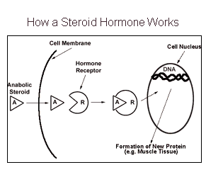
Notes:
Explain what you see in picture.

Slide 7
The Major Issues
Steroids are illegal
Steroids have adverse side effects
Steroids have severe health risks
Steroid use creates an uneven playing field
Steroid use by elite athletes influences the children who look up to them as hero’s.
Steroid use has spread down the sports ranks all the way to little league baseball.
Notes:
Bullet 1: we already went over on the last slide
Bullet 2: steroids cause side effects that are undesireible such as shrunken testicles and man boobs
Bullet 3: Steroids cause heath risks like liver cancer and enlarged left ventricles in the heart
Bullet 4: If two players with the same natural abilities were to compete and one was on steroids they’d have a huge advantage over the other
Bullet 5 & 6: Steroid use by athletes does have an influence on the children who look up to them, in fact, there was an 8 year old who was recently discqualified from playing in the little league world series, firstly because his birth certificate was falsified to make him older than he actually was, and secondly, because he tested positive for a designer steroids called ZXT. This kid was 6’ 2” and 200lbs at the age of 8!

Slide 8
Potential/Common Side Effects
For men-shrinking of the testicles, reduced sperm count, infertility, baldness, development of breasts, increased risk for prostate cancer(10)
For women-growth of facial hair, male-pattern baldness, changes in or cessation of the menstrual cycle, enlargement of the clitoris, deepened voice(10)
For adolescents-stunted growth due to premature skeletal maturation and accelerated puberty changes; risk of not reaching expected height if taken before the typical adolescent growth spurt(10)
Notes:
Bullet 1: Development of breast in men gynocomastia
Bullet 2: cessation of the menstral cycle is basically when the menstral cycle stops all together

Slide 9
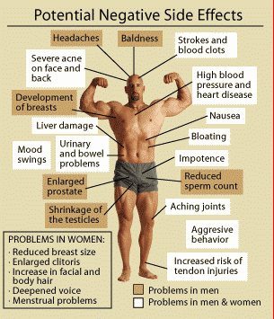
Notes:
We like this chart because it points to where the body is affected from steroids.
If you notice, there isn’t any place on the body in men or women that doesn’t have the potential to be damaged by steroids.

Slide 10
Side Effects in Men & Women
Bone growth to stop before it is complete in a teen. The teen may not reach his or her full adult height.
A heart attack or stroke, even in a very young person.
High blood pressure.
Higher levels of bad cholesterol (LDL) and lower levels of good cholesterol (HDL).
Liver disease and possibly liver cancer. The chance of these problems is higher when steroids are taken as a pill.
Oily skin and acne.
Male-pattern hair loss.
Skin infections that can become severe if the drug was tainted with bacteria.
Irritability, rage, uncontrolled high energy (mania), or false beliefs (delusions).
(12)
Notes:
Just list these right off the ppt.

Slide 11
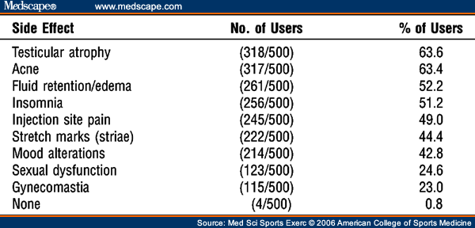
Survey Results
(11)
Notes:
This is a list of the results of a survey of 500 steroid users. As you can see, 50% of the participants had at least 5 of these side effects, and only .8% had no side effects at all. That’s 4 out of 500 people.
Go over what these side effects are…
Testicular atrophy- Shrinking of the testicles
Fluid retention/edema- retaining water
Gynecomastia- man boobs… referred to by many people as moobs

Slide 12
Severe Health Risks
Liver failure
Increased likelihood of developing cancer
Cardiovascular problems
Neurological issues
HIV (13)
Notes:
Bullet 1: Steroid abuse has been associated with liver tumors and a rare condition called peliosis hepatis, in which blood-filled cysts form in the liver. Both the tumors and the cysts can rupture, causing internal bleeding.
If you think that sounds bad, then finding out that those are acutally only the short term affects might shock you.
Long-term affects to the liver come from those same cysts, but with long-term use of steroids, those cysts actually replace the liver tissue, and can create liver cancer and go undetected until a life threatening abdominal hemorrhage occurs.
Bullet 3: Cardiovascular referes to the heart and blood vessels.
Having elevated blood pressure over time, “causes the heart to get larger, which may lead to heart failure, small bulges (aneurysms) can form in blood vessels, the main artery from the heart (aorta), arteries in the brain, legs, and intestines; and the artery leading to the spleen.
Blood vessels in the kidney can narrow, which may cause kidney failure. Arteries throughout the body can "harden" faster, especially those in the heart, brain, kidneys, and legs. This can cause a heart attack, stroke, kidney failure or amputation of part of the leg.
(FOR THOSE WHO MAY NOT KNOW: a stroke is a blockage or hemorrhage of a blood vessel leading to the brain, causing inadequate oxygen supply and can cause symptoms such as paralysis of parts of the body, speech difficulties, and, if severe, loss of consciousness or death.)
Blood vessels in the eyes may burst or bleed, which can cause vision changes and can result in blindness ₍₃₆₎.” In addition, elevated blood pressure affects the good and bad cholesterol levels in the body, which can also lead to heart attack and stroke.
On top of this, steroid use causes the muscles to grow more quickly than the heart can handle, and the heart has to work harder to provide more blood to the additional muscle.
Bullet 4: “Studies have confirmed steroid abuse has a long term effect on the neurological pathways of the brain. Depending on the age when steroids are taken, the effects can sometimes be permanent.
For example, abusing steroids in the teenage years of development has shown to affect the brain’s ability to properly produce serotonin, the enzyme tied with our sense of well-being. This tampering with serotonin can lead to permanent increases in depression and aggression.
In women, this hormonal tampering can also lead to significantly lower levels of progesterone and estrogen, potentially upsetting the delicate balance of female chemistry and inducing severe anxiety and depression ₍₃₆₎.”
Bullet 5: HIV is one of the deadliest side effects and it is rarely considered by steroid users as something they need to worry about,
however, “Intravenous needle sharing, combined with a heightened sex drive and libido function can be a very dangerous combination.
This is especially true in adolescent teens and young adults who often have weaker decision-making skills and a high susceptibility to peer pressure.
Also, a lot of steroid users are already good at rationalizing their actions and they tell themselves things like “this only happens to others, not to me”

Slide 13

Healthy Liver
Notes:
To demonstrate the severity of this we have a picture of a healthy liver

Slide 14
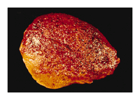
Liver On Steroids
Notes:
Compared to a liver covered in peliosis hepatis, the blood filled cysts that can rupture and cause internal bleeding.

Slide 15
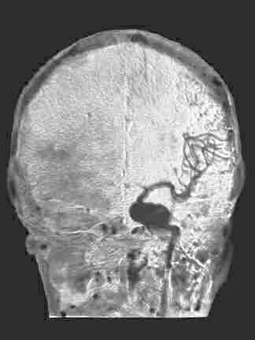
Aneurysm in the Brain
Notes:
This is a picture of an aneurysm in the brain. This big dark spot is the brain aneurysm. An aneurysm is an abnormalblood-filled dilatation of a blood vessel (especially an artery) resulting from disease of the vessel wall or weakening of the blood vessel wall.

Slide 16
VIDEO
http://www.kqed.org/quest/television/science-flexes-its-muscles
(24)
Notes:
This video were going to show you describes how steroids work, how testing for steroids works, and why focusing on steroids in sports is important.
You will here two terms in here that we didn’t explain earlier because other than in this video we don’t mention them.
The first is Human Growth Hormones also called HGH which are: a synthetic version of hormones that usually are found in the body. Synthetic HGH is used to treat children with growth hormone deficiencies and has been used especially by athletes to increase muscle mass —
The second is blood doping which is basically when and athlete loads their body with extra blood in order to increase the oxygen intake capabilities which gives them a boost in endurance.
Start video at 3:43 end video at 9:31

Slide 17


Steroid Deaths
Taylor Hooton
16 years old
Committed suicide which was later attributed to severe depression brought on by the use of steroids (20)
Matthew Dear
17 years old
Spent 1 weeks on life support before dying (21)
Notes:
Taylor Hooton, a 16 year-old boy from Texas took his own life on July 15, 2003 due to the side effects of steroids, which caused him to become severely depressed ₍₂₈₎,
and in April of 2009, 17 year-old Matthew Dear’s death was attributed to steroid abuse ₍₂₉₎. 3 men were arrested due to his death for their part in supplying the illegal suppliments.
A big part of the reason that steroid use has become such a big issue is because children and teens are being influenced by these players and many feel that steroids are the only way they can achieve their dreams are by using steroids. And because most teens arent used to thinking critically and researching things before they buy into them, they are more likely to use steroids and use them in an unsafe manner.
Baseball has been called America’s Passtime since 1856, Sports are hugely popular especially here in the United States, and the players need to realize that they set an example for the young kids who look up to them.
Nowadays with the internet being so accessable, and mobile, and televisions pretty much everywhere you go, these kids can watch their favorite team all the time, and see their favorite players all the time.
This being said, its important for professional athletes to realize the impact they can have on these kids and be good role models for them.
According to one survey, Most teens consider using steroids to be cheating, and know some of the health risks, but despite that fact, some are still willing to sacrifice their long term health for short term benefits to become like the players they look up to.

Slide 18
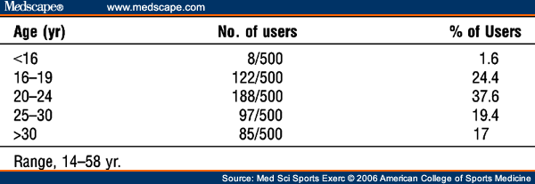
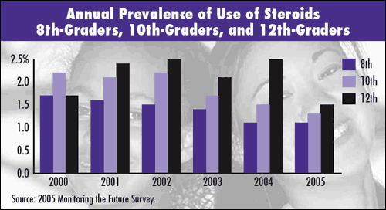
Notes:
The first chart shows the number of users of steroids and their ages between 14 and 58 for 500 ppl sampled. By the american college of sports medicine
The second graph shows the number of 8th graders through 12th graders that use steroids from 200 to 2005
Finally, we don’t have a graph for this one, but a study was conducted in the United States in 2005, showing that approximately 4% of U.S. teens between the ages of 14 and 17 have admitted using steroids. This may seem like a small percentage, but based on the CDC’s 4% current lifetime user’s statistic, it works out to be approximately 660,000 students that have admitted steroid use

Slide 19
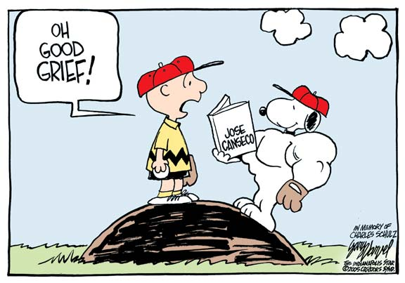
Steroids in Baseball
Notes:
Now that we’ve introduced you to what steroids are, and what some of the side effects and health risks are we’re going to get into the specifics of steroids in baseball.

Slide 20
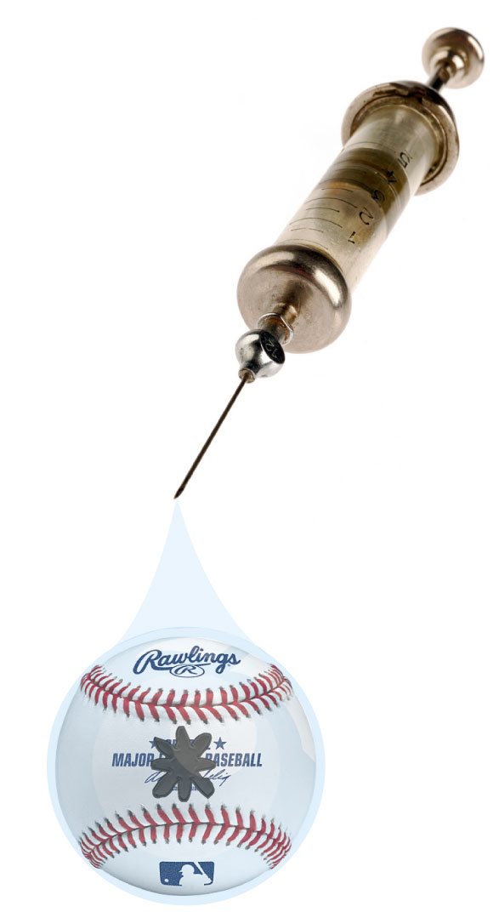
The Asterisk: is used whenever a record is broken by a player who has used steroids or Performance-enhancing drugs to differentiate that record from the records of non-steroids users
Notes:
An asterisk like you see on the baseball in this photo is used to denote steroid use when a new record is made by a player who has been proven to used steroids at the time they broke that record.

Slide 21
Physics: On the Ball
10% increase in muscle mass
help a batter swing 5% faster
could cause a ball to jump off the bat 4% faster
Increase homeruns by 50%
(25)
Notes:
When looking into the physical science, there is an impact on the physics of balls coming off bats, and added physiological benefits within the players’ body.
One analyst who writes a blog for Scientific American crunched the numbers and found that,
“steroids might bring about a 10 percent increase in muscle mass. That extra muscle could help a batter swing five percent faster,
and that extra bat speed could cause a ball to jump off the bat 4 percent faster.
It doesn’t sound like much; however,
if you add four percent initial velocity to a model distribution of trajectories of batted baseballs, you can increase homers by a full 50 percent ₍₂₂₎.”
Which is huge.
It is important to realize however that hand-eye coordination is also a factor, so steroids don’t give you a increased chance of hitting the ball 50% more, that is still dependant on skill,
they just give you a increased chance of hitting a homerun 50% more often when you do connect with the ball.

Slide 22
Notes:
These are the top ten homerun hitters in the entire history of baseball. Number one on the list is Barry Bonds who has a total of 762 homeruns, almost 200 more than the 10th place hitter Harmon Killebrew.
They both played the same number of seasons in major league baseball, but barry bonds who has an asterisk next to his name used steroids.
One other thing to notice is that 5 out of the top ten homerun hitters of all time are admitted or proven steroid users.

Slide 23
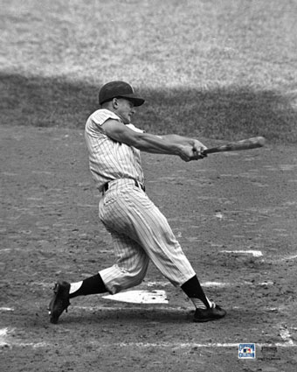
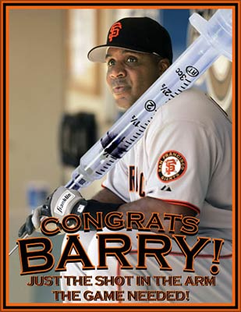
Roger Maris vs. Barry Bonds
Held the Single Season Homerun Record from 1961 until 2001 with 61 Homeruns. He won this title from Babe Ruth who held the record since 1927at 60 Homeruns in a single season.
***Broke the Single Season Homerun Record in 2001 with 71 Homeruns. It was the only season Bonds hit above 49 homeruns his entire career.***
(14)
Notes:
To further illustrate the problem this creates, we can look at the 2001 season when Barry Bonds broke the single season all-time highest homerun record.
He beat roger maris’s record of 61 homeruns hit in a single season, which stood for 40 years, by hitting 71 homeruns.
This was a very exciting moment in baseball, until it was proven that Barry Bond’s was using steroids when he broke the record.
Because he was using steroids, he has an asterisk next to his name in the record books, and may never be inducted into the baseball hall of fame.
Barry Bonds was the third person to actually break the record, but he is the current leader which is why we’ve listed him, however Sammy Sosa and Mark McGwire both broke the record a few years prior to barry bonds.
Unfortunately they are both guilty of using steroids as well.

Slide 24
Survey of MLB Players
(16)
Notes:
When USA Today conducted this survey they asked the players a number of questions.
One of these questions was what shoul be done about records if players who have set those records were using steroids?
62.4% of the players analyzed said the record should remain, but we do have to consider the bias that may be involved in that answer.
Some of those players may be using and some of them may be close friends with some of the players whose records are in question.
The remaining players said that the record should remain with an asterisk, be stripped, or refused to answer.
However, being that is pretty much a 60/40 split, and this is how the players themselves feel, its pretty telling.

Slide 25
Survey of MLB Players
(16)
Notes:
In the same survey by USA Today, the players were asked if the felt that steroids were a major contributor to record performances in recent years. 52% said they were a minor contributor.
That means that the remaining 48% feel that steroids either are a minor contributor, not a factor at all, or refused to answer.
These statistics may not support our stance, but if you have 79.2% of the players feeling that steroids are a contributor to record breaking, even if they feel its only a minor contributor, then Id say that steroids don’t belong in baseball.

Slide 26
Testing Policies and MLB Involvement
2001 MLB Implemented its first random drug testing policy. (17)
2004 Mandatory testing for all players was implemented. (18)
2006 Bud Selig commissioned George Mitchell to investigate steroid use in MLB. (19)
2007 The Mitchell Report was released. (19)
Notes:
Bullet 1: this Policy only applied to minor league players. The players on the major league 40 man roster, which is their starters and their backups, as well as their pitchers and their bullpen, were all exempt from this testing policy.
Bullet 2: The 2001 random testing policy was implemented when 1438 of the players who participated in the random drug testing had positive results.
Bullet 3: Selig , enlisted George Mitchell, a United States Senator, to conduct an “independent investigation into the illegal use of steroids and other performance enhancement substances by players in Major League Baseball
Bullet 4: In 2007 Senator George Mitchell finished his investigation and wrote the Mitchell Report which was filled with details about steroid use in baseball as well as the names of over 100 players who illegedly tested positive for steroids. And sparked the interest of Congress who began interviewing the players listed in the report.

Slide 27
Testing Methods
Gas Chromatograph Mass Spectrometry machine
Gas Chromatograph Thermo-ionic Specific Detection
Gas Chromatograph Flame-Ionization Detection
Testing costs anywhere between $400 and $650 per test, and can either be a urine or hair sample.
(23)

Slide 28



Steroids and Performance-Enhancing Drugs of Choice in MLB
Testosterone
Pro hormones
Androstenedione
Anabolic Androgenic Steroids
Primobolan
Notes:
Testosterone is a naturally occuring hormone in the body.
Synthetic testosterone is a manufactured form of the naturally occurring steroid hormone testosterone…
In men, testosterone plays a large role in normal sexual development, causing masculine characteristics (deep voice, facial hair) and producing semen.
It also exhibits anabolic effects, stimulating muscle growth by increasing protein synthesis and promoting bone density which is what the baseball players are interested in.
Pro Hormones are precousors to anabolic steroids.
An enzyme in the body will convert the pro-hormone supplement in the liver, into an active anabolic steroid
Prohormones are inteded to boost the affectiveness of testosterone based steroids.
Androstenedione is one of the most popular prohormones, and it is the same substance that was found in Mark McGwire’s locker in 1998
““Anabolic” refers to muscle-building, and “androgenic” refers to increased male sexual characteristics. “Steroids” refers to the class of drugs
One of the most popular types of AAS is Primobolan, “This banned steroid has been linked to several Major League Baseball players, including Alex Rodriguez
Doesn’t have these side effects (acne, aggression, water retention, infertility, breast development, etc...) are not seen in those taking the drug. This drug is one of the most expensive of the anabolic steroids

Slide 29

Why Choose Steroids?
Offensive Production (OPS)
Additional annual salary of $2, 085,438
(22)
Notes:
Follow the MONEY
Managers from baseball teams will award a player who has higher offensive statistics a larger contract than a player who has lower offensive statistics.
General Managers also take into consideration the fact that homeruns hit by that player will bring more fans into the ballpark.
In a study conducted in 2004, players who played 100 or more games during the regular season in the “steroid era” were analyzed base on the Offensive production, also called OPS, versus players who played 100 or more games during the regular season in the pre-steroid era.
The increase in offensive production was the compared to the salaries earned.
The researchers felt that, “In order to determine the effect of using steroids on a player’s salary, we first needed to determine the effect of increased OPS on a player’s salary.
we determined that an increase in OPS of .100 leads to an increase in salary of $2 million.
Therefore, our average increase of OPS due to steroids of .104 leads to an additional annual salary of $2, 085,438 ₍₄₄₎.”

Slide 30
The Other Side of the Fence
Players on steroids are able to play more games
Players on steroids hit more homeruns
Banning steroids delivers a blow to the nation’s free market economy
Notes:
steroids and performance enhancing drugs have actually allowed players to play throughout the entire season without missing many games because steroids allow for quicker recovery times from injuries and workouts which in turn raises ticket sales, and keeps fans in the seats
Another supposed benefit for fans, is that players who use steroids have increased the number of homeruns they hit throughout the season, and baseball fans love to see homeruns
Sean Michael Benhabib, wrote an article for the Associated Press claiming that the cleaning up efforts of the new drug policy in baseball, and are a blow to the nation’s free market economy.
“People like their athletes and the events they partake in to be pure, clean, and free of disease. This is merely out of respect for the sanctity of the craft.
Economically however, these restrictions on filth and impurity poison the legitimacy of a people’s claim to the free market economy.
Free market economies don’t place restrictions on what items can be bought or sold, injected, or absorbed.

Slide 31
The Religious Aspects
steroids cause the body to be enhanced beyond what it was designed to do. We believe that God has designed us with his purposes in mind, and he has gifted people with different talents and abilities (26)
The Bible tells us to offer our bodies as living sacrifices… In addition, as we see in Luke 12:22-34, Jesus tells us not to worry over what we will eat or drink and what to wear, that He will provide what is necessary (26)
As Christians, we believe in being good stewards of our health, but there is a difference between "therapeutic" and "enhancement.” (26)
Notes:
George will, a commentator for News week, commented on the mitchell report, and had 3 things to say about the religious aspects involved with steroid use.
The first is BULLET 1…. so when a steroid user becomes stronger than that for which he was designed, the rest of the parts, his joints, tendons, and ligaments, become damaged
The second is Bullet 2 on this point he says that this puts the body in its proper perspective as something to care for, but not something to obsess over. And too many athletes put emphasis on the asthetic apearance that steroids provide.
The Third is BULLET 3: Therapeutic medical advancements alleviate the effects of the fall of man, such as death and suffering. Enhancements involve man trying to become what he deems as "better" than how God made him

Slide 32
Looking to the Future
until testing methods can catch up with, and keep pace with steroid and performance enhancing drug development, there will continue to be cheaters in baseball and the abuse of these substances by professional players will not be completely eradicated
We believe that with the measures taken by congress and Major League Baseball to clean up the abuse of illegal steroids and performance enhancing drugs in baseball, continuous pressure on the players to remain clean, and vigilance by the individual teams and their managers in testing their players, there can be a substantial decrease in steroid use in baseball

Slide 33
References
DOCflashsports, (2007, July 23), Roger Clemens Barry Bonds - Steroids in Baseball [Video File]. Retrieved from: http://www.youtube.com/watch?v=-xREert4p-U
"Performance-Enhancing Drugs," Microsoft® Encarta® Online Encyclopedia 2009 http://encarta.msn.com © 1997-2009 Microsoft Corporation.Retrieved October 22, 2009, from MSN Encarta website: http://encarta.msn.com/encyclopedia_701765667/performance-enhancing_drugs.html
anabolic steroids. (n.d.). Dictionary.com Unabridged. Retrieved October 22, 2009, from Dictionary.com website: http://dictionary.reference.com/browse/anabolic steroids
doping. (n.d.). The American Heritage® Dictionary of the English Language, Fourth Edition. Retrieved October 22, 2009, from Dictionary.com website: http://dictionary.reference.com/browse/doping
Domestic Gear. (N/A). Steroid Questions. Retrieved November 5, 2009, from Domestic Gear website: http://www.domesticgear.com/steroidfaq.html
Carroll, W. (2005). The Juice. Chicago. Ivan R. Dee.
Doherty, A. (2006-2009). Steroids Timeline, Retrieved October 5, 2009, from SteroidsinBaseball.net Website: http://www.steroidsinbaseball.net/steroidtimeline.html
Dimeo, P. (2007). A History of Drug Use In Sports 1876-1976: Beyond Good and Evil. New York. Routledge.
None, (2006) Written Steroid Era Timeline, Retrieved October 5, 2009, from thesteroidsera.blogspot.com Website: http://thesteroidera.blogspot.com/2006/08/baseballs-steroid-era-timeline.html
NIDA InfoFacts: Steroids (Anabolic-Androgenic),(2009, July). Retrieved October 22, 2009, from the National Institute on Drug Abuse, website: http://www.nida.nih.gov/Infofacts/steroids.html

Slide 34
Parkinson, A., Evans, N. (2006, June 6). Anabolic Androgenic Steroids: A Survey of 500 Users. Retrieved November 5, 2009, from Medscape Today website: http://www.medscape.com/viewarticle/533461_3
Men’s Health. (2007, July 15) Anabolic Steroid Abuse. Retrieved November 5, 2009, from WebMD website: http://men.webmd.com/tc/anabolic-steroid-abuse-topic-overview
Association Against Steroid Abuse. (N/A) Side Effects of Anabolic Steroid Abuse (Long-term and Short-term). Retrieved November 4, 2009, from stroidabuse.com website: http://www.steroidabuse.com/side-effects-of-steroids.html
Baseball Almanac. (N/A). Home Run Records in a Single Season. Retrieved November 5, 2009, from Baseball Almanac website: http://www.baseball-almanac.com/recbooks/rb_hr2.shtml
Major League Baseball. (N/A) Sortable Player Stats: Major League Baseball Hitting Stats: Career All time. Retrieved November 5, 2009, from MLB.com website: http://mlb.mlb.com/stats/historical/player_stats.jsp?teamPosCode=all&statType=1&timeFrame=3&Submit=Submit&c_id=mlb&sitSplit=&timeSubFrame2=0&venueID=&baseballScope=mlb&timeSubFrame=0&&sortByStat=HR
Coddington, R., Gardner, S., Piggott, R., Teeuwen, D., Webb, L., USA Today. (N/A) Major League Baseball and Steroid: Players Survey. Retrieved November 4, 2009, from USA Today website: http://www.usatoday.com/sports/graphics/steroid_scandal/flash01.htm
MLB Special Report. (N/A) Drug Policy in Baseball: Event Timeline. Retrieved October 5, 2009, from MLB.com website: http://mlb.mlb.com/mlb/news/drug_policy.jsp?content=timeline
McGlaughlin, D. (2009) Baseball’s Big Problem: Bill James on Steroids. Retrieved October 5, 2009, from the New Ledger web site: http://newledger.com/2009/07/baseballs-big-problem-bill-james-on-steroids/
Mitchell, G. (2007). The Mitchell Report. Retrieved October 5, 2009, from MLB.com Web site: http://mlb.mlb.com/mlb/news/mitchell/index.jsp
Taylor Hooton Foundation. (N/A). Taylor’s Story. Retrieved October 29, 2009, from Taylor Hooton Foundation website: http://www.taylorhooton.org/
BBC News Channel. (2009, April 21) Steroids Blamed for Youths Death. Retrieved October 29, 2009, from BBC News website: http://news.bbc.co.uk/2/hi/uk_news/england/essex/8009520.stm
Grossman,M., Kimsey, T., Moreen, J., Owings, M. (N/A) Steroids and Major League Baseball [PowerPoint Slides 4-6] Retrieved from .docstoc website: http://www.docstoc.com/docs/13303825/Steroids-and-Major-League-Baseball
Toxicology Associates Inc. (N/A) Anabolic Steroids. Retrieved November 4, 2009, from Toxicology Associates Inc. website: http://www.toxassociates.com/steroids.htm
ITUNES Podcast. (N/A) Science Flexes its Muscles. [Video File] retrieved from http://www.kqed.org/quest/television/science-flexes-its-muscles
Mirskey, S. (2007, September 25) Big Consequence of Small Increase in Bat Speed from Steroids. Retrieved October 5, 2009, from Scientific American website: http://www.scientificamerican.com/podcast/episode.cfm?id=3967FE78-E7F2-99DF-3D122BD4D1AE028B
Zeiger, H. (2008) The Mitchell Report: Christian Response to Steroids in Sports. Retrieved October 5, 2008, from Probe Ministries website: http://www.probe.org/site/c.fdKEIMNsEoG/b.4217851/k.C75A/The_Mitchell_Report_Christian_Response_to_Steroids_in_Sports.htm

