Slide 1
Justice and Equality
Aubrey Berman

Slide 2
Marjory Stoneman Douglas
Believed in justice and equality for all people as well as for the environment
Indicted into the Florida Women’s Hall of Fame and the National Women’s Hall of Fame for her devotion and support for the Equal Rights Amendment
Nineteenth Amendment ratified on August 18, 1920
Protested the inhumane treatment of sugar cane growers in the Everglades

Slide 3
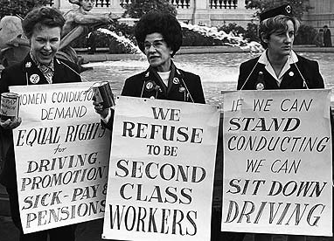
Women’s Rights Protestors

Slide 4
Women Equality and the Environment
The ERA gave women the ability to “get on with the work of being responsible citizens.”
Believed women were crucial to the protection of the environment for social and biological reasons.
Programmed to look at nature with more sympathetic eyes
Have the social values of caring and responsibility which needed to be fused into what were mainly male priorities and policies
Men view greater number of offspring as proof of their fertility
Overpopulation = world’s greatest menace
More people = more artificial to sustain

Slide 5
“Our Newest National Sugar Bowl”
Fidel Castro takes control of Cuba, causing nearly 200,000 to flee to U.S.
Sugar cane was the “ideal crop for Florida”
1960- Eisenhower imposed a Cold War embargo on sugar from Castro’s Cuba
Taxpayers shell out $78 million to cane growers
In ten years the 49,000 acres devoted to sugar rose to 321,000
U.S. Department of Agriculture lifts it’s acreage controls in 1960
Two decades later, the Everglades Agricultural Area was shipping $700 million in farm products; $600 million from sugar alone
Everglades Agricultural Area supplied 40% of all domestically grown sugar cane

Slide 6
Great Success!!!

Slide 7
Sugar Cane Workers
Two layers of clothing to protect themselves from razor-edged leaves
Aluminum guards to protect from swinging machetes
Labor recruiters assembled worker pools exceeding the number of needed workers by 30 or 40 percent in order to quickly replace the noncompliant.
Recruits were told transportation to U.S. would cost them nothing- was deducted from their pay and placed into an account which they would lose if they did not complete 50% of their contract
23% of each employees pay went into a forced savings account which employers could access when there was a dispute about worker debt
1970 Senate subcommittee report-
“Migrant camp is a microcosm of nearly every social ill, every injustice, and everything shameful in our society.”

Slide 8
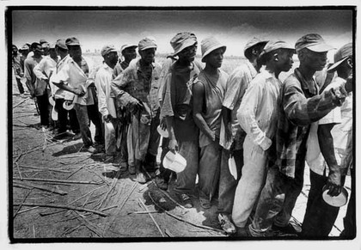

Slide 9
Douglas
Advocated for better migrant conditions
Gave speeches and wrote letters to important people saying that sugar cane should be grown in Puerto Rico, Haiti and other West Indian Islands (whose economy suffered) giving people work and allowing them to stay at home
In River of Grass she connects the conditions of the Everglades environment with the living conditions of the Everglades workers
Wrote of a malignant culture of greed that exploited humans as eagerly as it did nature

