Slide 1
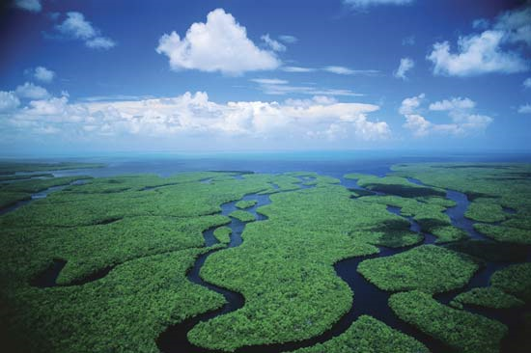
Chapter 32: Regionalism and Environmentalism
Mary Holt

Slide 2
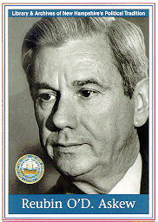
Governor Askew
Corporate income tax, moratorium on death penalty, racially integrate schools, blacks and women’s rights, & a prioritization of environmental protection
Pushed for a new environmental agency (EPA)
Relied on public
Richard Stone
Letter gone public
Conservationist of the Year

Slide 3
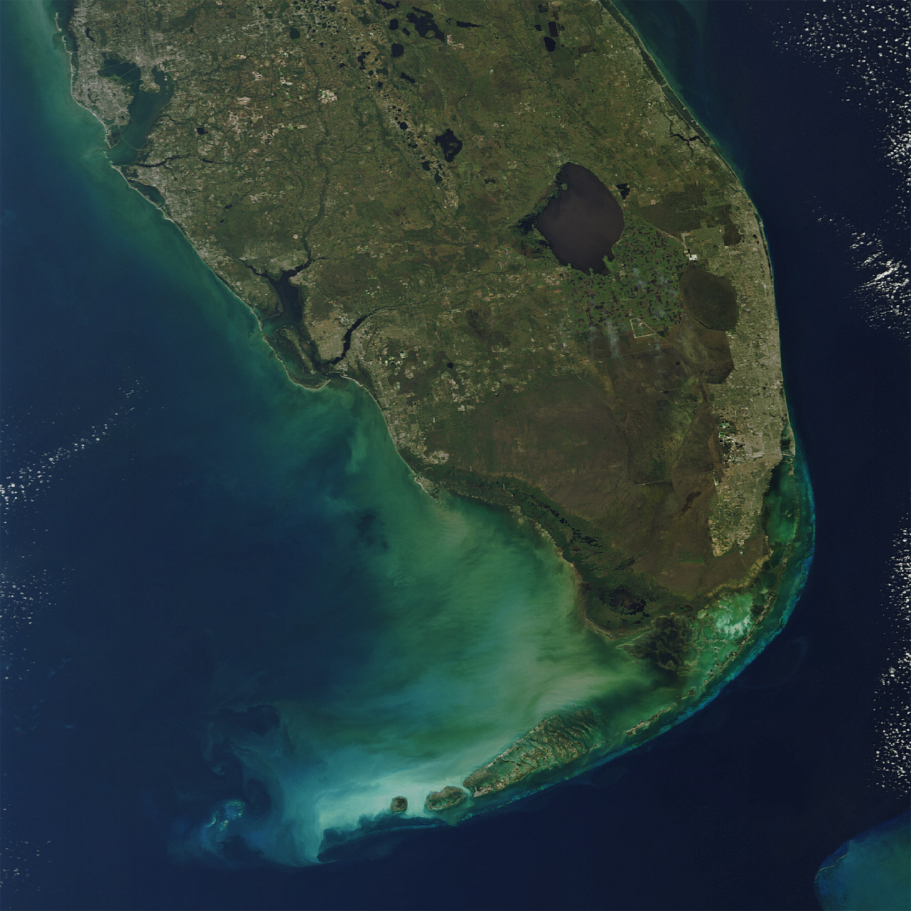
The Fall of Miami
Dade county urbanized more than 60%
Chloroform in the water
Drought in Miami
“One of the most important conferences in Florida”
Too much or too little water

Slide 4
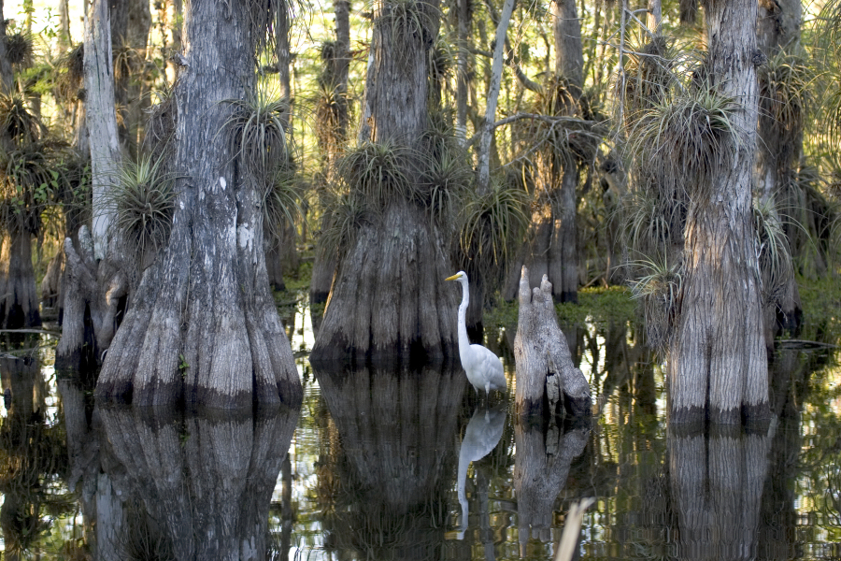
River of Grass
Areson – friend and activist
Recommended replacing Flood Control District with regional water-management district
Askew signed Florida Water Resources Act
The Everglades could never be whole again
Plume hunting era

Slide 5
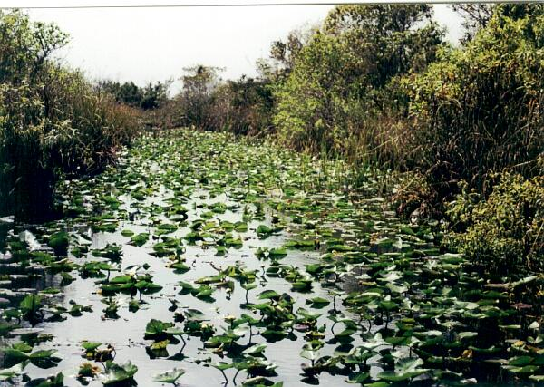
Shrinking Water Supply
Walt Disney World
49% of fresh surface water lost, 51% impaired
Developers making land from water
Illegal dredging projects
Tax on non-reusable containers

Slide 6
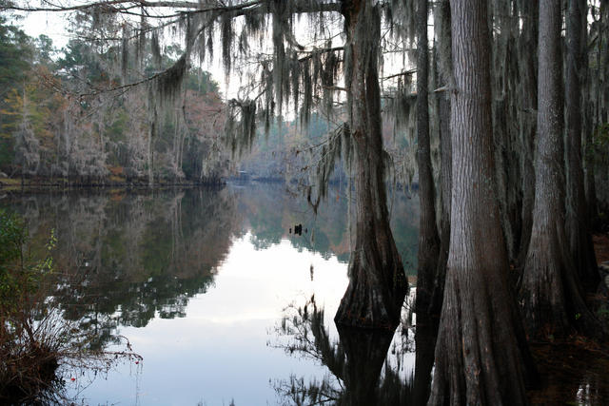
Earth Day!
April 22, 1970
Protests, Parades, Cleanup rallies, Tree-planting campaigns
Big Cypress Preserve – 25 hundred sq. miles of everglades
Golden Gate Estates grew on western area of preserve
Askew kept development off

Slide 7
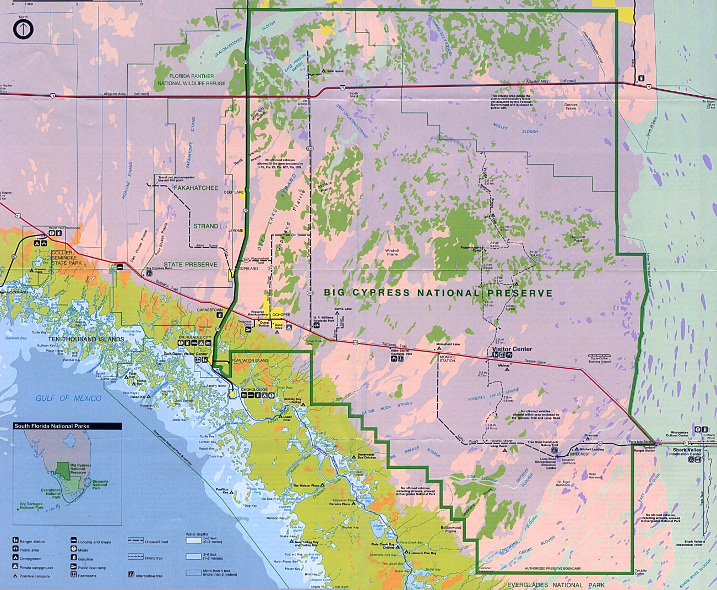
Land Sellers to Land Purchasers
Douglas went to Tallahassee to lobby for the bill- $40 million
Fire in Big Cypress resulted in $116.9 million
Largest private land purchase in National Park history
Indians, hunters, and oil companies could not be kept away

Slide 8
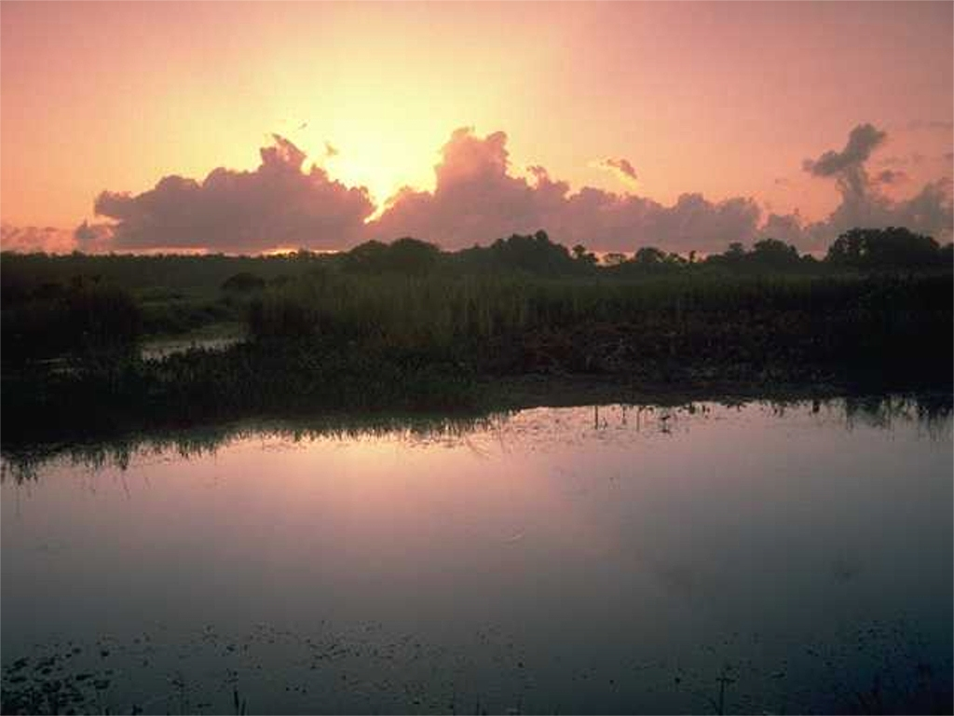
Douglas, Jones & Marshall
Douglas questioned Jones about hunting
Partnership strengthened by Art Marshall
Environmental problems of the everglades are no different that of urban area
Growth is not unlimited, “the more people there are, the more artificially we have to live to sustain life”

