Slide 1
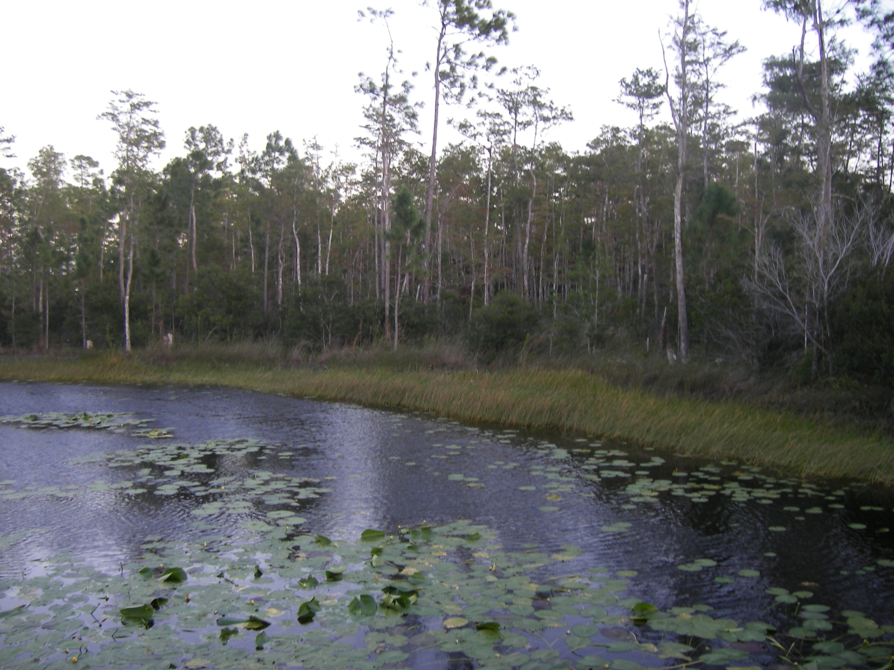
Pond Wetland/ Interior Wetland Boundary
Slash Pine
Bald Cypress
Wax Myrtle
Slash Pine
Rushes
Bald Cypress
Water Lilies
Wax Myrtle
Notes:
Start the slide show (“From Beginning” – upper right) and press space key to advance

Slide 2
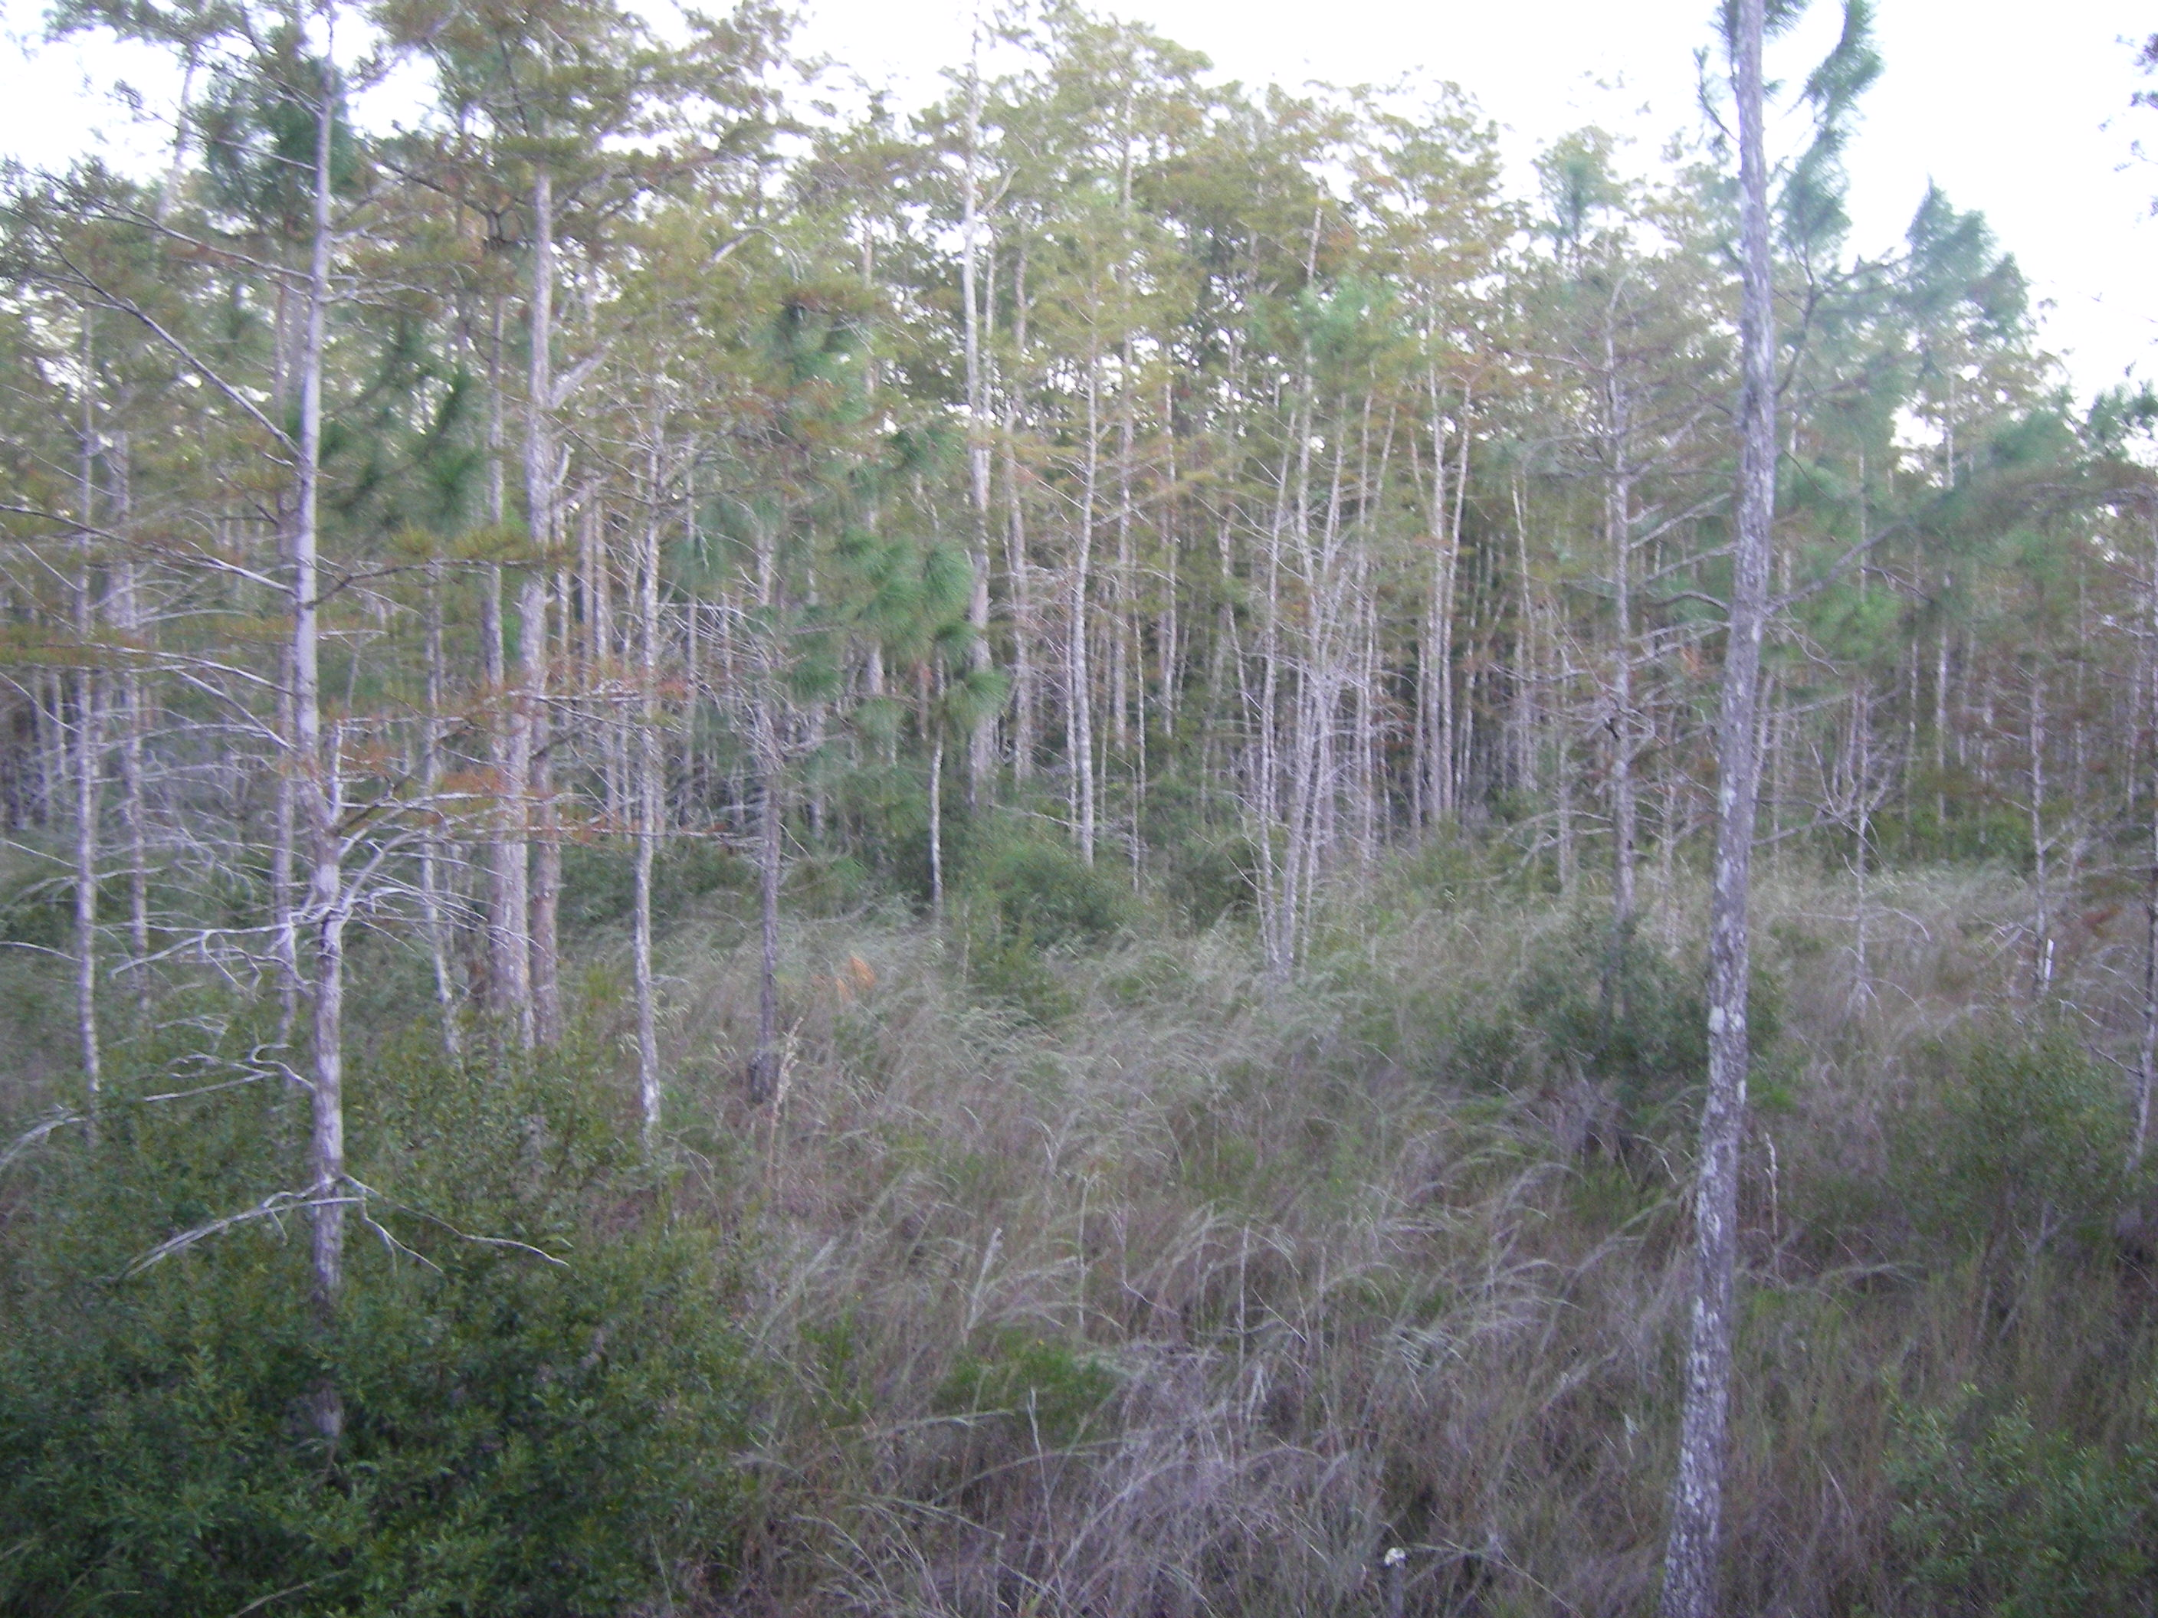
Prairie/ Cypress Dome Boundary
Bald Cypress
*note edge of cypress dome in
background
Slash Pine
St. John’s Wort
Wax Myrtle

Slide 3
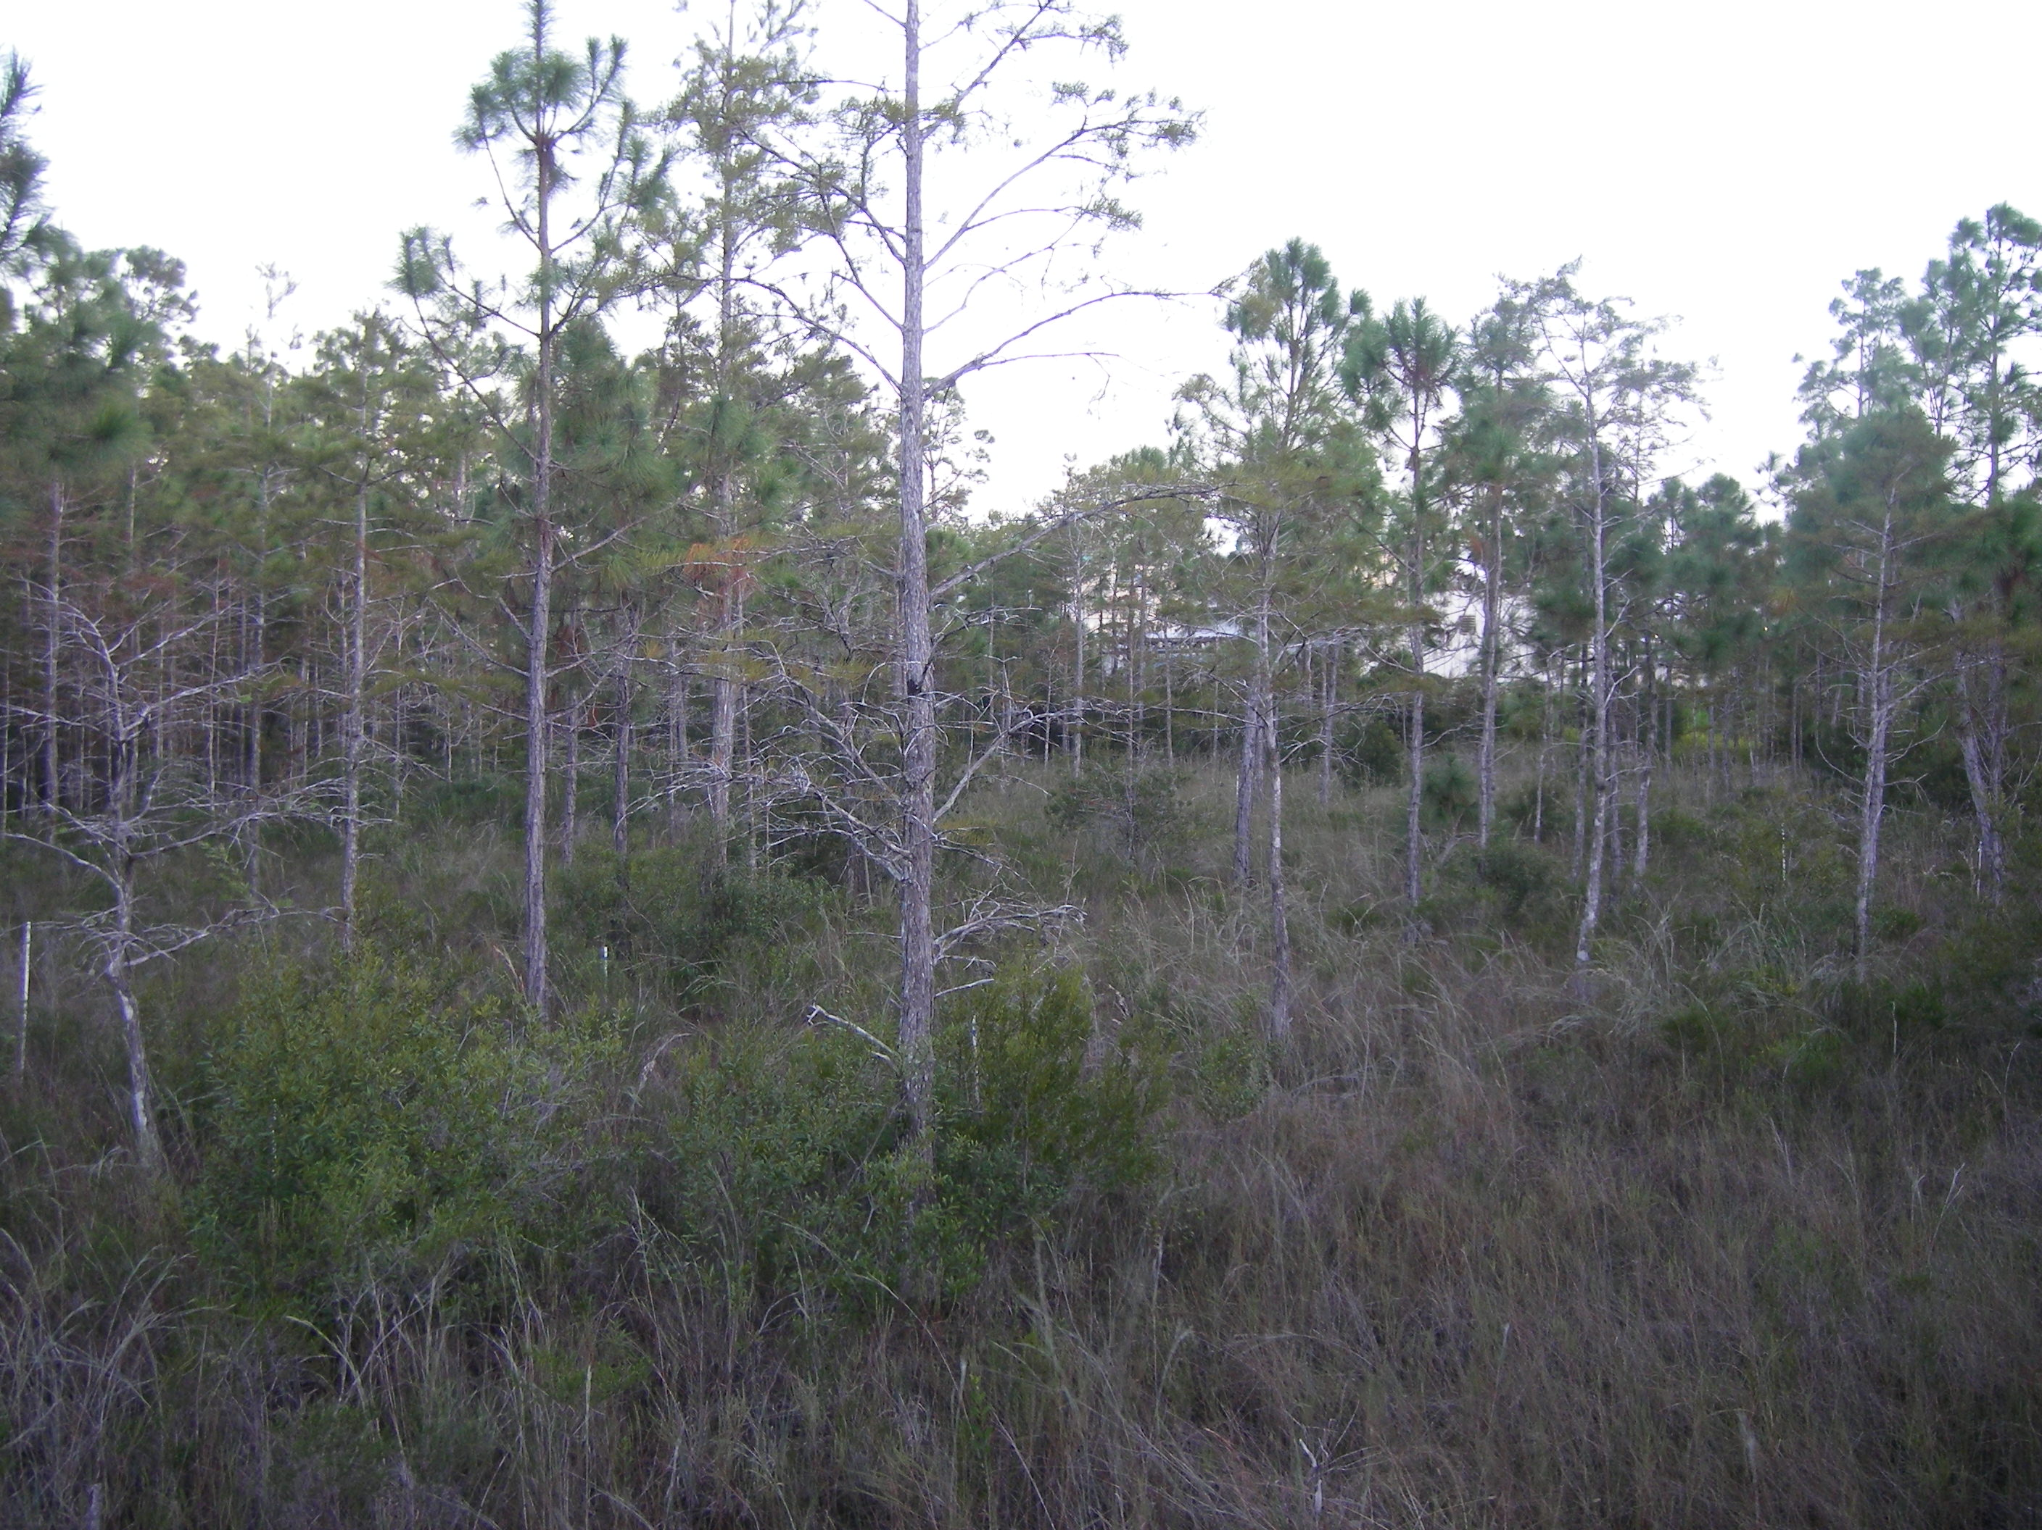
← Bald Cypress Dome
Slash Pine
Slash Pine Forest →
Slash Pine
Bald Cypress
Wax Myrtle
Grasses

Slide 4
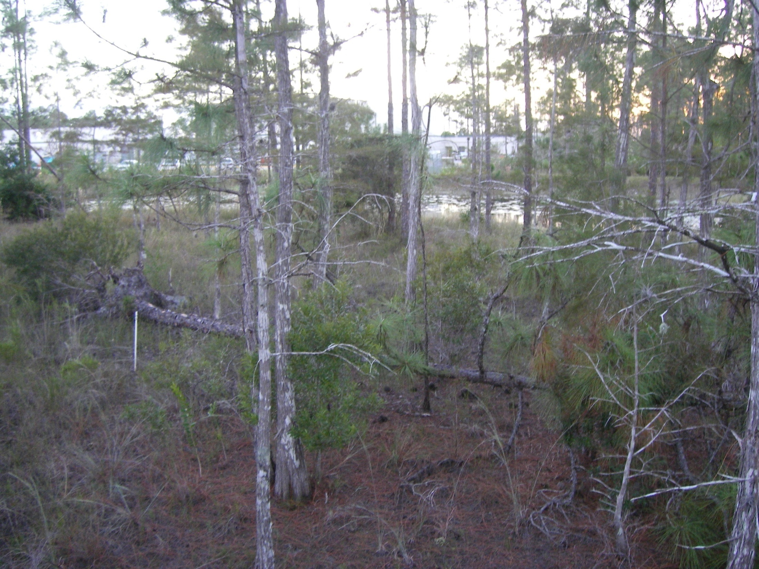
Mixed Pine/ Cypress System
Slash Pine
Slash Pine log
Wax Myrtle
Bald Cypress

Slide 5
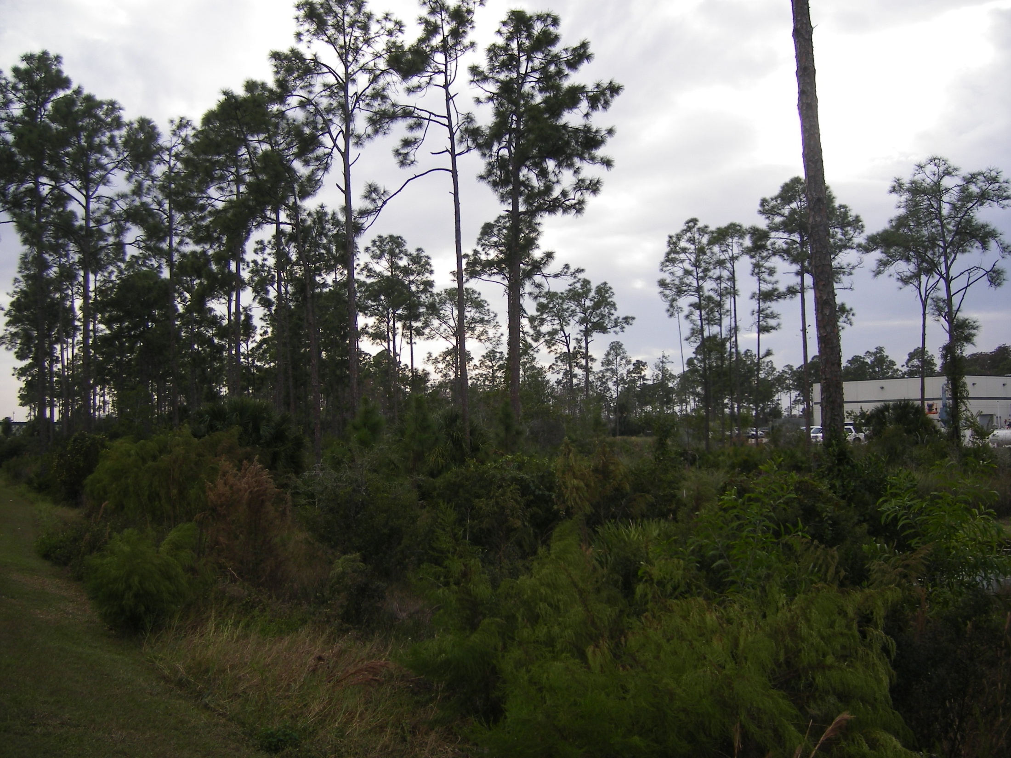
Pine Flatwoods
Slash Pine
Muscadine Grape covering wax myrtle
Wax Myrtle
Saw Palmetto
Dogfennel

