Slide 1
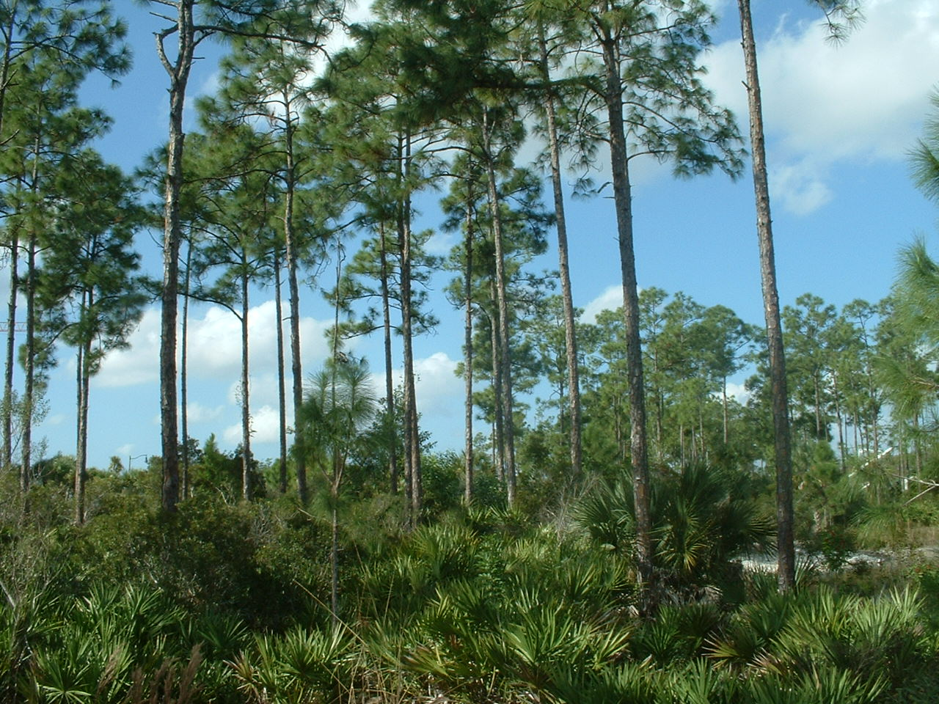
Pine Flatwoods
Slash Pines
Cabbage Palm
Saw Palmetto
Notes:
Start the slide show (“From Beginning” – upper right) and press space key to advance

Slide 2
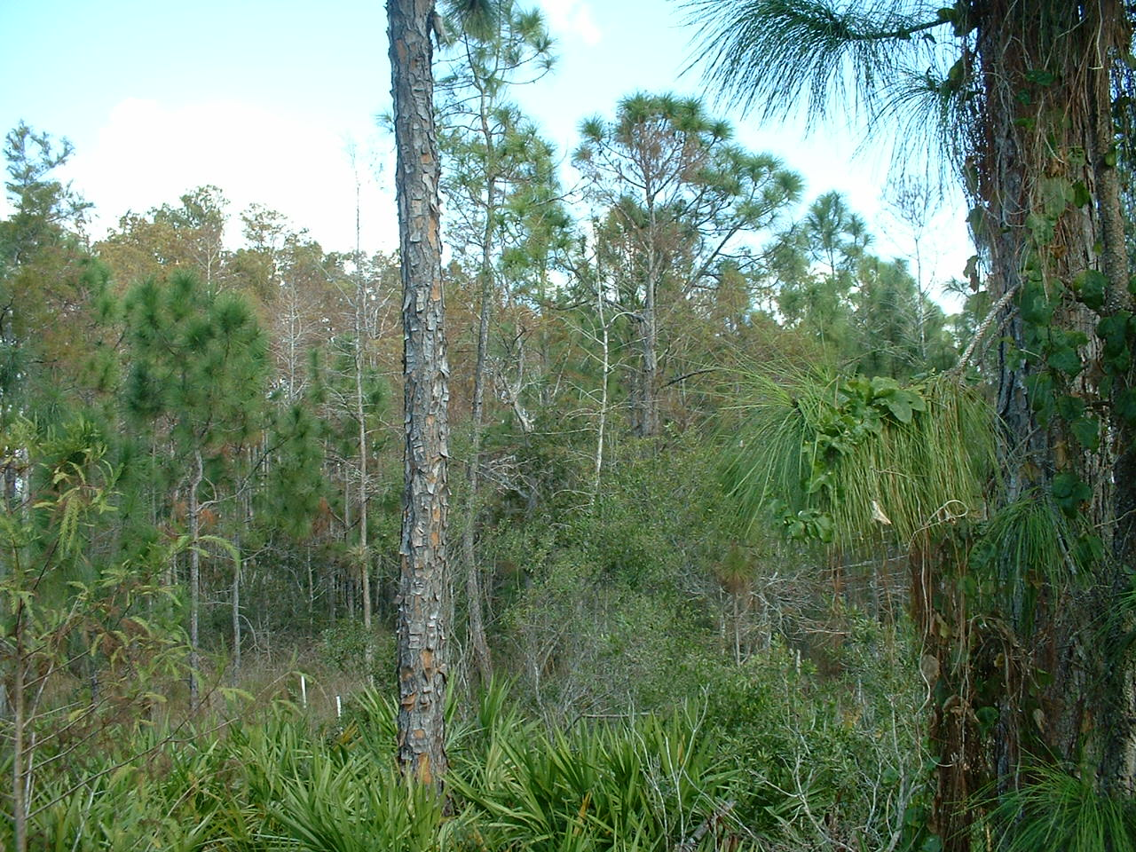
Cypress/ Pine Transition Zone
Bald Cypress
Slash Pine
Wax Myrtle
Saw Palmetto

Slide 3
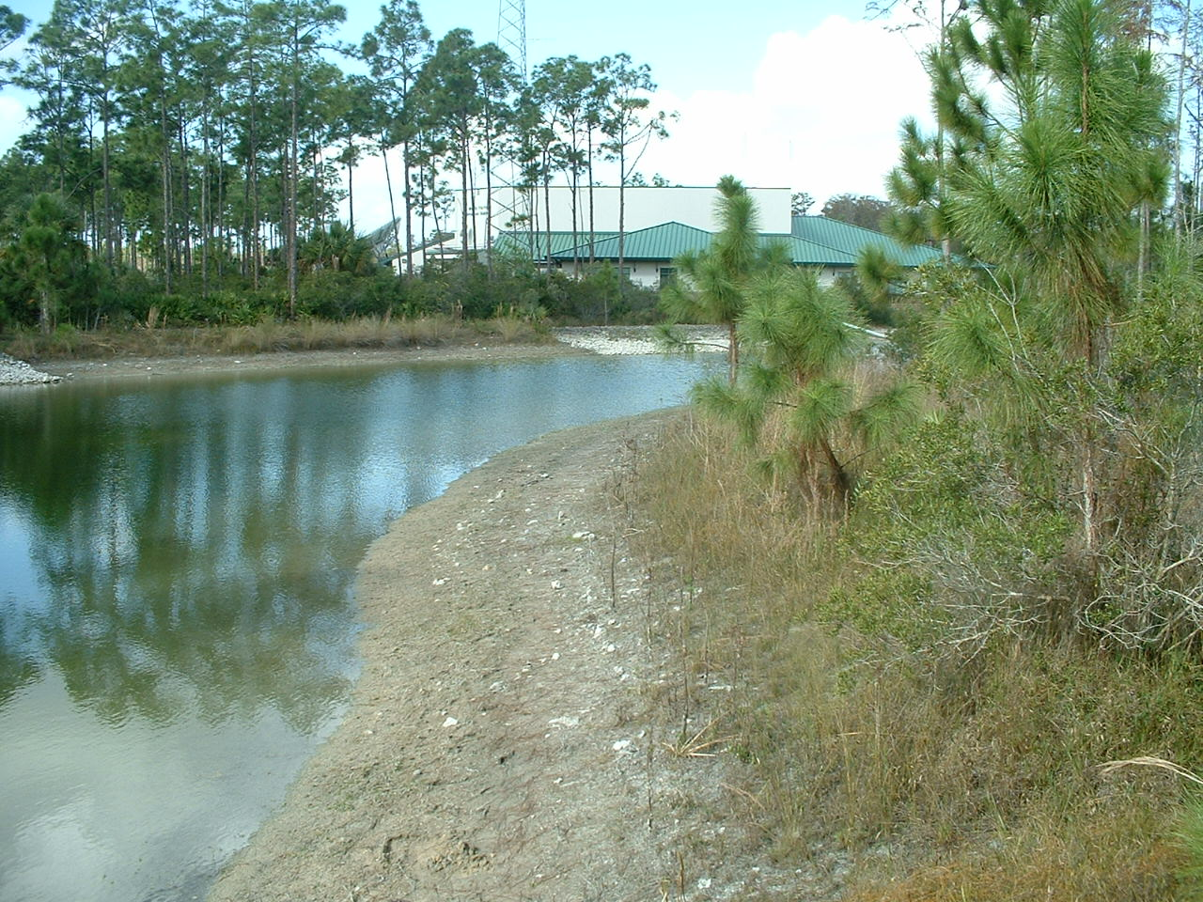
Forest/ Lakeshore Transition
Slash Pine
Wax Myrtle
Littoral Zone: exposed during dry periods, submerged during wet periods.

Slide 4
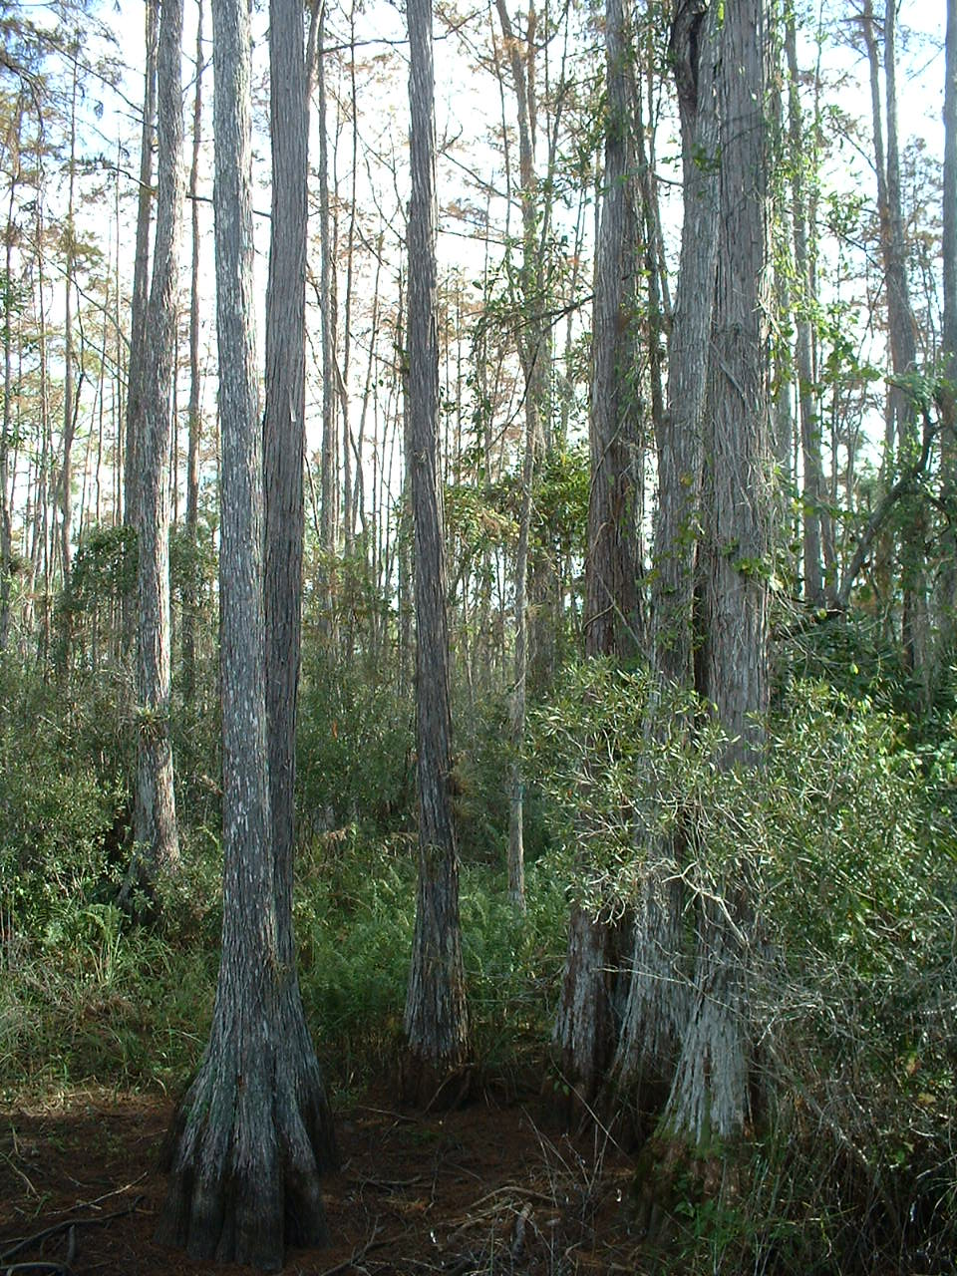
Bald Cypress Forest off of AB3- Parking Lot 3 Boardwalk
Bald Cypress
Wax Myrtle
Marsh Fern

Slide 5
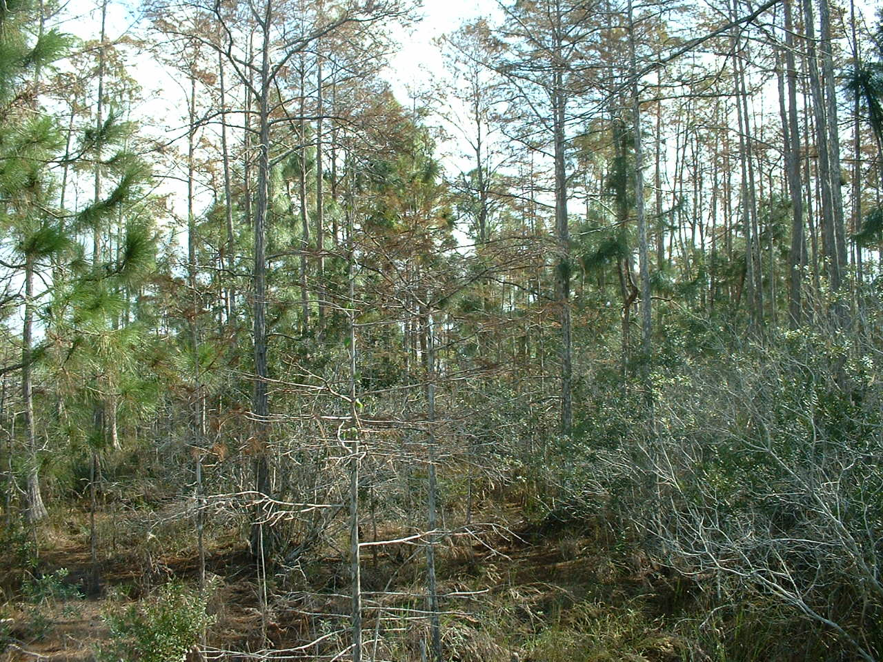
Cypress/ Pine Transition Zone
Bald Cypress
Slash Pine
Wax Myrtle

Slide 6
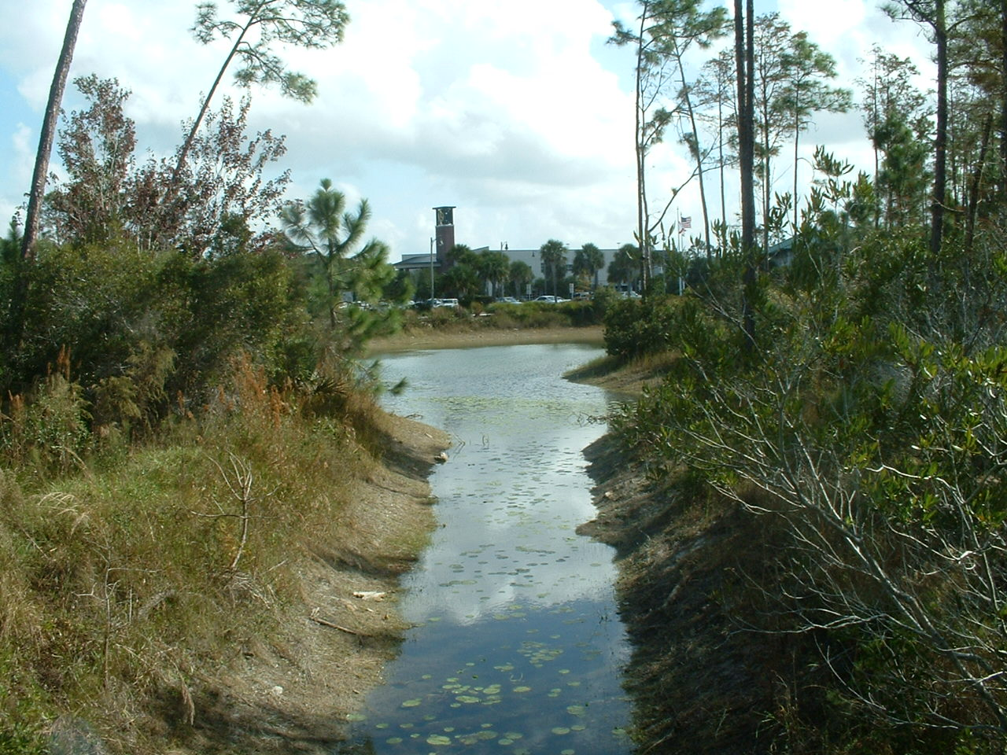
Artificial Pine/ Channel Transition Zone
Slash Pine
Wax Myrtle
Spatterdock

