Slide 1
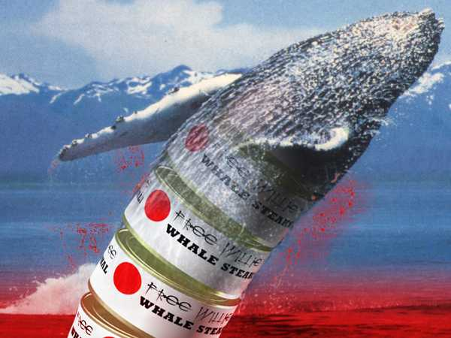
Free Mercury: Japan’s whaling trade promotes the consumption of toxic mercury levels.
Presenter: Erinn Campbell

Slide 2
A brief history of whaling
Earliest archaeological record of whaling found in South Korea dating back to 6,000 BC
Though 19th century whaling techniques improve
IWC established in 1946
Moratorium on whaling put into effect in 1986
Japan establishes scientific whale research programs beginning in 1987
Today the moratorium and Japan’s research continue however, there is talk of lifting the moratorium
Notes:
Carvings and drawings show that “stone age” people hunted whales using boats and spears
Exploding harpoons introduced, factory ships enable whale products to be processed at sea
Original duty was to regulate whale stocks throughout the world. Today (among other things) it protects specific species of whales, designate areas for whale sanctuaries, limits catch size and numbers of whales taken
The moratorium put a pause in commercial whaling because of drastically declining population numbers, initially to help replenish “stocks”. Because that the IWC is run by numerous anti-whaling countries, the moratorium has been upheld.
Purpose is to estimate whale stocks and population abundance, study reproductive data and general health, role of whales in ecosystem. To do this, whales are caught and killed then studied. Under IWC’s “no waste” rules the by-product (whale meat) is required to be processed, thus how it is sold in Japan.
Recent meetings in 2010 of the IWC have been toying with the idea to lift the moratorium and put strict limitations on whaling. No consensus was reached therefore it will be brought up in the meeting this year.

Slide 3
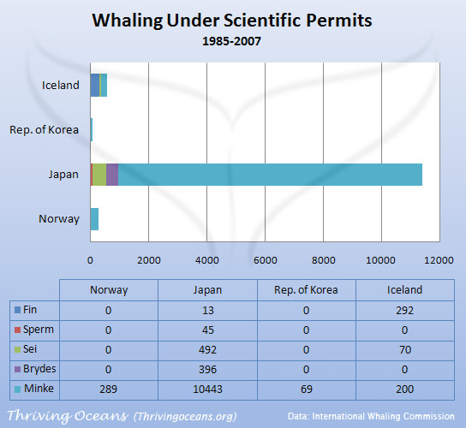
Japan’s “Research”
The IWC protects the ‘great whale’ species, mainly large baleen whales.
Scientific Permits override moratorium regulations.
Does not set regulations for smaller Cetaceans (i.e. dolphins, porpoises, pilot whale, and other lesser whales)
The halt in commercial whaling for larger whales has increased the demand and price of dolphin products to substitute whale products.
This is where the dangers of mercury come into play.
Notes:
-In response to the pause on commercial whaling Japan (and other nations) rely on special scientific permits which allow them to kill whales for scientific research. This right was established in Article VIII of the 1946 convention. The nation must submit the proposals for review by the convention, however the member nation ultimately decides whether or not to issue the permit. The permit overrides any Commission regulations including the moratorium and sanctuaries. Also under Article VIII, the animals must be utilized once the scientific data is collected. This is how the meat gets to the market.
- This is a problem because, toothed whale meat has highly concentrated amounts of methylmercury due to their place in the marine food chain.

Slide 4
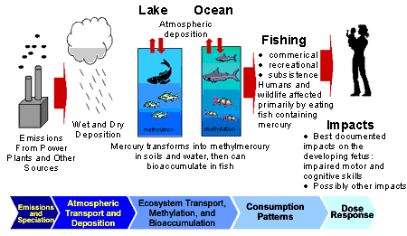
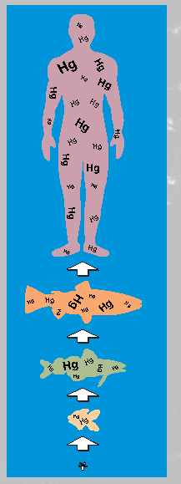
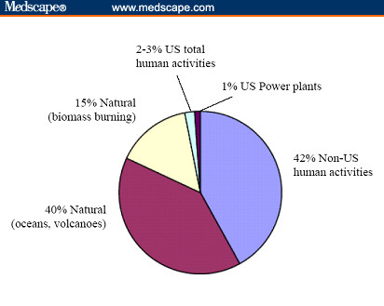
Methyl mercury in the environment
Mercury enters the atmosphere naturally and by human influences.
Enters the aquatic ecosystem through rainfall, then begins a complex cycle where it is converted into different forms.
Settles into sediments where bacteria convert the inorganic mercury into methyl mercury though metabolic processes.
Methyl mercury enters food chain via bacteria.
Through bioaccumulation and biomagnification, the threat and toxicity of methyl mercury increase rapidly.
Dolphins, porpoises, and small toothed whales have the highest concentrations of methyl mercury.
When humans consume the cetacean meat they consume the dangerous levels of methyl mercury as well.
Notes:
natural: mercury deposites/volcanoes, Human: coal combustion, waste incineration and metal processing.
Methyl mercury is significantly more toxic than inorganic mercury and harder to process once its inside the body.
It enters when the bacteria are consumed by higher-level food chain members, or when the bacteria release it directly into the water.
Bioaccumulation: the international union of pure and applied chemistry define bioaccumulation as the progressive increase in the amount of a substance in an organism which occurs because the rate of intake exceeds the organisms ability to remove the substance from the body.
Biomagnification: processes in an ecosystem by which higher concentrations of a particular chemical are reached in organisms higher up in the food chain.
Plankton eat the bacteria, little fish eat the plankton, larger fish eat the little fish, even larger predatory fish eat the large fish, and at the top of the food chain the dolphins, porpoises, and small toothed whales eat the predatory fish.
So through the predator prey relationships, the members that make up the top of the food-chain now have the highest concentrations of methyl mercury

Slide 5
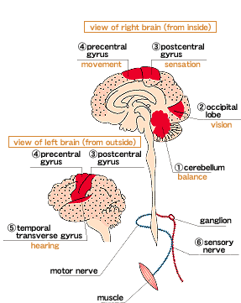
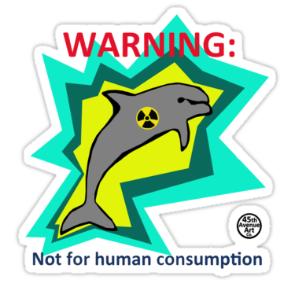
Methyl mercury poisoning
International Program of Chemical Safety lists methyl mercury as one of the six most dangerous chemicals in the world’s environment.
Methyl mercury can cause widespread brain lesions that result in permanent neurological disorders.
Symptoms and direct effects of these lesions:
Parasthesia
Ataxia
Neurasthesia
Vision and hearing loss
Tremors
Coma/death
Fetuses, infants, and young children are at the highest risk for methyl mercury poisoning due to brain growth and development.
Children in fish eating populations (for example, Japan) show deficits on neurobehavioral tests.
Particularly on tests of attention, motor function, language, visual-spatial abilities, and memory.
This is especially disturbing because Japanese schools have begun serving whale meat for lunch.
Notes:
If too much dolphin and whale meat is ingested methyl mercury…
Here is a diagram of the brain areas affected by methyl mercury.
Numbness/tingling in mouth and extremities. Stumbling gait/difficulty swallowing and talking. Sensations of fatigue and weakness/inability to concentrate. In the most severe cases coma and death can occur.
Birth defects from MeHg exposure: low birth weight, small head circumference, mental retardation, cerebral palsy, deafness, blindness and seizures.

Slide 6
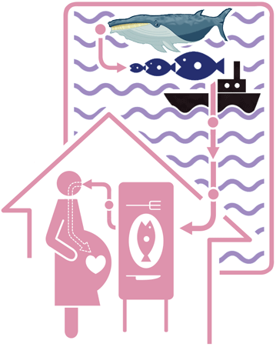
Government regulations and advisories
The U.S. Environmental Protection Agency acknowledges that 0.10 ug/kg/day is a safe level to consume.
The World Health Organization sets its intake at 1.6 ug/kg per week.
The Japanese Health Ministry has set its consumption limit to 2.0 ug/kg per week.
Japanese Health Ministry set maximum contamination levels of methyl mercury in seafood products at 0.3ug/g. Total mercury limit is 0.4ug/g.
Many cetacean products on the market exceed this limit.
These regulations are aimed towards people who eat seafood regularly, as well as pregnant women.
Fetal mercury levels are always much higher than their mothers. Low doses still very toxic.
Notes:
Ug: micrograms, kg: kiligrams of body weight per day

Slide 7
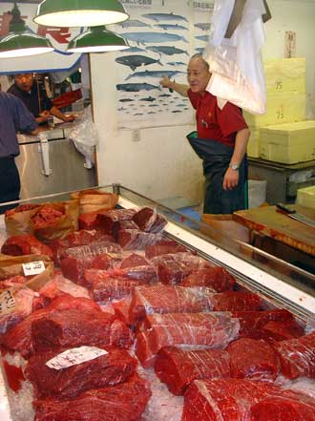
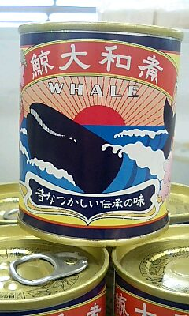
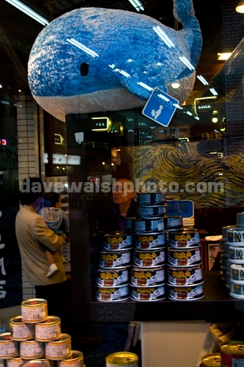
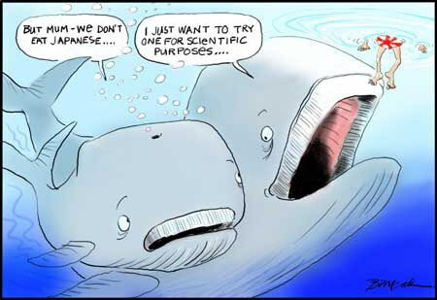
Cetacean in the market
2000-2002 professor Tetsyua Endo, of the Health Sciences University of Hakkaido, exposed the actual levels of mercury and methyl mercury in cetacean products on the market.
Purchased fresh and frozen products from vendors and processors, then analyzed mercury content.
Found that 137 of their meat samples exceeded the total mercury limit of 0.4ug/g set by the Japanese government.

Slide 8
Endo’s results for toothed cetaceans
TABLE 1. Total Mercury Concentrations in Red Meats
Originating from Odontocetea
species total mercury (no. of sample and range)
Dall’s porpoise 1.26 (n ) 17, 0.52-2.51)
Baird’s beaked whale 1.64 (n ) 60, 0.43-6.46)
pantropical spotted dolphin 4.72 (n ) 3, 4.28-5.02)
Risso’s dolphin 5.42 (n ) 15, 1.70-20.3)
rough-toothed dolphin 6.00 (n ) 2, 2.01, and 9.98)
pilot whale 7.59 (n ) 23, 1.33-23.1)
bottlenose dolphin 9.55 (n ) 9, 2.36-22.5)
striped dolphin 15.0 (n ) 5, 1.04-63.4)
false killer whale 46.9 (n ) 3, 27.3-81.0)
*Mean ( SD of total mercury (ug/wet g).
Notes:
Odontocetea= toothed whale species. The table shows that every sample that Endo took from the market had surpassed the total mercury concentration limit of 0.4 ug/g.

Slide 9
Endo’s results for baleen whales
TABLE 2. Total Mercury Concentrations in Red Meats
Originating from Mystecete
Species total mercury (no. of sample and range)
Southern Minke whale 0.03 (n ) 22, 0.01-0.08)
North Pacific Minke
whale 0.10 (n ) 13, 0.01-0.54)
North Pacific Minke
whale (J) 0.09 (n ) 10, 0.05-0.14)
Bryde’s whale 0.08 (n ) 10, 0.03-0.22)
fin whale 0.07 (n ) 6, 0.03-0.22)
sei whale 0.02 (n ) 2, 0.01, and 0.03)
*Mean ( SD of total mercury (ug/wet g).
Notes:
The Mystecete samples did not exceed the 0.4ug/g limit because baleen whales do not eat fish, they eat krill so their mercury intake is much smaller.
They also stated that the samples of fin ans sei whales could have been supplied by stranding, long time stock or illegal sources.

Slide 10
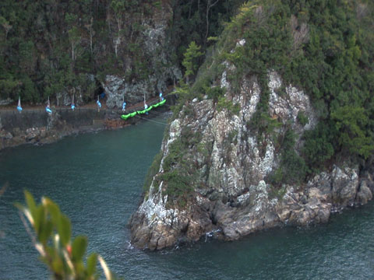
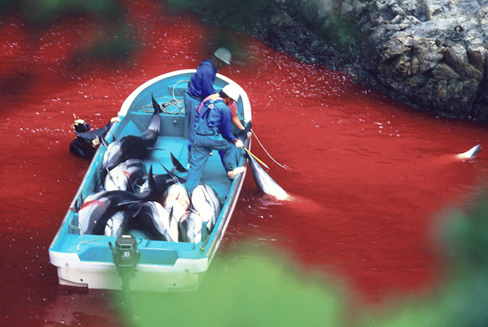
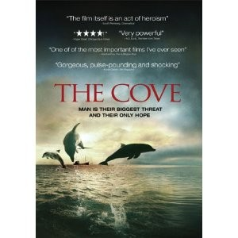
Endo’s second study
In 2007-2008 Endo focused on the mercury levels in the people of Taiji, Japan.
Endo took hair samples from 30 men and 20 women residents and tested mercury levels.
Revealed an average of 21.6 ppm in men, and 11.9 ppm in women.
Ten times the national average .
Three subjects had levels of 50+ ppm, at this level nerve damage is likely.
Symptoms of methyl mercury poisoning could appear.
Notes:
Taiji is a fishing village that has deep cultural roots in the hunting of dolphins and whales, so it is eaten often.
by banging metal pipes in the water they confuse the dolphins and corral them into the cove, then spear them and collect them.
His findings revealed an average of 21.6 ppm for men and 11.9 ppm for women. Both of these are about ten times the national average mercury levels in Japan.
Three subjects had 50+ ppm levels. At this level nerve damage is likely and symptoms of methyl mercury poisoning could appear.

Slide 11
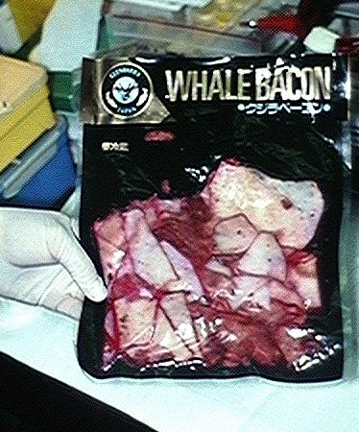
Ethics and Mislabeled packaging
2002 law required seafood products to be labeled with species name however, Naoko Funahashi Japan’s representative for the International Fund for Animal Welfare, says that many products sold lack specie name, or are mislabeled altogether.
The Environmental Investigation Agency used DNA testing to confirm false labeling in 2001.
The Japanese government also did a similar study testing 980 products from retail outlets across Japan.
24% were correctly labeled, and 90 of the products were mislabeled.
Notes:
They purchased 17 “whale” products from supermarkets in Japan, then DNA tested them. Of the 17, 5 were correctly labeled. The remaining 12 were either Dall’s porpoise, pilot whale, or bottlenose dolphin.
dolphin meat was being sold as Minke whale.

Slide 12
Ethics and Mislabeled packaging
Japanese government and health advisories have done little to warn people of mercury danger. Most advisories issued are directed towards pregnant women.
“Wall of silence” in Taiji.
Two councilmen tried to raise the mercury issue but efforts were stifled.
In response they printed fliers and sent them to town residents
One resident responded, “the flier is all I know about the mercury issue” and was concerned for her child who eats pilot whale in school.
Food Sanitation Law of Japan
(Law no.233, December 24, 1947, last amended
December 2002)
Article 12
“No person shall falsely declare or exaggeratedly
label or advertise any food, additive, apparatus, or
container/package in a manner which may injure
public health.”
Notes:
Residents in Taiji have claimed that the government and media have ignored the mercury problem and say there is a wall of silence.
two councilmen tried to raise mercury issue but said the media did not write about their warnings and that city hall said little to the public.
Printed 1,900 fliers concerning the mercury issue and sent them to town residents, many of whom were alarmed and outraged after reading them.

Slide 13
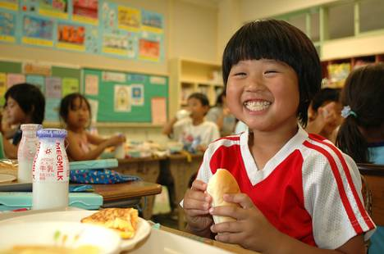
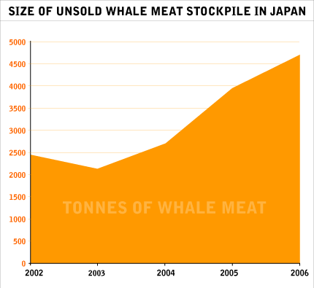
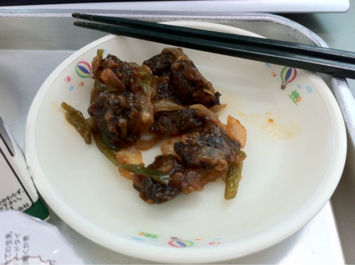
The push to eat more whale
Whale stocks are higher than ever before due to less people eating whale meat.
280 schools have added whale to lunch menus.
Fry the meat, or mince it into burgers.
Government does not want the severity of mercury’s danger brought to the publics attention.
Fisheries Agency fears if the ban on whaling is made permanent activists will turn to restricting other species like tuna. Many will lose jobs.
Notes:
Try to make it more appetizing by frying it or mincing I into burgers
Whaling may cease altogether

Slide 14
Conclusion and further implications
Danger in cetacean meat is real and can impair the human brain.
Although there are limits on mercury contamination, many products exceed those limits.
Japanese government does not address the issue.
Serve whale meat to the most susceptible age group to mercury poisoning.
Whale meat could be taken off shelves because of less demand.
Action needs to be taken to inform the Japanese public of the danger.
Notes:
The danger in cetacean meat is very real and has been recognized to have mercury levels that could impair the human brain. Although the Japanese health organizations have put limits on the amount of mercury allowed in packaged seafood products, multiple studies (including ones done by Japanese officials) have shown that a vast majority of cetacean products drastically exceed these limits. Instead of making this danger known, the Japanese government conceals the threat by not addressing it in the media, not informing the public by issuing warnings, mislabeling products, and actually pushing for whale meat to be served to children, one of the most susceptible ages to mercury contamination.
Many people believe that because whale meat is losing its popularity that it will soon cease selling altogether. However, if the government is allowed to push its exploitation there is no telling how its people will be affected. More action must be taken to inform the Japanese public of the dangers if mercury and methyl mercury that lurk in their supermarkets.

Slide 15
Sources
Kabbenhoft, D. Ricket, D. 2009. Mercury Contamination of Aquatic Ecosystems. U.S. Geological Survey fact sheet. Version 1.0.
U.S. Department of Interior. U.S. Geological Survey. Toxic Substances Hydrology Program. Modified September 2008
Johnston, E. 2009. Mercury danger in dolphin meat. The Japan Times. Retrieved online.
International Whaling Commission .The Convention. Article 8. Last updated 2008. Retrieved from iwcoffice.org.
Bass, C. 2005. Japan’s Dall’s porpoise hunt: A quarter of a century as the largest cetacean kill in the world. Environmental Investigation Agency.
Endo ,T. Hataguchi, H. Hisamichi, Y. Lavery, M. Dalebout, M, Baker, S. 2005. Total Mercury, methylmercury, and Selenium Levels in the Red Meat of Small Cetaceans Sold for Human Consumption in Japan. Environmental Science and Technology. 39:5703-5708.

Slide 16
Perry, C. Stickland, M. Paun, A. Mercury Rising: The sale of polluted wahle, dolphins and porpoise meat in Japan. Environmental Investigation Agency.
Gilbert, S. Grant-Webster, K. 1995. Neurobehavioral Effects of Developmental Methyl mercury Exposure. School of Public Health and Community medicine, Department of Environmental Health, University of Washington, Seattle, Washington. 135-140.
U.S. Department of Health and Human Services. U.S. Food and Drug Administration. “Mercury levels in Commercial fish and shellfish”. Updated November 2009.
Endo, T. Hotta, H. Sakata, M. 2003. Mercury contamination in the Red Meat of Whales and Dolphins marketed for Human Consumption in Japan. Environmental Science and Technology. 37: 2681-2685.
Graham, S. 2003. Packaged Whale Meat in Japan Contain High Levels of Mercury. Scientific American.

Slide 17
Gales, N. Kasuya, T. Clapham, P. Brownell, R. 2005. Japan’s whaling plan under scrutiny. Nature. 435: 7044.
Fackler, M. 2008. Mercury Taint Divides a Japanese Whaling Town. The New York Times. Published February 21, 2008.

