Slide 1
We are Not Ready for Google Glass
By: Justin Kline

Slide 2
What the heck is Google Glass?
Smartphone technology for your face!
Surf the Internet, read emails, receive messages, place and receive calls, capture video, take photos, set reminders… You name it, Glass does it
Sleek design: thin frame, slim battery pack/touchpad on right side, one small interface lens where everything shows up
Two ways to control it: touchpad on the side, or head movements
(Pogue, 2012)

Slide 3
Picture something like this:
http://www.youtube.com/watch?v=9c6W4CCU9M4

Slide 4
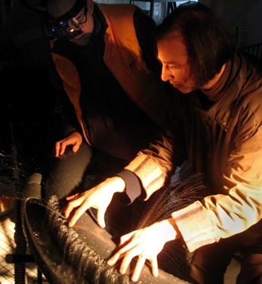
So, is this a completely new concept? NO!
Dr. Steve Mann
Pioneer of “wearable computing”
Began working on the technology in the 1970’s, started wearing the gear around full-time, and continually upgraded everything
Currently wears “EyeTap” technology that allows him to take pictures, record videos, and “replace” everyday objects with other things of his choosing (Schechter, 2001).
So influential that Google hired some of his researchers to help with Glass (Ante, 2012).
(Zen, 2008)

Slide 5
What can we expect?
Pricing comparable to that of most high-end smartphones
Extremely high demand
Rising stock for Google
The beginning of a new wave of technology
And…

Slide 6
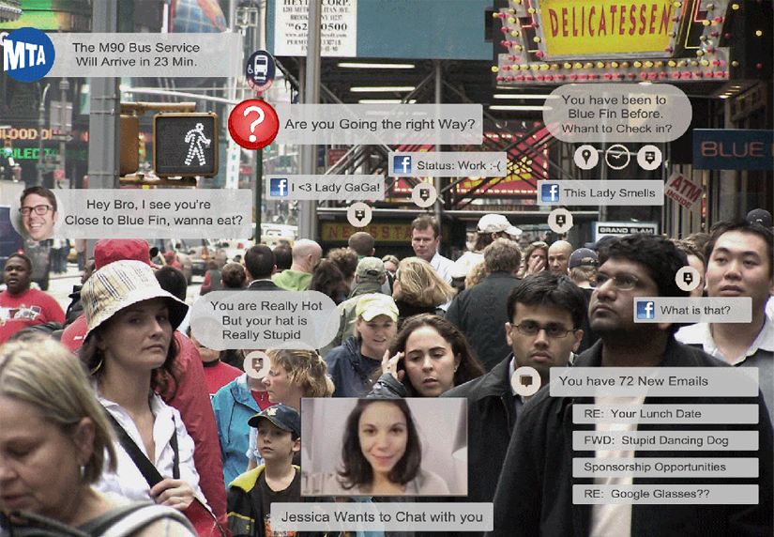
DISTRACTIONS!
http://www.youtube.com/watch?v=Ma8NbpCvSwo

Slide 7
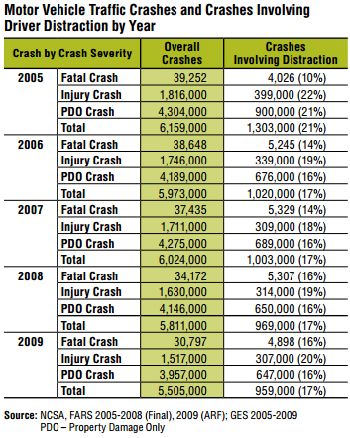
Distracted driving is real, and it’s not good
17% of the 5,505,000 car crashes in 2009 were caused by distracted driving.
That’s 959,000, which is a lot. (NHTSA, 2010)

Slide 8
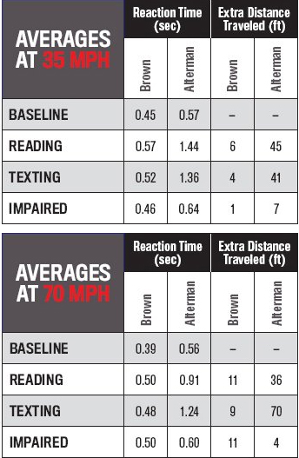
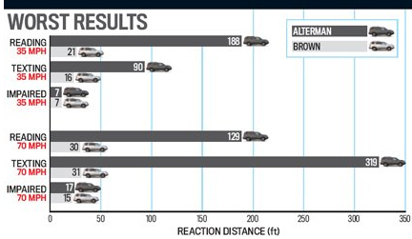
How do distractions affect one’s driving? Here are two examples: (Austin, 2009)
Car and Driver, a popular automotive magazine, conducted this experiment in 2009. These are the results that their testing yielded.

Slide 9
Could Google Glass affect my driving ability?
POSSIBLY!
Spencer E. Ante, of the Wall Street Journal, has said that seeing the information pop up on the interface in front of his right eye was “a little disorienting”, and he kept shutting his left eye to counter that effect (2012).
Would you want to drive with just one eye? At least you can put the smartphone away easily!

Slide 10
Politically and legally speaking – who cares?
Distracted driving is not illegal in all 50 states – only some.
Connecticut – first state to ban the use of mobile phones while operating a motor vehicle (Connecticut General Statutes, 2006).
New York - drivers must use a hands-free device to talk on cell phones after receiving calls, and that they are not allowed to send text messages or use their phone for anything similar while they are driving. Penalties: $150 fine and two points on the driver’s license. Over 20,000 tickets were issued between July 12, 2011 and July 12, 2012 (Hands Free Info, 2012).
On the flip side…
Florida – absolutely no laws against using a phone in any way while driving (Hands Free Info, 2012). Talks of creating legislation seem to be stagnant right now.

Slide 11
Economically speaking – what’s important to know?
Stepping into the smartphone game will only further Google’s reputation as a business juggernaut, as they stand to make a killing by selling the Glass. How much did they make in 2010 (before taxes, etc.)?
Or, enough to build 29 Taj Mahals. It’s not unreasonable to think that Google could make enough profit to build one or two of their own if/when Glass sells big. At the same cost as an iPhone, it won’t be very hard for people to get their hands on these things. But, will they sell?
OF COURSE THEY WILL!

Slide 12
That’s our culture!
Everyone wants the newest, fanciest, shiniest technology out there, and something like Glass has never been commercially available.
Glass will be the beginning of the next big wave of technology.
Brand recognition
Social stigma
Convenience

Slide 13
Is it ethical to launch a product that could be this dangerous?
In my opinion, NO!
Which brings me to my stance:
Google Glass should not be made available to the public with its built-in smartphone technology. It will be abused in the same way that smartphones currently are.

Slide 14
When will we be ready for Google Glass?
In the future, when technology bestows self-driving cars upon us.
But some cars can park themselves now, so we’re on our way there!
What could Google do now, if they must release something?
Turn Glass into the world’s coolest camera!
Set picture timers
Single shot with a press of the touchpad
Link up with user’s smartphone and Google account via cloud computing technology

Slide 15
Works Cited
Ante, S. (2012, September 11). Hype and hope: Test driving Google's new glasses. Retrieved October 15, 2012 from http://online.wsj.com/article/SB10000872396390443779404577643981045121516.html
Austin, M. Texting While Driving: How Dangerous is it? Car and Driver. (June 2009). Retrieved September 17, 2012 from http://www.caranddriver.com/features/texting-while-driving-how-dangerous-is-it
Connecticut General Statutes. (2006). Chapter 248, Section 14-296aa. Retrieved September 26, 2012 from http://www.cga.ct.gov/2011/pub/chap248.htm#Sec14-296aa.htm
Florida: Cell phone laws, legislation. (June 8, 2012). Retrieved September 17, 2012 from http://handsfreeinfo.com/florida-cell-phones-texting-laws-hands-free-info
New York: Cell phone laws, legislation. (August 23, 2012). Retrieved September 17, 2012 from http://handsfreeinfo.com/new-york-cell-phones-texting-laws-hands-free-info
Meyers, P. (2011, June 29). How much does Google make? Retrieved October 8, 2012 from http://www.seomoz.org/blog/how-much-does-google-make
U.S. Department of Transportation National Highway Traffic Safety Administration. (September 2010). Distracted Driving 2009. Retrieved October 17, 2012 from http://www-nrd.nhtsa.dot.gov/Pubs/811379.pdf
Pogue, D. (2012, September 13). Google Glass and the future of technology. Retrieved September 17, 2012 from http://pogue.blogs.nytimes.com/2012/09/13/google-glass-and-the-future-of-technology/
Schechter, B. Scientist at work: Steve Mann; Real-life cyborg challenges reality with technology. The New York Times. (2001, September 25). Retrieved September 26, 2012 from http://www.nytimes.com/2001/09/25/science/scientist-at-work-steve-mann-real-life-cyborg-challenges-reality-with-technology.html
Dan Zen. Dan Zen & Steve Mann at Hydraulophone. (2008, February 8). Retrieved September 26, 2012 from http://www.fotopedia.com/items/flickr-2314156634

