Slide 1
Science and Technology Presentation Ethanol
Garrett Farmer

Slide 2
Ethanol Stance
Ethanol has negative effects on engines both on land and marine motors and non-ethanol added fuel should still be available for purchase at regular fueling stations.

Slide 3
Science
Ethanol
Burning of fuel from spark ignition
Biotic plants used as fuel
Combustion
Atmospheric emissions

Slide 4
Ethanol
Ethanol is a alcohol based fuel made by fermenting and distilling starch crops such as corn. Ethanol can also be made from cellulosic biomass found in trees and grasses.
E10 also called gasohol is a blend of 90% gasoline and 10% ethanol
E85 is a blend of 85% ethanol and 15% gasoline.
(Energy)

Slide 5
Combustion
This is the burning of fuel from a chemical reaction between a fuel source and oxygen releasing heat.
The process that moves us.

Slide 6
Technology
Biofuels
Engines and parts

Slide 7
Internal Combustion Engine
Any engine that operates by burning its fuel inside the engine.
Common fuels include gasoline, diesel, hydrogen, methane, propane and others.
Engines typically run on one fuel type and require adjustment to run on other fuels.
Process:
Mix of gasoline and air sprayed into cylinder
Compressed by piston at optimal point
Spark plug ignites the fuel
Heat generated
Hot gases and high pressure then drive the piston back down
Repeated
(About.com)

Slide 8
Early Engines and Fuels
1860 Ottocycle First prototype engine ran on straight ethanol. (ICM)
1907 Cheap fossil fuels found ethanol then went to the side because of higher cost. (ICM)
1908 Henry Ford developed his model T which could run on flex fuel or ethanol. (Keeney, 2011)
If we kept using ethanol from the start the technology may have developed over time to handle the ethanol with less damage

Slide 9
Using ethanol and its Effects
Temperatures
Price
Damage Cost
Fuel Mileage
Corn Production
Availability
Environment Emissions
Future Implications

Slide 10
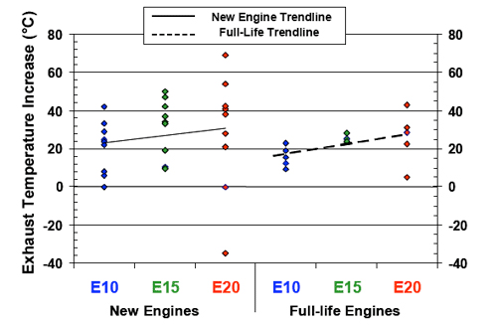
Higher Temperatures
Higher running temperatures lead to possibility of damage and running hot for both car and boat engines. The hotter the engines run they run the risk of overheating leading to engine failure.
(Naidenko, 2009)

Slide 11
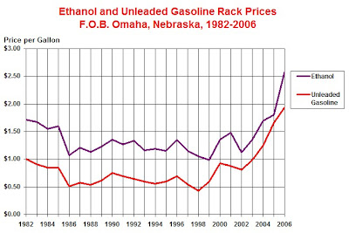
Price
The cost of regular unleaded fuel has always been lower then the cost of ethanol as shown in the graph.
Being as the ethanol also has lower mpg we have to burn more fuel to go the same distance as regular non ethanol fuel. (Papier, 2007)

Slide 12
Damage cost
Hoses
Clogs engine filters
Stalling
Overheating
Contamination
All these lead to repair cost

Slide 13
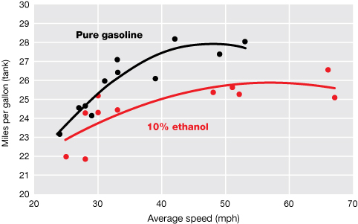
Fuel Mileage
The graph shows how pure gasoline gets better mpg over gasoline with 10% ethanol at the more common slower drive speeds. (Wertheimer, 2009)

Slide 14
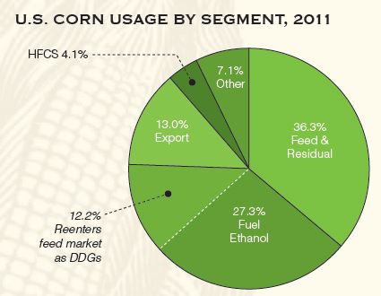
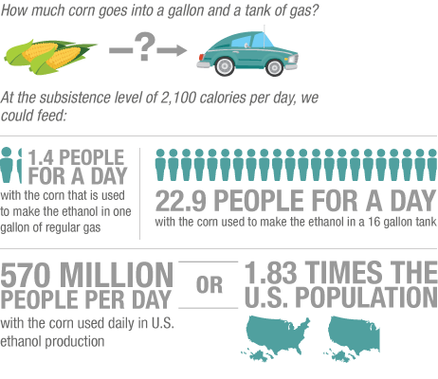
Corn production
Instead of using corn for food purposes we are using for fuel. We could be feeding millions of people with the amount of corn used daily. (Jessen, 2012), (Future)

Slide 15
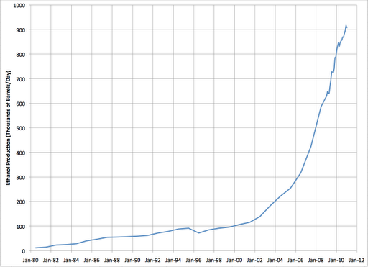
Ethanol Being Produced
Ethanol amounts being produced is growing at a rapid rate. (Us Ethanol Production, 2011)

Slide 16
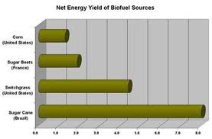
Biofuels
The use of more renewable biofuels is what is being worked toward in the future. The graph shows the net energy yield of a few biofuel sources and corn is the least shown. If we are moving toward biofuels why are we not using sugar cane instead? (Biopact, 2007)

Slide 17
Currently 10%
There are moves being made to make 15% and 20% ethanol added gasoline.
Automakers and Boaters are against the idea.
Many lawsuits and court cases.

Slide 18
Environment
Ethanol being burned leads to new and high amounts of emissions.
When we consider the total greenhouse gas emissions from growing and processing the ethanol emissions are not less.
We also can consider that as demand grows for corn we will be clearing farmland which may be forest and other natural environments we need for carbon sinks. (American)

Slide 19
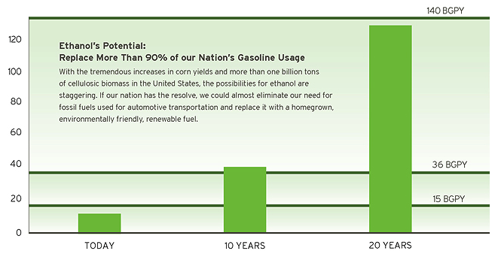
Future
The future is to continue to replace more then 90% of our nations gasoline usage in the next 20 years. Our engines will then have to be replaced or completely overhauled which is not cost efficient.

Slide 20
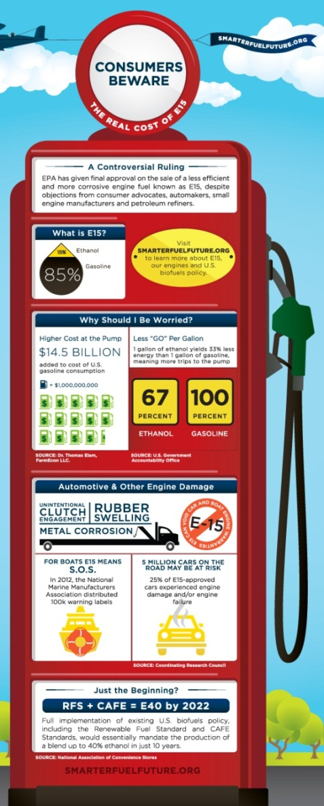
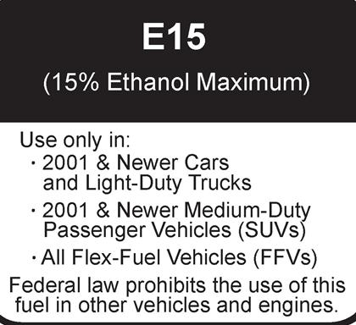
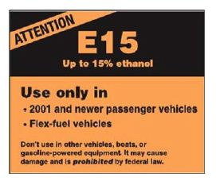
Warning Labels
(Future)
(Future)
(Healey, 2011)

Slide 21
Non-Ethanol Fuel Availability
Very fuel regular gas stations only 1 that I know of in South Florida
Marinas
Not easily accessible for recreational vehicles both land and on water.

Slide 22
What can we do?
Ethanol enzyme treatments
Run higher octane fuel like premium
Frequent maintenance and checks of engine parts
When available use non-ethanol fuel

Slide 23
Solutions
Make the non-ethanol fuel available by choice at regular gas stations
Develop a cost effective program for consumers to switch engines to newer engines being made to handle the ethanol
Get rid of ethanol fuels all together

Slide 24
Bibliography
About.com. The History of Engines- How Engines Work Part 3 Understanding the Internal Combustion Engine. http://inventors.about.com.library/inventors/blinternalcombustion.htm.
Energy, U. D. Energy Efficiency and Renewable Energy. http://www.fueleconomy.gov/feg/ethanol.shtml.
(2011). Us Ethanol Production.
Biopact. (2007). Pre combustion of CO2 capture from biogas the way forward?
Engineer-Poet. (2006). Sustainability, Energy Independence and Agricultural Policy. http://www.theoildrum.com/story/2006/11/27/0432/3533.
Future, S. F. (n.d.). Vehicles & Small Engines. http://smarterfuelfuture.org/.
Healey, J. R. (2011, March 25). Auto lobbyists want less ethanol allowed in gasoline. USA Today, pp. http://content.usatoday.com/communities/driveon/post/2011/03/auto-lobbyists-want-feds-to-require-e10-fuel-even-though-e15-now-is-legal/1.
Jessen, H. (2012, March 1). World of Corn report breaks down corn used for ethanol, DDGS. Ethanol Producer Magazine, pp. http://www.ethanolproducer.com/articles/8611/world-of-corn-report-breaks-down-corn-used-for-ethanol-ddgs.
Karpf, S. (2011). Whose Freedom is Growth Energy Fueling? http://www.ewg.org/agmag/2011/01/whose-freedom-is-growth-energy-fueling/.
Naidenko, O. V. (2009). Ethanol-Gasoline Fuel Blends May Cause Human Health Risks and Engine Issues.
Papier, R. (2007). The Mythical Ethanol Threat.
Wertheimer, H. (2009, August 18). Another Outrage of the Ethanol Scam: Increased Gasoline Consumption. Energy Tribune.
ICM. (n.d.). Ethanol Timeline. ICM found online and retrieved September 26th.http://www.icminc.com/innovation/ethanol/ethanol-timeline.html
Keeney, D. (2011). An Ethanol Timeline: How We Got Here. Online Source retreieved September 25.http://www.livablefutureblog.com/2011/09/ethanol-timeline-how-we-got-here
American, S. (n.d.). Corn ethanol wil not cut greenhouse gas emissions. Scientific American , pp. www.scientificamerican.com/article.cfm?id=ethanol-not-cut-emissions.

