Slide 1
Eye movement desensitization and reprocessing
An Effective Tool for Treating Childhood Trauma
By: Bryana Jacobelli

Slide 2
Historical Overview of Treatment for Mental Illness
In the fifth century B.C., Hippocrates (often referred to as the father of modern medicine) separated medicine from religion and superstition (Kring, 2012). He believed mental illness should be treated like any typically physical aliment. Hippocrates suggested serene care in choosing food and drink, and absence from sexual activity (Kring, 2012). His naturalistic approach to disease and disorder became generally accepted by the Greeks and the Romans.
Following the death of Galen (the last great physician of the classical era) in 130 A.D., the Dark Ages began in Western Europe. During this period, there was a belief in supernatural causes of mental disorders (Kring, 2012). People began to turn to demonology in order to explain mental illness. The persecution of so called “witches” and lunacy trials was methods of determining the severity of an individual’s mental health and well-being.

Slide 3
Historical Overview of Treatment for Mental Illness
In 1243, the first asylum was established as a refuge for people with mental illness. The Priority of St. Mary of Bethlehem became the only asylum in London devoted to the confinement of people with mental illness. The father of American psychiatry, Benjamin Rush, believed mental illness was caused by an excess of blood in the brain. The treatment he developed for this disorder was draining large qualities of blood from the disordered individual, which usually resulted in death (Kring, 2012).
In 1793, Philippe Pinel and Jean-Baptiste joined forces to establish a movement for humanitarian treatment of people with mental illness at La Bicetre. Light airy rooms replaced dark cold dungeons, and patients once considered to be dangerous strolled the grounds peacefully, causing no harm to anyone or themselves (Kring, 2012). This marked the beginning of the Moral Treatment Movement. The movement consisted of patients having close contact with attendants, which talked, read, and encouraged them to engage in purposeful activities (Kring, 2012)

Slide 4
Historical Overview of Treatment for Mental Illness
Beginning in the mid-1800s through the early-1900s, scientists and psychologists of the time began to uncover various biological and psychological approaches to treating mental illness. Francis Galton’s eugenics movement, based solely on genetics, suggested sterilization in order to restrict those with mental illness from having children.
Ugo Cerletti and Lucino Bini developed electroconvulsive therapy (ECT) in order to treat people diagnosed with schizophrenia and severe depression. ECT is a procedure in which electric currents are passed through the brain, intentionally triggering a brief seizure. It causes changes in brain chemistry that can quickly reverse symptoms of mental illnesses.
Egas Moniz introduced the prefrontal lobotomy which rescinds the tracks connecting the frontal lobes to other areas of the brain; however, many individuals who underwent this intense procedure became bleak and apathetic, suffering from severe cognitive capacities (Kring, 2012).
Josef Breuer established the cathartic method, of which consisted of the individual to relive earlier emotional trauma and release emotional tension by the expression of previous forgotten thoughts about the event .

Slide 5
The Science Behind EMDR
Eye movement desensitization and reprocessing was discovered by psychologist Francine Shapiro, Ph.D. in 1987. While strolling through the park one sunny afternoon in the middle of June, Shapiro recognized eye movements appeared to decrease the negative emotions associated with her current distressing memories (Shapiro, 2011). The use of specific eye movements had a lulling effect, of which surprised Shapiro and inspired her to conduct research to see if eye movements affected others to the extent that they affected her.

Slide 6
Shapiro’s Study
In 1989, Shapiro conducted her first controlled study to test the effectiveness of EMDR. In the study, she randomly assigned twenty two individuals with traumatic memories to two conditions: half received eye movement desensitization and half received the same therapeutic procedure with imagery and detailed description replacing the eye movements (Shapiro, 2011). Shapiro reported that EMDR resulted in significant decreases in ratings of subjective distress and significant increases in ratings of confidence in a positive belief about oneself.

Slide 7
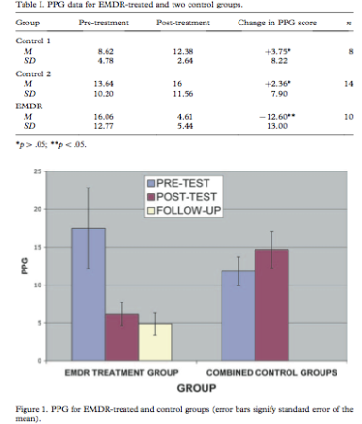

Slide 8
The technology behind EMDR
EMDR International Association established a set of standardized protocols, of which an eight-phase treatment was developed.
The therapist takes a thorough history of the patient and devises a treatment plan best suited to accommodate the patient’s needs. This treatment plan includes a discussion of the specific problem that has brought the individual into therapy, the individual’s behaviors stemming from the specific problem, and the individual’s current symptoms.
The clinician teaches the patient precise breathing techniques to rapidly deal with any emotional disturbance. The clinician explains to the individual what EMDR is, how it is administered, and what to expect pre and post-treatment (Beer, 2010).

Slide 9
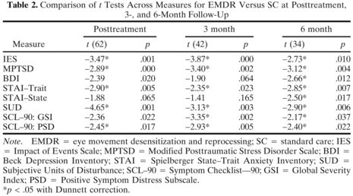
3. An assessment is administered. The assessment asks the patient to rate the level of disturbance using the Subjective Units of Disturbance scale: 0 (no disturbance) to 10 (extreme disturbance). The table below is research conducted by psychologist Nancy Joyce (2010). It states the SUD scale produces significant results during post-treatment in comparison to various other scales used to measure effectiveness of EMDR (p.99).

Slide 10
The process of reprocessing begins. Eye movements (taps or tones) are used. In this phase, research has found children to respond more effectively to tones than do adolescents (Greenwald, 1999). Research suggests this has to do with the cochlea. The cochlea is filled with perilymph, which moves in response to the vibrations coming from the middle. As the fluid moves, the cochlear partition moves; thousands of hair cells sense the motion via their cilia, and convert that motion to electrical signals that are communicated via neurotransmitters to many thousands of nerve cells (Greenwald, 1999). Primary auditory neurons transform the signals into electrochemical impulses known as action potentials, which travel along the auditory nerve to structures in the brainstem for further processing (Greenwald, 1999).
The therapist administers the individual a set of eye movements with appropriate shifts and changes of focus until the SUD-scale levels are reduced to zero. In comparison to adults, children’s SUD-scale levels typically reduce to about one (Maxwell, 2003).
Installation occurs. The individual concentrates on and increases the strength of the positive belief that he or she has identified to replace the original negative belief. The Validity of Cognition (VOC) scale is used during this phase. Since children and adolescents tend to have difficulty generating suitable statements, the therapist might decide to use pre-selected statements of which represent common beliefs related to trauma and recovery (Greenwald, 1999).

Slide 11
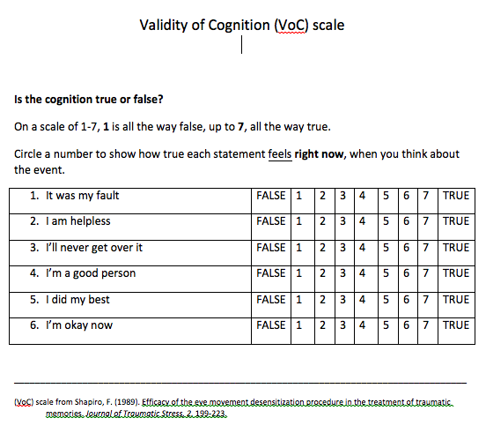

Slide 12
MRI is given to note any residual tension in the body. The MRI identifies the area in the brain where the negative emotion is being evoked. A color-contrast MRI maps the area, and if there is an absence of the negative emotion, the “hot spot” would not appear on the color-contrast MRI (Shapiro, 2011).
A revaluation is given to make sure positive results (low SUD, high VOC, zero tension) have been minimized. A therapist might identify any new areas that might need treatment and suggest other psychotherapeutic treatments; some more costly than others.

Slide 13
Economic Relevance
It has been discovered that providing comprehensive mental health care coverage would cost around $1,133 per person. Current research shows that the demand and clinical need for mental health services exceeds availability for many parts of the country (New York Times, 2012).
Up until 2011, many individuals undergoing EMDR had to pay out of pocket because there were no insurance companies that covered the treatment. With limited funds, many individuals went without proper treatment or were misdiagnosed in order to qualify to receive insurance to pay for treatment that was ineffective and not beneficial to the individual’s mental health and well-being (New York Times, 2012). *One out of ten children in the United States suffers from a mental illness.

Slide 14
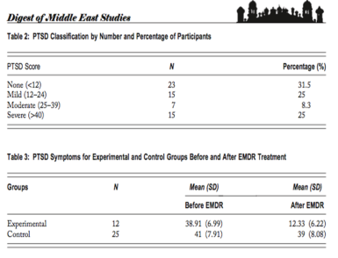
Cultural Relevance
National survey data from 2002 to 2003 on children ages 12 to 17 indicate that one on eight children experienced a form of child maltreatment, such as abuse or neglect (Ricci, 2006). One in twelve experienced sexual victimization, and one in three witnessed or indirectly experienced violence or victimization (Ricci, 2006). Wadaa, Zaharim, and Alquashan (2010) conducted research examining the prevalence of post-traumatic stress disorder (PTSD) among Iraqi children and the effectiveness of eye movement desensitization and reprocessing (EMDR) treatment in traumatized Iraqi children (p. 28). According to the graph below, the experimental and control groups did not diﬀer signiﬁcantly on mean scores of PTSD symptoms at pretreatment. However, at post-treatment, the mean scores of PTSD symptoms for the experimental group decreased signiﬁcantly as t(37) = 10.14, p < .001. Overall, EMDR was successful

Slide 15
Pros and Cons of Emdr
Pros:
Very effective in treating symptoms of PTSD.
Relatively quick treatment (12 weeks); however, many see improvement in symptoms as soon as 2 weeks after treatment begins.
Cons:
Re-experiencing the traumatic event can be stressful and cause emotional instability; traumatic feelings might persist after a session is finished or interfere in other aspects of a person’s life.

Slide 16
Cognitive behavioral therapy
Despite its effectiveness, EMDR has been up to debate. Many psychologists, psychotherapists, and psychiatrists continue to label EMDR as a “pseudoscience”, even with all the successful case studies and research conducted. There are those who believe it produces more harm than good in child abuse patients, suggesting it causes the child to become physically and mentally distressed. In response to these remarks, psychologists suggest Cognitive Behavioral Therapy (CBT) as an alternative in treating abuse and trauma in children. CBT is a psychotherapeutic approach that addresses dysfunctional emotions, maladaptive behaviors and cognitive processes and contents through a number of goal-oriented, explicit systematic procedures (Wanders, 2008). Meta-analytic reviews support the effectiveness of CBT in decreasing impulsivity, anger-related behavior, anti-social behavior, and anxiety stemming from traumatic events (Beck, 2011). It examines the relationship between thoughts, feelings, and behaviors. Cognitive Behavioral Therapy focuses on thoughts and beliefs applicable to a wide variety of symptoms (Okhakhume, 2012).

Slide 17
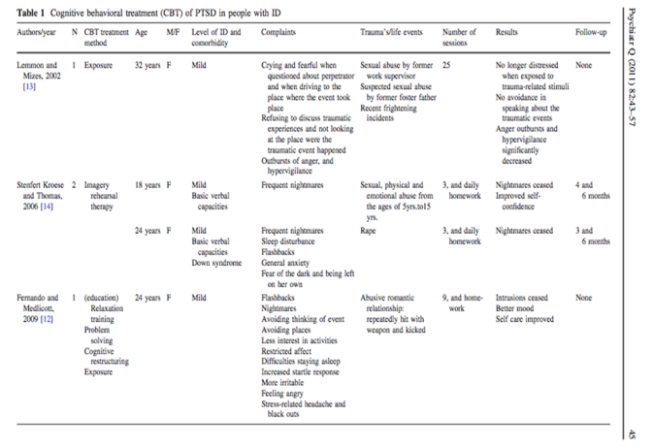

Slide 18
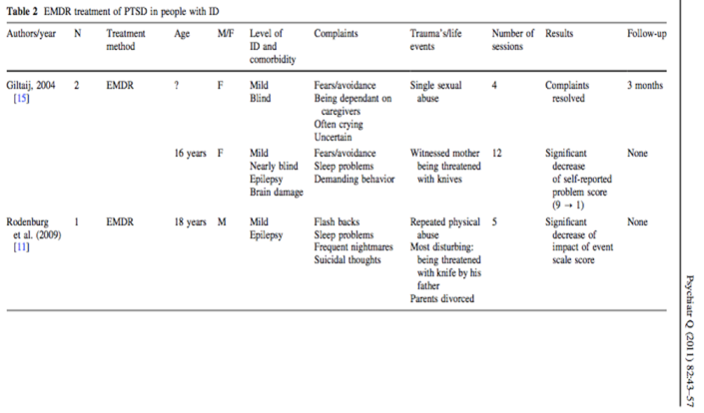

Slide 19
Results of Data
The data compares the effectiveness in Cognitive Behavioral Therapy and Eye Movement Desensitizing and Reprocessing in regards to adolescents and young adults suffering from PTSD and mild Intellectual Disability (ID). The results of the four cases suggest that EMDR can be used as a treatment for people with mild ID as the application of the procedures resulted in a clear reprocessing of the memories related to the traumatic events. Following treatment, none of the four clients fulﬁlled the diagnostic criteria of PTSD according to the Diagnostic and Statistical Manual of Mental Disorders (DSM-IV-TR) and the Diagnostic Manual of Intellectual Disability (DM-ID) (Mevissin, 2011).

Slide 20
Pros and cons of CBT
Pros:
More independent effort on part of patient.
Involves less reliance on the therapist.
More directive skills learned in flexible amount of time (12-16 weeks).
Cons:
Downplays emotions while seemingly over-emphasizing the logical and thought-oriented components of one’s mental life.
SSRI’s, MAO’s, and tricyclic's used along with CBT.

Slide 21
Future Implications
EMDR is effective in treating childhood abuse and trauma. When compared to Cognitive Behavioral Therapy, EMDR has been found to have a more positive effect, with little follow up. Although the 8-phase treatment model is a bit tedious, it produces significant results.
The development of new scales in order to analyze the severity of trauma in children, as well as adults, is ongoing. The newest scale created is the Clinician-Administered PTSD Scale for Children and Adolescents. It is a 33-item clinician-administered PTSD scale for youths aged 8 to 18 years old. It measures the frequency and intensity of symptoms associated with PTSD symptoms, as well as the impact of those symptoms on such aspects of functioning as overall distress, coping skills, and impairment (VA Mental Health). The items assess overall severity, validity of ratings, associated symptoms, and coping strategies

Slide 22
References
Beer, R., Bronner, M.B. (2010). EMDR in pediatrics and rehabilitation: An effective tool for reduction of stress reactions? Developmental Neuro-rehabilitation, Vol. 13, p. 307-309
Greenwald, R. (1999). Eye Movement Desensitization and Reprocessing in Child and Adolescent Psychotherapy. Maryland: Jason Aronson, Inc
Joyce, N. (2010). Treatment of traumatized adults and children. Journal of EMDR Practice and Research, Vol. 4, p. 97-108.
Maxwell, J. (2003). The imprint of childhood physical and emotional abuse: A case study on the use of EMDR to address anxiety and lack of self-esteem. Journal of Family Violence, Vol. 18, p. 281-293.
Mevissen, L., Lievegoed, R., de Jongh, A. (2011). EMDR treatment in people with mild ID and PTSD: 4 cases. Psychiatric Quarterly, Vol. 82, p. 43-57.
Okhakhume, A. (2012). Influence of psychological factors on self-esteem and perceived stigma and the efficiency of cognitive behavioral therapy in symptom reduction among mentally ill patients. Ife Psychology, Vol. 20, p. 39-50.
Ricci, R., Clayton, C., Shapiro, F. (2006). Some effects of EMDR on previously abused child molesters. The Journal of Forensic Psychiatry and Psychology, Vol. 17, p. 538-562.
Shapiro, F. (2001). Eye Movement Desensitization and Reprocessing (EMDR): Basic Principles, Protocols, and Procedures. New York: The Guilford Press

