Slide 1
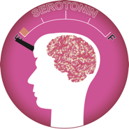
Gaining your ground
Alternatives for antidepressants
Presentation by Maria Kindelan

Slide 2
Depressive disorders affect approximately 18.8 million American adults or about 9.5% of the U.S. population age 18 and older in a given year. This includes major depressive disorder, dysthymic disorder, and bipolar disorder
15% of depressed people will commit suicide
Depressing Statistics
Everyone, will at some point in their life be affected by depression
80% of depressed people are not currently having any treatment
54% of people believe that depression is a personal weakness
Murray, B. & Fortinberry, A. (2005). “Depression Facts and Stats”. Retrieved from Uplift Program website: http://www.upliftprogram.com/depression_stats.html#2

Slide 3
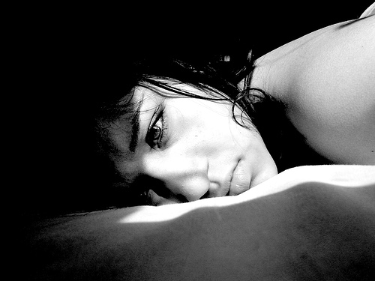
Oh yea, I forgot to mention the
chemical imbalance…
The “most common” cause of depression.
CAUSES OF DEPRESSION | EFFECTS OF DEPRESSION
Lack of (positive, healthy, rewarding) Relationships Poor Diets Lack of Quality Family Support “Digital Addiction” (social networking, gaming, online schooling) Inactivity Perfectionism Financial Stress / Economic Status Change of Seasons / Lack of Time spent outdoors Vitamin Deficiencies Loss of employment High Divorce Rates Genetic Predisposition | Less Productive Citizens / Community Involvement Job Loss Bringing Others Down with You Lack of sleep Long Term Prescription Expenses Digitally Dependent People
Depression
- a mood disorder marked especially by sadness, inactivity, difficulty with thinking and concentration , a significant increase or decrease in appetite and time spent sleeping, feelings of dejection and hopelessness, and sometimes suicidal thoughts or an attempt to commit suicide.
“depression”. (n.d.). Merriam-Webster's Medical Dictionary. Retrieved October 16, 2011, from Dictionary.com website: http://dictionary.reference.com/browse/depression

Slide 4
NOT MUCH EVIDENCE
How Antidepressants are ‘believed’ to work:
News Flash (2010)
“While the cause is unknown…”
http://www.effexorxr.com/depression/depression-treatments.aspx
Zoloft Commercial (2003)

Slide 5
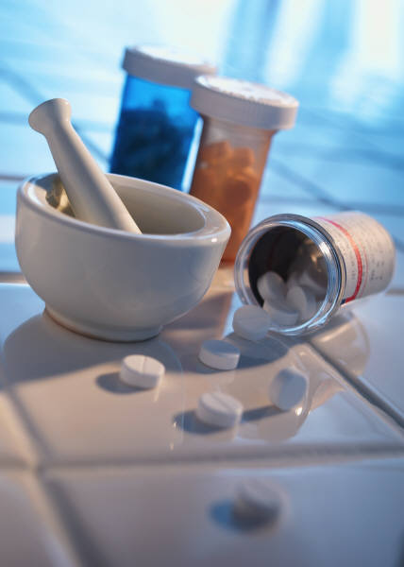
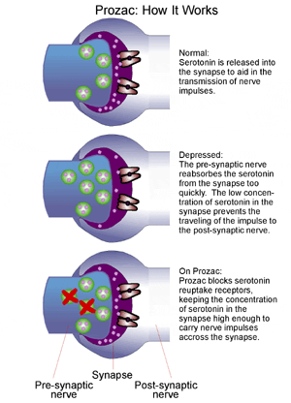
Side Effects
Dry Mouth
Excessive Yawning
Constipation
Weight Gain/Loss
Sexual Dysfunction
Blurred Vision
Agitation
Headaches
Diarrhea
Dizziness
Drowsiness
Increased Heart Rate
Loss of Appetite
Nausea
Increased Risk of Suicide
Cannot forget withdrawals….the high dependency on the medication, discontinuance is not recommended without consulting your physician.
Antidepressant Drugs
Antidepressants

Slide 6
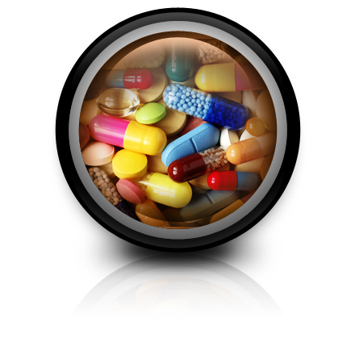
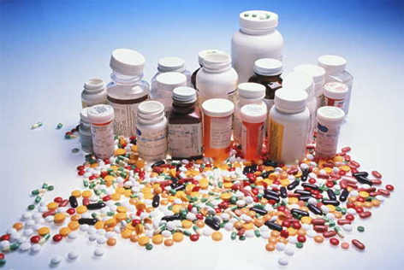
Kresser, C. The “Chemical Imbalance” Myth. Retrieved November 20, 2011, from http://chriskresser.com/the-chemical-imbalance-myth
… and we buy it
Want one?
$20 Billion spent on Direct-to-Consumer Advertising by Drug Companies

Slide 7
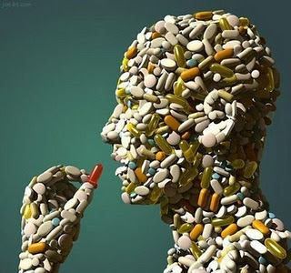
“Physiological problems, plus learned beliefs and behaviors,
Make functional decisions difficult, and the
results reinforce the depression in a vicious cycle.”
Pills are NOT the only
solution
Murray, B. & Fortinberry, A. (2005). “Depression Facts and Stats”. Retrieved from Uplift Program website: http://www.upliftprogram.com/depression_stats.html#2

Slide 8
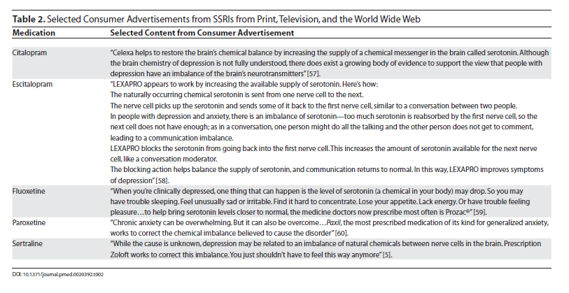
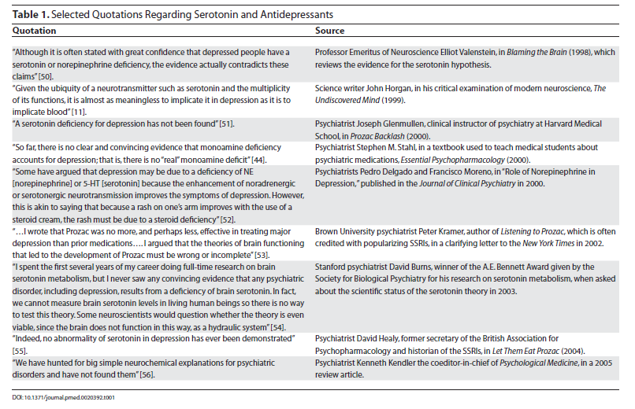
MY STANCE
It is, after all, a neat theory. It takes a complex and heterogeneous condition (depression) and boils it down to a simple imbalance of two to three neurotransmitters (out of more than 100 that have been identified), which, as it happens, can be “corrected” by long-term drug treatment. This clear and easy-to-follow theory is the driving force behind the $12 billion worth of antidepressant drugs sold each year.
– Chris Kresser L. Ac, a practitioner of Integrated Medicine and
Licensed Acupuncturist.
There are alternative treatments to dealing with life’s stressors.
… and other ways to insure serotonin and similar metabolites are being released in your brain and body
Lacasse JR, Leo J, 2005 Serotonin and Depression: A Disconnect between the Advertisements and the Scientific Literature. PLoS Med 2(12): e392. doi:10.1371/journal.pmed.0020392

Slide 9
“Depression is both formed and healed in the world of people
[not chemicals]”
Yapko, M. D. (2009). Depression is contagious. New York: Free Press.
Alternative Treatment Options
Exercise & Endorphins
Create positive relationships
Volunteer (gain a since of accomplishment)
Meditate
Eliminate Addictive Substances
Self-induce Mood Changes

Slide 10
References “depression”. (n.d.). Merriam-Webster's Medical Dictionary. Retrieved October 16, 2011, from Dictionary.com website: http://dictionary.reference.com/browse/depression
Kresser, C. The “Chemical Imbalance” Myth. Retrieved November 20, 2011, from http://chriskresser.com/the-chemical-imbalance-myth
Lacasse JR, Leo J, 2005 Serotonin and Depression: A Disconnect between the Advertisements and the Scientific Literature. PLoS Med 2(12): e392. doi:10.1371/journal.pmed.0020392
Murray, B. & Fortinberry, A. (2005). “Depression Facts and Stats”. Retrieved from Uplift Program website: http://www.upliftprogram.com/depression_stats.html#2 Yapko, M. D. (2009). Depression is contagious. New York: Free Press.

