Slide 1
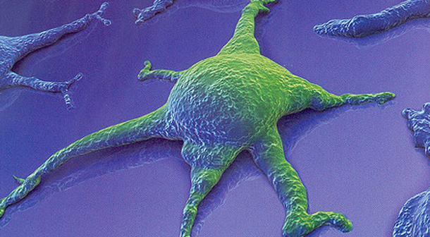
Why Scientists Should Not Use Induced Pluripotent Stem Cells to Save Endangered Species
Presented by
Kristin Hertzog
IDS 3143
Fall 2011

Slide 2
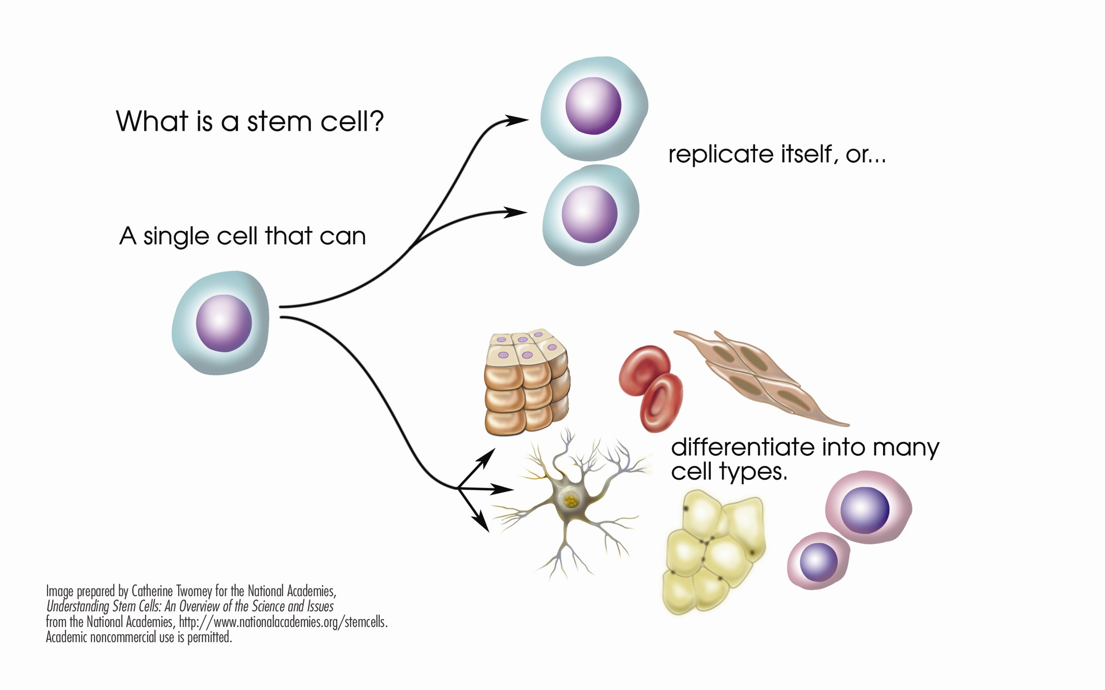
www.katiephd.com/spray-on-some-stem-cells-and-grow-your-own-skin

Slide 3
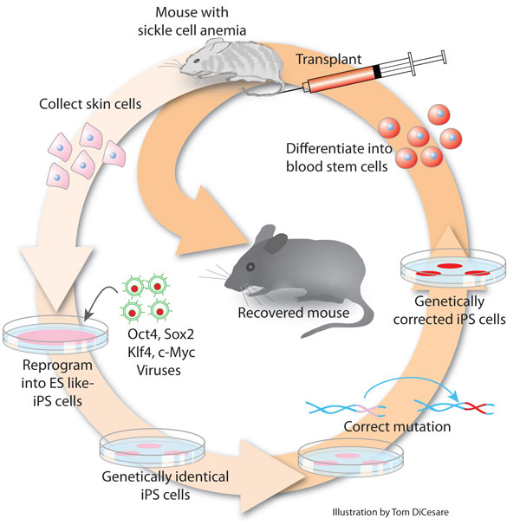
http://thefutureofthings.com/news/1132/induced-stem-cells-for-gene-therapy.html

Slide 4
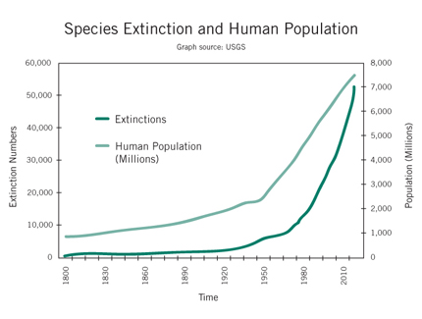
http://sciencetrio.wordpress.com/2010/02/09/overpopulation-and-species-extinctions/

Slide 5
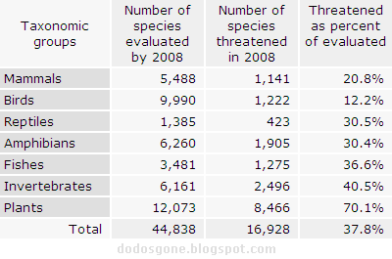
http://dodosgone.blogspot.com/2007/06/extinction-rate-estimates.html

Slide 6
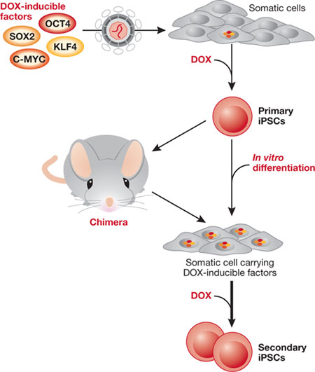
http://www.nature.com/embor/journal/v11/n5/fig_tab/embor201047_F1.html

Slide 7
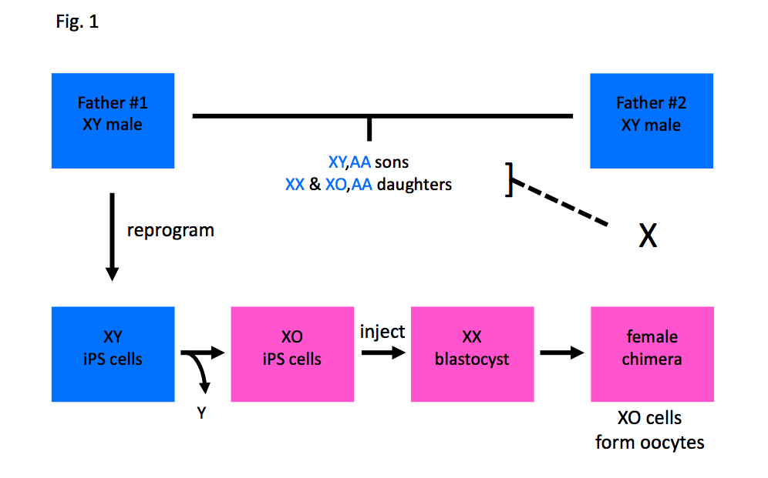
http://www.biolreprod.org/content/early/2010/12/07/biolreprod.110.088831.full.pdf+html

Slide 8
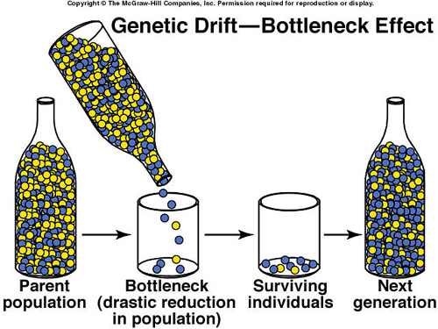
http://www.biologycorner.com/APbiology/evolution/ch18.html

Slide 9
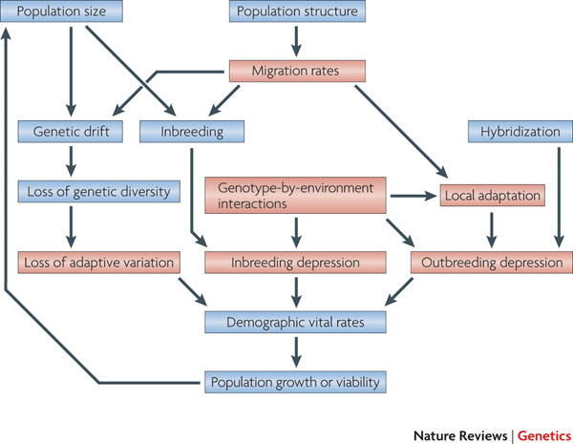
http://www.nature.com/nrg/journal/v11/n10/fig_tab/nrg2844_F1.html

Slide 10
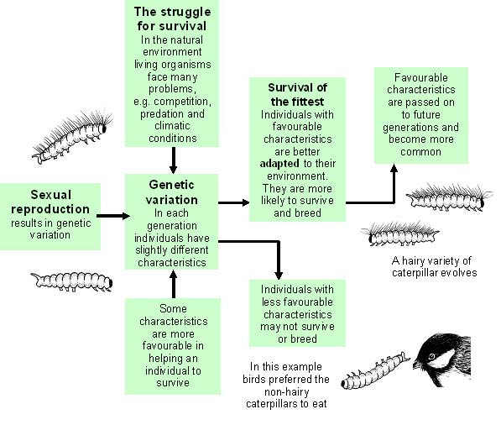
http://www.evolutionarymodel.com

Slide 11
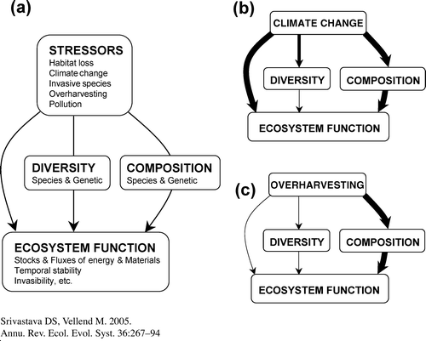
http://www.annualreviews.org/doi/abs/10.1146/annurev.ecolsys.36.102003.152636?journalCode=ecolsys

Slide 12
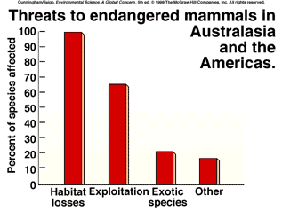
http://zoology.muohio.edu/oris/cunn06/cs6_13.htm

