Slide 1
Early Intervention is the Key to Slowing and Stopping Alzheimer’s Disease

Slide 2
_{Contents}
Alzheimer's What’s the Big Deal?
1
2
Alzheimer’s Statistics
Alzheimer’s History
3
Early Indicators
4
Medellin Families
5
6
Diabetes Connection

Slide 3
_{Contents}
Alzheimer’s Preventative Initiative
7
8
Medicare
The Future
9
References
10

Slide 4
Alzheimer’s Disease: What’s the big deal?
Incidence of Alzheimer’s Disease continues to rise as the population ages, but effective treatments are lacking.
35 million people worldwide have Alzheimer’s disease.
5.3 million people in the US have Alzheimer's disease.
Every 70 seconds someone in America develops Alzheimer’s disease.
Alzheimer's is the fifth leading cause of death in people 65 and older.
Death from Alzheimer’s rose 46.1% from 2000 to 2006.
Alzheimer’s disease has touched 54% of the U.S. population in some way.
At current rates, 19 million Americans will have Alzheimer’s by the year 2050

Slide 5
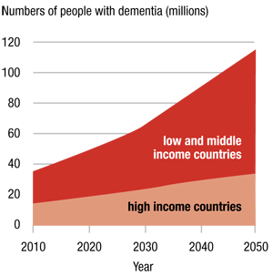
The Alzheimer’s Statistics
Alzheimer’s disease is the 6th leading cause of death among American adults, and the 5th leading cause of death for adults aged 65 years and older. Notably, mortality rates for Alzheimer’s disease are on the rise, unlike heart disease and cancer death rates which are continuing to decline. An estimated 5.4 million Americans have Alzheimer’s Disease.

Slide 6
Yearly Cost per patient of Select
Medical Conditions
_{10,000’s}
_{D}
₂₅
₂₀
_{C}
₁₅
_{B}
₁₀
_{A}
₅
₀
_{Congestive Heart}
_{Failure}
_{Diabetes}
_{Cancer}
_{Alzheimer’s Disease}

Slide 7
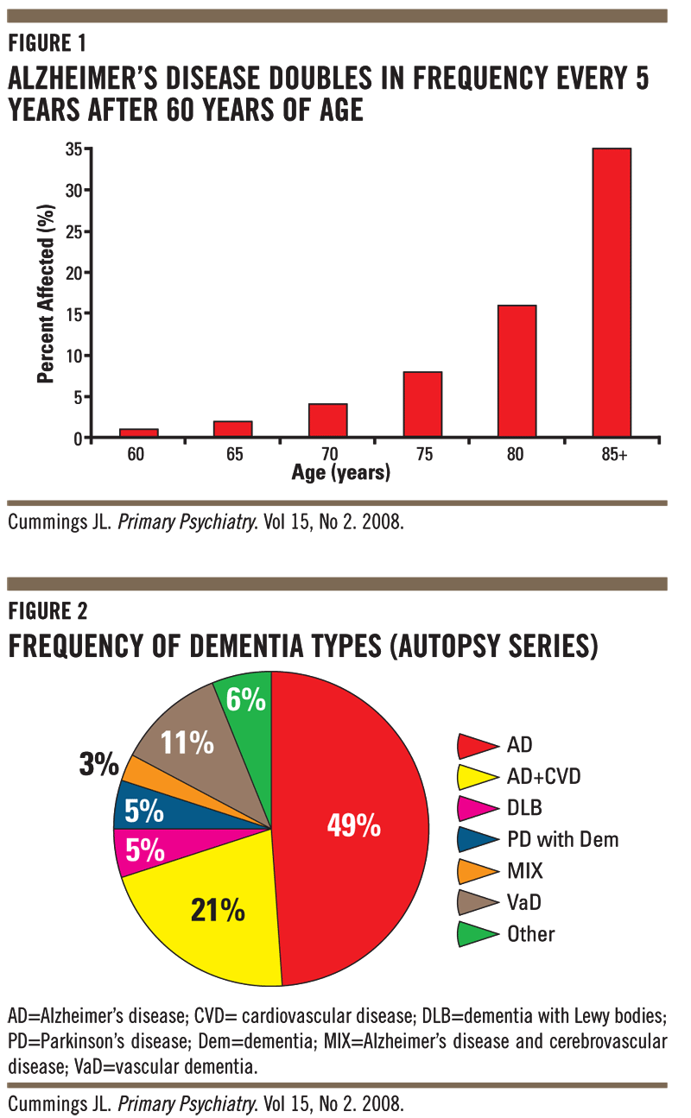
The Alzheimer’s Statistics

Slide 8
Alzheimer’s Disease: A History
1901
Dr. Alzheimer studies his first patient, Auguste D.
1910
Dr. Emil Kraeplin names Alzheimer's Disease.
1974
Congress establishes the National Institute on Aging
1976
Biochemical Changes in the Brain first identified with Alzheimer’s.
1979
Alzheimer’s Association Formed.
1993
First FDA Approved Drug for Alzheimer’s Released – Cognex.
1999
First Alzheimer’s Disease Vaccine Tested on Mice
2002
Alzheimer’s Disease Vaccine Tested on Humans.

Slide 9
Early Indicators of Alzheimer’s Disease
Amyloid Accredation
TAU Build Up
Brain Shrinkage
1
2
3
4
Leads to..
Full on Alzheimer’s Disease
Patient Loses Memories
Disoriented, Paranoid
Unpredictable Behavior

Slide 10
Early Indicators: The Technology
Three Significant Symptoms
AA Found VIA PET Scan
TAU Buildup found VIA Spinal Tap
Brain Shrinkage Found VIA MRI
TAU Buildup
(1-5 years)
_{Amyloid Accredation}
_{(5-20 Years)}
Brain Shrinkage
(1-3 years)
Fragment Inside Neurons.
Nerve Cells Begin
to Die.
Protein fragment in center
That builds new memories.
_{Alzheimer’s Disease}

Slide 11
Alzheimer’s Disease: A Profile on the Medellin Families
Medellin, Columbia and its environs are home to the world’s largest group of individuals with a hereditary form of Alzheimer’s. Members of 25 extended families, with 5,000 members, developed early onset Alzheimer’s, if they have the mutated E280A in the presenilin 1 gene. The Medellin’s attracted the attention of a particular group of scientists who are considering the approach that will test drugs in patients before the first signs of dementia appear. The Medellin researchers are seeing improvements in their patients with the use of enzyme inhibitors and aggregation blockers to prevent amyloids for patients not yet experiencing dementia symptoms that have the mutated presenilin 1 gene.

Slide 12
Alzheimer’s Disease: A Profile on the Medellin Families Video
http://youtu.be/ohMiwg-duPQ

Slide 13
Alzheimer’s Disease: The Diabetes Link
Diabetes was first linked with Alzheimer’s disease in 2004. There is a 65% increased risk of Alzheimer’s Disease for Diabetics according to the National Institutes of Health. Evidence linking Diabetes and Alzheimer’s Disease is even stronger after a study done by Japanese Doctors that concluded in September of 2011. The doctors recruited 150 people with confirmed type II diabetes and followed them for 11 years. There was a 35% increased risk of Alzheimer’s for the diabetes patients.

Slide 14
Alzheimer’s Disease: The Diabetes Link
Research is coming about that says that Insulin through the nasal cavity could help alleviate Alzheimer’s. Half of the patients were given insulin via a nasal spray. The other half were given saline spray. PET scans on the patients showed that those given insulin had the affects of Alzheimer’s slowed and improved memory.
Small Pilot Study: Only 104 people were tested and for a period of only a few months. The key to this drug would be stopping the disease early, but with such a small test group extensive testing still needs to be done.
Done by the University of Washington in Seattle.

Slide 15
The Alzheimer’s Preventative Initiative
Mutation bearing family members around the age of 40 have begun to receive amyloid therapies in the form of a drug or vaccine that are already tested for safety in Alzheimer’s patients.
Trial evaluates whether or not a treatment can stop or delay the disease.
Biomarkers would allow the drug clinicians and researchers caring for the patients to evaluate success of a therapy relatively quickly.
Clifford Jack’s biomarker and MRI model on how the disease progresses paired with biomarker shows a particular type of amyloid peptide years before the disease steals a patient’s memory.
They’re finding proof that the amyloid damages the contact points between neurons 5-20 years beforehand.

Slide 16
The Medicare Connection
Publically, more than 45 million Americans are enrolled in medicare to assist with the financial burden of healthcare. For Alzheimer’s Disease, according to the Fisher Center for Alzheimer's Research Foundation, Medicare coverage will "include 'reasonable and necessary' doctor's visits; physicals, occupational or speech therapy; psychotherapy or behavioral management therapy by a mental health professional; and skilled home-care services" for qualifying patients with Alzheimer's disease. Supplementary, private insurance companies offer medigap to cover the in between charges but thus far, private and public companies are hesitant to offer coverage for early intervention treatment.

Slide 17
The Medicare Connection
In 2011, total Medicare and Medicaid spending for individuals with Alzheimer’s disease is estimated at $130 billion. These statistics are staggering and show the need for more financial resources. The national cost of Alzheimer’s over the next 40 years is estimated at 20 trillion dollars. In comparison, it’s estimated that the war on Iraq cost 100 billion dollars a year to fund.

Slide 18
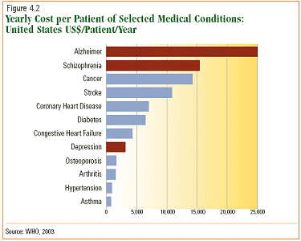
The Medicare Connection

Slide 19
The Future
There is absolutely no way around the fact that the only way to prevent and cure Alzheimer’s Disease is early intervention. This is a disease that touches the world. The economic ramifications of ignoring early intervention are vast but they are nothing compared to the personal pain that Alzheimer’s Disease inflicts by robbing its victims of not only their future, but their past.

Slide 20
References
Barnes, Melody. (2010, September 10). Preparing the Nation to Better Address the Challenge of Alzheimer’s Disease. Retrieved September 24, 2011 from http://www.whitehouse.gov/blog/2010/09/29/preparing-nation-better-address-challenge-alzheimer-s-disease
Bazell, Robert. (2011, September 19). Alzheimer’s Link Yet Another Reason to Fear Diabetes. Retrieved on September 26, 2011 from http://today.msnbc.msn.com/id/44582653/ns/today-today_health/t/alzheimers- link-yet-another-reason-fear-diabetes#.ToEI5d33Arw
Biotechnology Industry Organization. (2011). Alzheimer’s Search for a Cure (Motion Picture). United States: Biology Technology Institute.
Brownstein, Joseph. (2009, July 16). Symptoms of Alzheimer’s May Come in Your 50’s. Retrieved September 24, 2011 from http://abcnews.go.com/Health/AlzheimersNews/story?id=8094226&page=1
Cabranes, Jose. (2008) Alzheimer’s Disease Research Trends. Nova Science Publishers.
Center for Disease Control and Prevention. (2011). Alzheimer’s Disease. Retrieved September 24, 2011 from http://www.cdc.gov/aging/aginginfo/alzheimers.htm.
Cohen, Elizabeth. (2011, September 19). Insulin May Help treat Alzheimer’s. Retrieved September 26, 2011 fromhttp://newsroom.blogs.cnn.com/2011/09/13/insulin- may- help-treat-alzheimers/?iref=allsearch
Del Amore, Christine. (2010). To Stave off Alzheimer’s Learn a Language. National Geographic.

Slide 21
References
Graeber MB, Koesel S, Egensperger R, Banati RB, Mueller U, Bise K, Hoff P, Moeller HJ, Fujisawa K, Mehraein P (1997). "Rediscovery of the case described by Alois Alzheimer in 1911: historical, histological and molecular genetic analysis". Neurogenetics 1 (1): 73–80.
Grossberg, George. (2009). Alzheimers: The Latest Treatments and Strategies. Jones & Bartlett Publishers.
Hayden, Erika. (2011). Patient Dispute Threatens U.S Alzheimer’s Research. Nature. 472, 20.
Kosik, Kenneth. The Alzheimers Solution and how today’s care is failing Millions. Promethus Books, 2010.
Lopera, F. Neuropsychological study of familial Alzheimer's disease caused by mutation E280A in the presenilin 1 gene. Neurosciences Group, University of Antioquia (Medellín-Colombia), Rochester Hills, Michigan, USA.
Melnick, Meredith. (2011). Study: 4 Factors that May Shrink Your Brain. Time.
Park, Alicia. (2011). Nasal Spray of Insulin May Help Improve Memory in Alzheimer’s Patients. Time.
Peterson RC. (2010) Mild cognitive impairment: current research and clinical implications. Semin Neurol 2007;27(1):22-31. http://www.medscape.com/viewarticle/553257. Retrieved October 18, 2011.
Resnick, Susan. (2011). Amyloid Imaging and Memory Change for the Prediction of Cognitive Impairment. Alzheimer’s Research and Therapy. 3, 3.
Song, Sora. (2011). Having Diabetes May Double Your Risk of Alzheimer’s. Time.
Stix, Gary. (2011). Alzheimers: Forestalling the Darkness. Scientific American.
Vellas, Bruno. (2004). Research and Practice in Alzheimer’s Disease. New York: Springer Publishing.

