Slide 1
Xenotransplantation should be used to treat type 1 diabetes
By: Alicia Myall

Slide 2
Type 1 Diabetes
Also known as “insulin dependant diabetes” or “juvenile onset diabetes”
Life long illness
Most likely to be diagnosed in children, adolescents, and young adults.
Accounts for 10% of all diabetics
Estimated to increase 122% between the years of 1995 and 2025
This is due to the aging population and increased obesity from lack of exercise and poor diet.

Slide 3
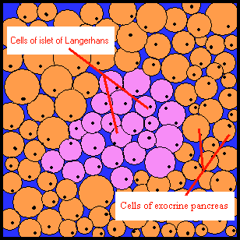
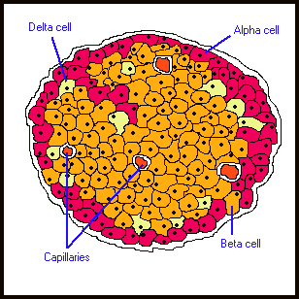
Islet Cells
Islet cells are found in clusters around the pancreas.
They are made up of several cells, including beta cells
Beta cells synthesize and secrete insulin

Slide 4
Damaged Beta Cells
Patients with type 1 diabetes have beta cells which produce little or no insulin
Cause is unknown
Insulin is a hormone that moves glucose into cells
Without enough insulin the glucose builds up in the blood stream and causes a high level of sugar in the blood (hyperglycemia)
This can cause many symptoms including blurry vision, tingling feeling in feet, dry skin, nausea, and stomach pain.

Slide 5
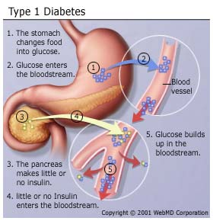

Slide 6
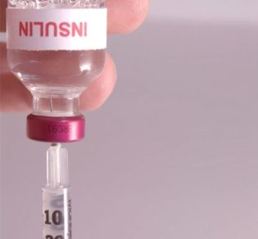
Standard Insulin Therapy
Insulin is injected into patients, and must be injected everyday
This is not a cure for diabetes, it simply allows the patient to survive
The insulin removes glucose from the blood stream and allows it to enter into cells

Slide 7
Allotransplantation
A possible cure for diabetes
Transplanting cells or organs from one genetically non-identical member of the same species to another.
Islets or a whole pancreas are taken from a suitable donor and transplanted into a type 1 diabetes patient

Slide 8
Immunosuppressant Drugs
Immunosuppressant drugs must be taken by the recipient in order to keep their immune system from immediately attacking the foreign object
These drugs have been shown to be very toxic, and have even been linked to cancer
Therefore allotransplantation shows a limited promise, because of the need for immunosuppressants and a lack of human donors

Slide 9
Problem of Organ Transplants

Slide 10
In order to find a cure…
We must find a way to replace islets that is plentiful and is not dependant on human donors
The islets must be able to survive without the help of toxic immunosuppressants
A routine that is as minimal in complexity and risk as possible
Reduced risk of viruses or diseases after transplantation

Slide 11
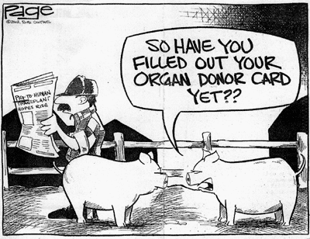
What is Xenotransplantation?
Defined as “the use of non-human material to treat diseases in humans”
Can use animal organs as transplants in humans

Slide 12
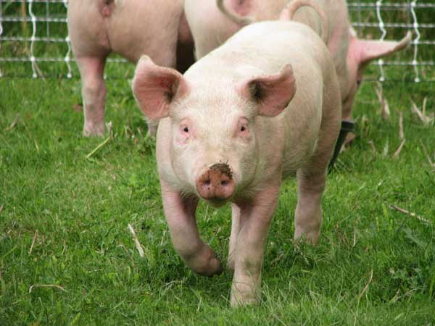
What species should we use?
Chimps: Organs are to small to support our circulatory system.
Cows: To much risk for disease.
Pigs: Some concerns, but research shows that pigs have the greatest compatibility.

Slide 13
Promising Research
Heart Transplants from pig to non human primates very successful.
Liver transplants have not shown rejection.
Lungs have shown that that they would be able to work properly in the human body.

Slide 14
However…
Porcine (pig) islet transplants have been attacked by the recipient’s immune system.
How can we solve this problem without using the toxic immunosuppressants?

Slide 15
New Technology
Scientists can protect islets by encapsulating them in a semi-permeable capsule
This capsule has an opening with a lattice structure that allows blood sugar, oxygen, and other molecules to reach the islet from the blood stream
Larger components such as antibodies and lymphocytes (from the immune system) cannot pass through to attack the islets

Slide 16
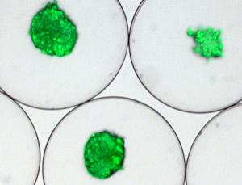
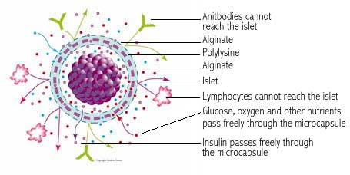

Slide 17
Success Stories
1996: Dr. Anthony Sun at the University of Toronto in Canada transplanted encapsulated pig islets into diabetic monkeys who were not able to produce any insulin internally and exhibited the same symptoms as a human with type 1 diabetes. For 26 months these monkeys maintained a normal blood sugar, without having to inject any insulin.

Slide 18
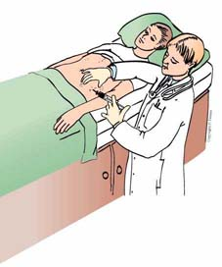
Diabecell
Scientists have conducted this experimental treatment on patients in New Zealand and Russia
The pig islets are coated with alginate (a substance found in sea weed)
The pig islets are then implanted into the recipients abdomen

Slide 19
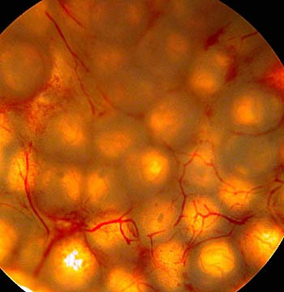
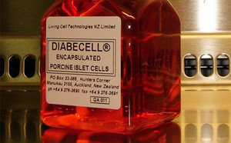
No immunosuppressant drugs are needed after implantation
In New Zealand the patients tested showed a reduced daily insulin dose by 25%
Russia started trials of Diabecell in 2007 and so far the trials have also been very successful

Slide 20
Concerns With Pig Organs
Transferring of microorganisms.
Specifically porcine endogenous retrovirus
Present in the genome of all pigs
It’s possible affect on humans is not known.
Transmission from pig to human has never occurred in testing.

Slide 21
A Recent Study
A study done in 2004 transplanted pig islets into 18 different patients who were monitored for 9 years after transplants
No sign of PERV in transplants
Blood and plasma tested, and no signs of immunological and neurological diseases
Also transplanted into 50 immuno-suppressed non human primates, no sign of PERV transmission

Slide 22
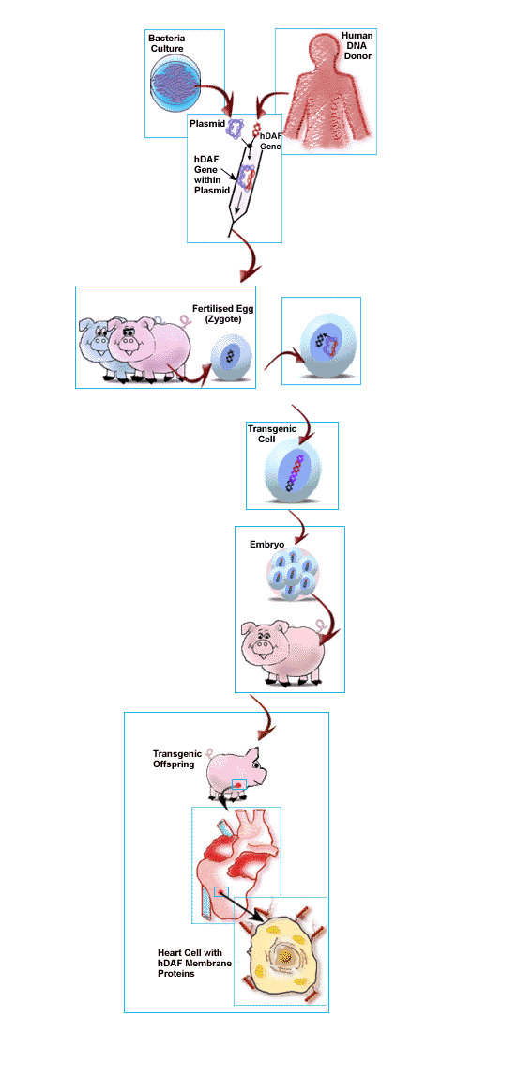
Genetically Modified Pigs

Slide 23
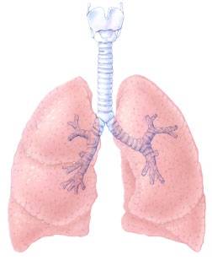
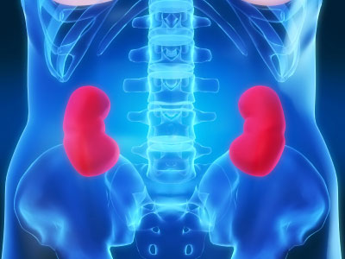
Benefits
Less chance of organ rejection
Can help with manufacturing organs that are free of harmful microorganisms.
Once an optimal pig donor has been created, the pig can be cloned and reproduce to make a limitless supply of organs.

Slide 24
Xeno
South Korea created first genetically modified pig.
Produced twenty clones of Xeno.
Experiments will begin soon by transplanting Xeno’s organ into monkeys.
If these trials are successful then scientists will begin trials on humans.

Slide 25
Public Concerns
People think of genetically modified pigs like genetically modified foods.
Many worry about the possibility of diseases.
There are also worries about experimental risks.
New regulations and laws are being created to ensure that proper precautions are being taken.

Slide 26
Cost-effectiveness Analysis
2007 study that compared porcine islet transplants to standard insulin therapy
Used a software specifically designed for health-economic evaluations
Quality Adjusted Life Years was used as the measure for effectiveness
Amount in U.S dollars was used to measure the cost

Slide 27
Results
Standard Insulin Therapy
$661,000, cumulative 9.4 QALY
$71,000/QALY
Porcine Islet Transplants
$659,000, cumulative 10.9 QALY
$60,700/QALY
Conclusion: Porcine islet transplants is more cost effective and has a higher possibility of cost saving than standard insulin therapy

Slide 28
Other Possible Solutions
A different system for recruiting organ donors like in other countries.
Can cause ethical issues

