Slide 1
Genetically Designing Nature’s Demise Through the Introduction of Bt Crops
Brittany Chase

Slide 2
Monsanto Chemical Co.
Founded in 1901
Began with chemicals, plastics, and sweeteners
Distributed or responsible for:
Agent Orange
Bovine Growth Hormone
Aspartame
PCB’s
Current leader in agricultural chemicals
Notes:
Monsanto is the leader of genetically modified crops. Monsanto controls 90% of the world’s GM seeds, and with the other companies DuPont and Syngenta, GM seeds take up 70% of the global seed market. Monsanto introduced caffeine to Coca-Cola. Agent Orange was a defoliant used in Vietnam that has been reported to kill or maim about 400,000 people and effect subsequent generations. The Bovine Growth Hormone is used in dairy cows to make them produce more milk. It increases risks for utter infections and lameness, and decreases fertility, and is at the basis of human health risk concerns. Aspartame is an artificial sweetener that people fear may cause MS, memory loss, Alzheimer's, brain lesions, etc. PCB’s are toxic compounds used in coolant fluids that inhibit estradiol, causing risks for cancers, irregular development and mental damage, and also can cause skin rash and liver damage. Monsanto is also the leader in agricultural chemicals, such as their herbicide Round-Up.

Slide 3
Monsanto as a Biotech Co.
Producing More
Goal to double yields by 2030
Conserving More
GM seeds require less resources
Improving Lives
GM seeds benefit 5 million small farmers
Notes:
The company formerly known as Monsanto is now known as Monsanto. With the world population expected to reach 9 million in the next four decades, these coming years will require more food to be produced than the last 10,000 years combined. Monsanto considers their genetically modified crops as the key to doubling crop yields by 2030. They claim that their seeds require less water and land because of such rapid growth and high yields, and that they require less pesticides and herbicides if they are used. Monsanto also claims to benefit the 5 million small resource-poor famers in developing countries that grow their seeds.

Slide 4
Monsanto as a Biotech Co.
Plant Patent Act of 1930
Allow the patenting of organisms in nature
Biotechnology
Process of inserting DNA from one organism into another
Express traits otherwise not naturally bred
Herbicide Tolerance
Viral Resistance
Insect Resistance
Stacking involves incorporating more than one trait
Notes:
Monsanto would be nothing had it not been for the passing of the Plant Patent Act of 1930. The signing of this act allowed for the patenting of natural organisms and of segments of organisms, such as of DNA. And so Monsanto makes its money by through the process of biotechnology. Most of Monsanto’s products are either herbicide tolerant or insect resistant, though some are viral resistant. Of all of the approved crops, Monsanto has made: 15/37 BT only, 8/26 Ht & BT stacked, and 7/7 VR & BT stacked.

Slide 5
Natural Insect Resistance
Ground bacteria Bacillus thuringiensis (Bt)
Creates a crystal that makes Bt protoxin
Toxin activates in the gut of the insect
Enzyme receptors in gut shaped to fit Cry delta-endotoxin
Receptors different in every species of insect
Over 200 known Cry endotoxins allow for specificity
Receptors DIFFERENT than the ones in humans
Destroys gut and allows bacteria to kill insect
http://www.bt.ucsd.edu/movies/bt.swf
Notes:
Bacillus thuringiensis is a common spore-like bacteria that creates a crystal during sporulation. The crystal makes and contains proteins that harbor the Cry delta-endotoxin. Once an insect ingests the bacteria, the enzyme receptors in the insect’s intestines attach to the endotoxin, thus activating it. Each of the 200 known Cry endotoxins is shaped differently, just as each insect’s enzyme receptors are shaped differently. This allows for high species specificity. The toxin destroys the walls of the intestine allowing for the bacteria to run rampant in the insect and kill it.

Slide 6
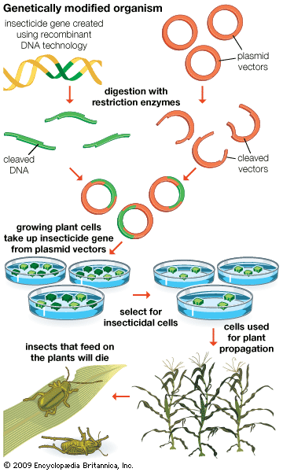
Recombinant DNA (rDNA)
Use restriction enzymes to cleave DNA and Plasmids
Incubate plant cells in bacteria
Select successful plant cells
Notes:
Monsanto achieves insect resistance through the process of Recombinant DNA (rDNA). Here, scientists have the DNA from the Bacillus thuringiensis, and uses restriction enzymes to cleave out the desired gene that codes for the Cry endotoxin. They also use restriction enzymes to cleave open a plasmid from a bacteria, and to remove the viral parts of the plasmid. Plasmids are used to replicate DNA separate of chromosomes, so they are used to manufacture the Bt DNA. They then combine the donor Gene and the Plasmid vector to create a new plasmid with the desired gene. The plasmid is placed back into the bacteria, and the bacteria is allowed to invade plant cells and insert the new DNA into the plant cells’ genomes. Now every time the plant cells replicate their DNA, they create the insect resistant gene. The cells that successfully adapt and create the Bt gene are selected and used for propagation.

Slide 7
Compositional Analysis
Is the gene known to be safe?
Is the product made by gene insertion safe?
Did only one copy of the gene get inserted?
Is the new DNA safe for consumption?
Notes:
Compositional analysis involves the safety of the gene being inserted and the safety of the product. Scientists must make sure that only one copy of the gene got inserted into the plant cell and that the new DNA is safe for consumption. These four questions are the only detailed “safety regulations” provided by Monsanto on their website, and no results or data, or even technical processes were given.

Slide 8
Animal Performance Assessment
42-Day broiler study on chickens
Rapid growth rate of chicks allows for the detection of obvious hindrances
90-Day rat feeding study
Involves a toxicology study
Evaluates blood chemistries, tissue pathologies, and organ weights
Notes:
The product then goes through the Animal Performance Assessment, which is Monsanto’s final stage of company tests. The 42-Day broiler study looks at chickens who eat the genetically engineered crop and allows for easy assessment of their development considering chickens grow at such a fast rate. The 90-day rat feeding study ends in a toxicology study and evaluates blood chemistries, tissue pathologies, and organ weights. Again, this is as detailed as Monsanto gets with sharing their safety information, and no results are posted.

Slide 9
Government Evaluation
Submit reports to two of the three:
Food and Drug Administration (FDA)
Environmental Protection Agency (EPA)
United States Department of Agriculture (USDA)
Approval given with “no further questions” if the crops are deemed “as safe as” conventional counterparts
Notes:
Then Monsanto’s report gets submitted to two of three: the FDA, EPA, or USDA. In the FDA, approval is given once they say that there are “no further questions” and the crops are deemed “as safe as” conventional counterparts. In 1990, the FDA stated that they “are not aware of any information showing that GMO foods differ from other foods in any meaningful or uniform way”. That seems to be an interesting remark considering that these products have patents BECAUSE they are different from conventional foods in a meaningful way.

Slide 10
Revolving Door
Exchange between Monsanto and:
EPA
FDA
U.S. Department of Commerce and Trade
White House Director of Production
Chief of Staff to U.S President Jimmy Carter
Supreme Court Justice
Notes:
Come to find out that the FDA and the other government organizations are quite comfortably nestled in the pockets of Monsanto. Although I have a list of names and positions held, for your information: 1 case of EPA to Monsanto, 2 cases of FDA to Monsanto, 4 cases of President’s advisors and White House to Monsanto, 1 case of Monsanto to the EPA, 1 case of Monsanto to the FDA, and 1 case of Monsanto to the Supreme Court. This does not include the “flip flopping” of jobs between them, but just the initial and final positions held. They also spend quite a bit of money on lobbying and campaigns, and over a half a billion dollars alone on lobbying to ease the oversight of genetically modified crops between 1999 ad 2009.

Slide 11
Corporate Loopholes
1992 Doctrine of Substantial Equivalence
Marketing before Safety
“Split Registration” –No longer allowed
Allows foods NOT passed for human consumption to be used in animal feed
Exemption from food residue tolerances, groundwater restrictions, endangered species labeling and special review requirements
Notes:
In 1992, George HW Bush signed the Doctrine of Substantial Equivalence, which allows for the marketing of a GE product before the product has passed safety inspections. Split registration was the corporate way around failed safety assessment for a while. Companies were allowed to authorize their crops for animal feed but not for human consumption. This became an issue when Bt corn that was deemed a high human allergy risk on split registration was found in the Taco Bell tortilla shells in grocery stores. The EPA also exempts GE crops from food residue tolerances, groundwater restrictions, meaning that the DNA can carry much further than the field and the wind, and have a larger effect than we realize.

Slide 12
Potential Health Risks
Sources of allergic reactions
Severe itching of the skin
Swollen apparatus
White eruptions on the skin
Upper respiratory problems
Bt found in women, pregnant and not
Found in developing fetuses and umbilical cords
Notes:
In India and the Philippines, farmworkers and mill employees have experienced severe itching of the skin and reproductive organs after small amounts of time handling the plants, which with prolonging can turn into a swollen apparatus, white eruptions on the skin, and upper respiratory problems. These allergic reactions can be caused by ingestion, skin contact, inhalation, or injection. Monsanto denies allergen risks in their crops, attributing allergy claims to an increase in the public’s interest of food allergies, an increase in the consumption of foods not previously consumed such as soy-based products, and to the “hygiene hypothesis” that says modern households are cleaner than ever and thus reduce children’s exposure to potential allergens. But considering that 75% of the world’s population live in the 59 countries that have approved biotech crops for planting or import, the risk for exposure is increasing.

Slide 13
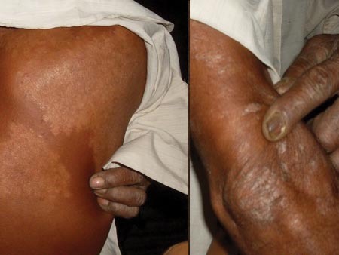
Allergic Reactions from Bt Crops in Farmers

Slide 14
Longitudinal Study On Mice
Multigenerational study
Bt mice differed biologically from control mice:
Important pathways
Under expression of genes
Lowered sensory perception, ion transport, and ability to break down proteins
“Significantly abnormal immune response”
Long term reproductive effects:
Bt mice had fewer pups, and higher pup losses
Notes:
While it is considered unethical to conduct experiments on humans, we have mice and other animals ready available for such inquiries. A study that was conducted over four generations of mice concluded that the Bt mice were significantly different than the control mice. “[I]nvestigation of the cell
nuclei revealed differences as to fibrillar centres, dense fibrillar components and
the pore density in hepatocytes… [and] [a]nalyses of metabolic pathways indicated, that the groups differed regarding some important pathways, including interleukin signalling pathway, cholesterol biosynthesis and protein metabolism.” The Bt mice expressed 1016 genes differently, they had under expressed sensory perception, ion transport, and ability to break down proteins, and they had a “significantly abnormal immune response.” They also had fewer pups and higher pup losses than the control group, with 14.59% losses compared to only 7.4% losses.

Slide 15
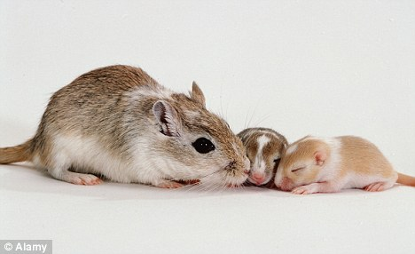
Study On Old and Weaning Mice
Test effects of Bt in vulnerable organisms
Changed immunophenotype of gut & spleen
Alterations in intestinal and peripheral immune responses
Notes:
Another study was conducted on old and weaning mice, to see the effects of eating Bt crops on particularly vulnerable organisms. The tests were run after thirty and ninety days, and they showed that the Bt changed the immunophenotype of the gut, spleen, and circulating lymphocytes, and that there were overall alterations in intestinal and peripheral immune responses. The study concluded that the ingestion of Bt does have biological effects on vulnerable organisms. This is significant in the consideration that our elderly and our infants, and even prenatal fetuses are eating these same ingredients.

Slide 16
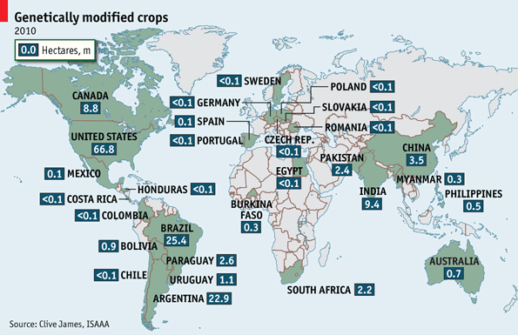
Cross Contamination
Effects current harvest and future harvests if farmers save contaminated seeds
Notes:
The controversy over Bt genetically modified crops has sparked a revolution in the organic markets, as more people turn to them now as their main food sources. Yet even here one cannot be 100% sure that the foods they purchase do not contain trace amounts of Bt toxins. It is quite easy for the wind or for insects to carry the pollen from Bt fields into traditional and organic fields and contaminate the crop. Traditional farmers save their seeds from harvest and replant them for their crop next year, and rely on 80-90% of their harvest for reused seeds. Monsanto has its farmers sign a contract agreeing to not save, store, or reuse seeds from the harvest, requiring that seeds be bought new every year. Monsanto does not like when others violate their intellectual property rights, whether it is intentional or unintentional. The company has already sued thousands of farmers in the U.S. for saving and replanting [genetically engineered] seeds and won an estimated 85 to 160 million dollars from farmers, in lawsuits that have ruined farmers’ lives.” Traditional seeds are very important not only as a safeguard against the potential failure of Bt crops, but also because there are many countries that refuse to import genetically modified crops.

Slide 17
Superweeds
Country | Number of Herbicide Resistant Weeds
United States | 11
Brazil | 5
Spain | 5
Argentina | 3
South Africa | 3
Australia | 3
Canada | 1
Chile | 1
France | 1
Italy | 1
Czech Republic | 1
Israel | 1
China | 1
Malaysia | 1
Herbicide Tolerance & Insect Resistance
Dangerous Chemical Mixes
Lower yields, Higher costs
More than 11 million acres infested
Notes:
Contamination can also occur in foliage other than the conventional counterparts. In 2011, 49% of the corn planted and 58% of the cotton planted was stacked for both insect resistance and herbicide tolerance, meaning both genes are capable of escaping into nearby foliage. individual farmers all over the world are finding that they have to increase their pesticide usage and herbicide usage with higher concentration levels and even have to mix chemicals in a manner that is cancerous and dangerous for livestock just in an attempt to be rid of these weeds, overall costing them money and reducing their yields. “[m]ore than 11 million acres are infested with Roundup-resistant weeds, up from 2.4 million acres in 2007”. “[F]armer efforts to control resistant weeds are estimated to cost nearly $1 billion a year and result in a 70 percent increase in pesticide use by 2015… Farmers and crop experts say that when superweeds take root in farm fields, yield reductions of 1-2 bushels an acre are common, even with extra pesticide doses. With soybeans at more than $14 a bushel, a 1,000-acre farm might lose more than $20,000 to weeds on top of the costs of the added pesticides”.

Slide 18
Superbugs
Scientific Name | Common Name | Food Crop | Acquired Resistance Known
O. nubilalis | European Corn Borer | Maize | Yes
K. lycopersicella | Pinworm | Tomato | No
H. zea | Cotton Bollworm | Tobacco | Yes
P. operculella | Tuber Moth | Potato | No
L. decemlineata | Colorado Potato Beetle | Potato | Yes
P. gossypiella | Pink Bollworm | Cotton | Yes
D. saccharalis | Sugarcane Borer | Sugarcane | Yes
H. armigera | Corn Earworm | Corn | Yes
Acquired Resistance
At least 7 species
Increased Pesticides
Biodiversity Imbalance in lesser pests
Notes:
Some target insects have developed a resistance to the Cry endotoxin through the evolution of their enzyme receptors. At least seven species are known to be resistant, though I’m sure there will be more. On the chart are the original target pests and the crops that they eat, and of those you can see that six of the eight have developed resistance. Not listed here is the cabbage borer, which is also resistant. Pesticide use has increased 12-fold in China since 1997, and has increased 13-fold in India since the introduction of Bt cotton. Non target species are also affected, and becoming main pests themselves. In China, the cotton bollworm kept mirid bugs in check. But between 1997 and 2008, these mirid bugs have become pests in Bt fields and have affected unrelated crops as well, such as dates, grapevines, apples, peaches, and pears. These occurrences are not happening in Bt-free fields.

Slide 19
GMO “Golden Snail”
Navdanya
500,000 farmers against chemical dependency
Landless Workers Movement
400,000 peasants
½ billion farms worldwide
Destroy GE fields in Rio Grande do Sul
“Long March for Biodiversity”
1,000 farmers against GMOs
Notes:
The Filipino story of the Golden Snail encompasses the feelings that they share for GMOs. Rice farmers used to eat the snails in their fields for extra protein. Dictator Imelda Marcos introduced the Golden Snail from South America that was higher in protein. Nobody liked the taste of these snails, so the project was abandoned. But the snails escaped into the wild and drove the local snails to the brink of extinction – eliminating a vital source of protein and calling for the use of toxic pesticides on their rice paddies to control the population. Navdanya is a group in India that is 500,000 strong that fights against chemical dependency and even has created seed banks to save and preserve their indigenous seeds. The Landless Workers Movement in Brazil is comprised of 400,000 peasants and is in touch with ½ billion farms worldwide that grow 70% of the world’s food. They have vowed to destroy any GE fields in Rio Grande do Sul. The Long March of Biodiversity was 1,000 farmers marching across Thailand. They believe that we as humans are highly dependent on biodiversity and refuse to trade that in for genetically engineered food.

Slide 20
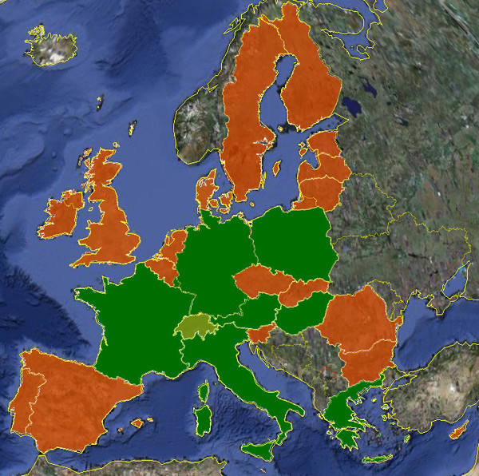
GMO-Free Regions 2010
GMO Free Regions In:
Albania |  | Japan
Australia & New Zealand |  | Latvia
Austria |  | Luxembourg
Belgium |  | Macedonia
Bulgaria |  | Netherlands
Croatia |  | Norway
Cyprus |  | Poland
Estonia |  | Portugal
Finland |  | Romania
France |  | Russia
Germany |  | Serbia
Greece |  | Slovenia
Hungary |  | Spain
Iceland |  | Sweden
India |  | Switzerland
Ireland |  | United Kingdom
Italy |  | United States
Notes:
Here is a list of countries from the GMO-Free Regions website that have at least some counties or communities with GM-Free fields, if not an entire national ban on GM crops.

Slide 21
Is It Really a Fair Share?
Bought 95% of Indian market
Suing for biopiracy
250,000 farmer suicides
$1.5 billion soy industry
$895 million first year vegetable industry
Stocks are up 25%
Notes:
Monsanto bought 95% of the Indian cotton seed market and drove up the prices in the country. India is actually suing Monsanto for biopiracy, which is defined as: The commercial development of naturally occurring biological materials, such as plant substances or genetic cell lines, by a technologically advanced country or organization without fair compensation to the peoples or nations in whose territory the materials were originally discovered.
There is also a correlation between the 250,000 Indian farmer suicides that have occurred in the 15 years since the introduction of genetically engineered crops. Monsanto is definitely making enough money. It’s soy industry is valued at $1.5 billion and its vegetable industry made $895 million in its first year, which is ONLY 8% of their annual revenue! And even as stock averages are down, theirs are up at $71 dollars, which is 25% increase from last year. How much of this wealth is being shared with the 14.4 million small resource-poor farm families that it employs? the Chief Spokesperson for Africa in the Biosafety Negotiations in a letter to the UK:
We, as informed Southerners, know that the South's poverty is caused by deep-seated structural economic imbalances which were established during the periods of slavery and colonialism and are continuing now… Since it is the transnational corporations which are the beneficiaries of the long history of inequity that has plagued us in our position of disadvantage, I believe that it is our responsibility to reject such a misleading oversimplification of the solution to our problem; especially the use of our condition, by those very beneficiaries of the inequity, to justify the continuation of the benefits that they derive.

Slide 22
What Can We Do?
Right2Know March Oct. 11-16
Truth In Labeling Coalition
Food Democracy Now!
Just Label It!
Notes:
It is important that the public is fully aware of the secrets and incentives that are behind genetically modified crops. We have the right to know what is in our food, and the right to be able to make conscious decisions about what to eat. Labeling the GM foods is the first step to eliminating them, because it allows the public to be aware of what is in their food. The Right2Know March just happened in October, where a group marched 313 miles from New York City to Washington D.C. to fight for the right to know what is in our food. President Obama said in his 2007 campaign that he would make labeling GMOs a top priority, and it is up to us to keep him to his word. You can sign pre-written petitions that are sent to Obama and to the FDA through these organizations. It is as easy as signing your name. And for them, it is as easy as labeling “GM”.

