Slide 1
Chapter 13 In Violence
By nick veintimilla

Slide 2
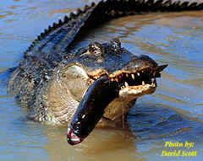
Nature lived off of nature

Slide 3
Introduce Man

Slide 4
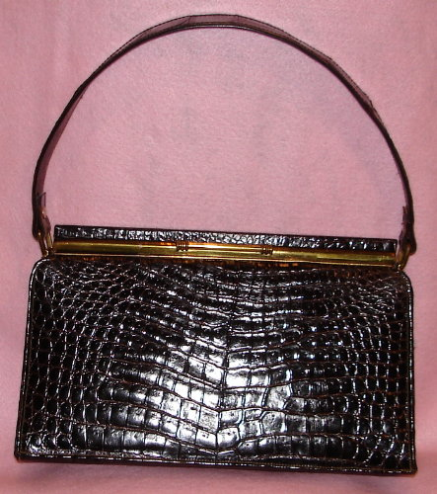
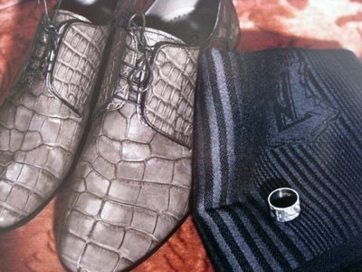
Alligator not animal but accessory

Slide 5
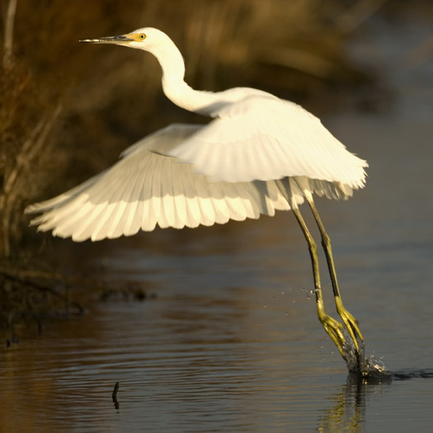
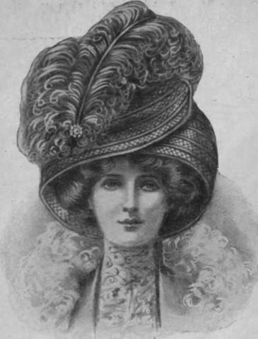
Egrets and Plumes

Slide 6
