Slide 1
Enduring Energy through Renewable Energies

Slide 2
Renewable Energy is any energy generated naturally such a sunlight, wind, tides, and geothermal heat.

Slide 3
Biomass
Biomass is organic material made from plants and animals. Biomass contains stored energy from the sun.

Slide 4
Geothermal
Geothermal is generated from the earths core.

Slide 5
Wind
Wind is air in motion.

Slide 6
Hydropower
Movement of water creating energy.

Slide 7
Solar
Solar energy is the sun’s rays that reach the earths surface.

Slide 8
Why transition to renewable energy?
Energy underpins virtually every aspect of our economy and everyday lives
Until recently, fossil fuels were cheap and abundant; as a result they have been used very inefficiently
The current use of fossil fuels release greenhouse gases (Carbon Dioxide and Methane) into the atmosphere
The demand for energy has increased to levels where the burning of fossil fuels is releasing enough greenhouse gases into the atmosphere to begin to directly affect our climate system

Slide 9
The Transition Away from Fossil Fuels
The urgent need to reduce the release of greenhouse gases has finally focused the world’s attention on the need for a rapid shift in how energy services are provided
It involves a dual strategy:
Reducing the amount of energy required through energy efficiency
Meeting most of the remaining needs with renewable resources

Slide 10
The Earth Summit
The problem of climate change was first addressed internationally at the United Nations Conference on the Environment and Development – the Earth Summit – in Rio de Janeiro in 1992
One of the major themes of the conference was the promotion of sustainable economic development in the face of global climate change
In the Rio Declaration Climate Treaty, the international community agreed to adopt measures to prevent the harmful effects of climate change
The signatories, especially developed countries, agreed to roll back their emission of greenhouse gases to the levels they were in 1990

Slide 11
What is being done worldwide
In, 1992, Gussing was a dying town and the capital of one of the poorest districts in Austria

Slide 12
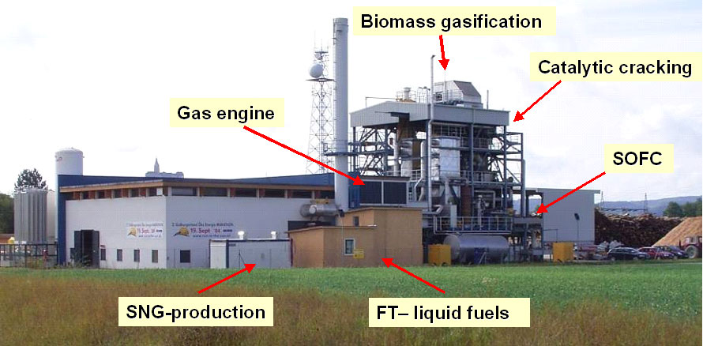
Gussing
Just nine years later, Gussing was self-sufficient
They were producing bio-diesel from local rapeseed and used cooking oil
They were also producing heat and power from the sun
They also had a new biomass-steam gasification plant that sold surplus energy to the national grid

Slide 13
Gussing
Today Gussing residents enjoy a much higher living standard
They have cut their carbon emissions by more than 90%
The Danish island of Samso and several other communities have achieved similar transformations

Slide 14
European Cities Are Implementing Ambitious Plans
Barcelona, Spain
In 2006 required new buildings to install solar panels to supply at least 60% of energy for hot water
Spain added 1.7 million kilowatts of capacity in 2008
They have become an example of how more ambitious policies can lead to real improvements

Slide 15
The UK has mandated Zero-Carbon Buildings
A zero-carbon building is one that produces all its own energy on site with renewable energy and emits no Carbon Dioxide
All new homes built after 2016 must be zero-carbon
All commercial buildings constructed after 2019 must be zero carbon

Slide 16
Zero-Carbon House

Slide 17
Renewable Energy Put to Use
Renewable energies already provide a significant share of the world’s energy
In 2007, renewable energy generated more than 18% of global electricity
At least 50 million households use the sun to heat water
Renewable resources are universally distributed, as are the technologies

Slide 18
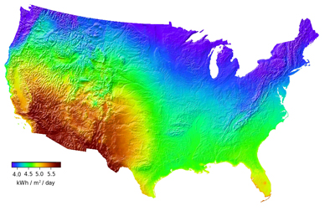
This map of the United States shows the amount of available solar power, ranging from 4 (blue) to 5.5 (red) kWh/m/day.

Slide 20
Some of the tasks that we need to accomplish include:
Build an industry based upon alternative energy technologies
Reduce energy costs
Reduce climate change
Increase energy security
Help to create conditions for long-term prosperity
In order to accomplish these tasks, we will have
to:
Use a combination of wind power (both on and off-shore)
Use both concentrating and standard PV power systems
Use geothermal systems
Use fuel cell systems that generate hydrogen using electrolysis
Use biomass and municipal waste

Slide 21
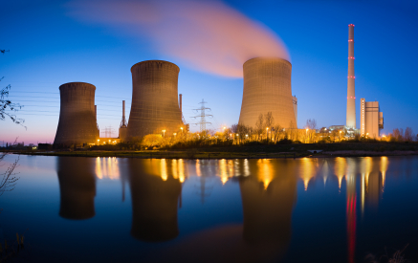
The Federal government is using voluntary and incentive-based programs to reduce emissions and has established programs to promote climate technology and science.

Slide 22
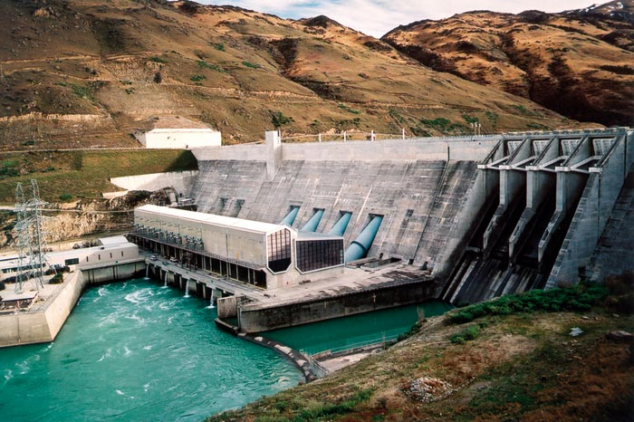
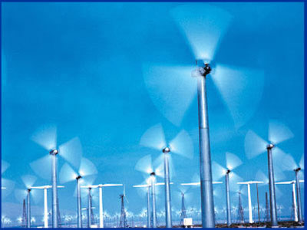
Hydropower
Wind
Energy

Slide 23
My Field of Study
Criminal Justice
Critical Thinking
Evaluate Current State of the World
What Can We Do and Contribute
Ethical Reasoning
What is the Right Thing to Do
What Will Produce the Greatest Outcome for Everyone

Slide 24
Allie the ECO friendly accountant
Renewable Energies and their importance on our environment effects everyone. In everyday business there are many ways to turn any office into and ECO friendly office.

