Slide 1
Education’s New Assignment: Sustainability
Magdalena Dzieza
Brittany Chase
Abigail Aaron
Jeremy Gianfagna

Slide 2
Early Childhood Education to Transform Cultures for Sustainability
Education should have a stronger focus on promoting sustainability
Education of children in their youngest years deserves special attention
Children in the youngest ages are very quick learners and it is a perfect time to teach them about sustainability

Slide 3
“Research shows that the human brain and biological pathways develop rapidly and that children’s experiences before they start primary school shape their attitudes, values, behaviors, habits, skills, and identity throughout life. Thus the first years of life provide a window of opportunity for nurturing children’s love of nature and the habits practices, and lifestyles that favor sustainability.”

Slide 4
Parents as First Educators
Before children go to school, parents are their first educators.
They have the biggest influence on their children’s values, behaviors, attitudes, skills and habits.
Parents should educate their children about sustainability development.

Slide 5
Early Childhood Education
Early Childhood Education is probably the most important in development of children’s brain and intellectual skills
Early Childhood education teach children about nature and also educate them about problems caused by unsustainable lifestyles.

Slide 6
7Rs
Reduce is about reducing consumption of resources
Reuse is about showing children that materials can be reused
Recycle is about teaching children how to recycle and encourage them to do so
Respect is about respecting and understanding environment and nature
Reflect is about learning how to reflect
Repair taking care of broken things and trying to fix them
Responsibility teaching children how to be responsible and take care of something

Slide 7
“Research Shows that the traditional subject teaching of knowledge that is common in schools does not give the best results in learning about issues related to sustainable development, which are interdisciplinary in nature”

Slide 8
Case Studies: Globally
In Australia, children have opportunities to work on small projects such us litter-less lunches, responsible cleaning, reusing and recycling things, a vegetable garden, a register of native plants, environmental aesthetics, efficient use of natural resources, and construction of frog pond.

Slide 9
Case Studies: Globally
In Japan, children in preschool were working on the project involving silkworm, a fascinating insect.
In Sweden, the Swedish national curriculum for early childhood education and care spells out that teachers are responsible for promoting respect for the intrinsic values of each person as well as for the shared environment.

Slide 10
United States
From the time they are born, most American children are exposed to hundreds of messages per day designed to convince them that a happy, meaningful life depends in large part on what they own.
Research shows that materialistic values negatively correlate with how frequently adults and children engage in pro-environmental behaviors such as commuting by bicycle, reusing paper, buying secondhand, and recycling. One study of 400 North American adults found that those with stronger materialistic values make transportation, food, and housing choices that result in higher ecological footprints.

Slide 11
Florida
K-12 schools can not only establish a framework for seeing connections and practicing skills. They need to implement sustainable practices with school lunch recycling and composting programs, school gardens, and student councils.
Education is a key aspect of moving Florida toward sustainability

Slide 12
Commercialism in Children’s Lives
“Advertising and marketing have been associated with eating disorders, sexualization, youth violence, family stress, and underage alcohol and tobacco use” (p.62)
“The ability to play creatively is central to the human capacity to experiment, to act rather than react, and to differentiate oneself from the environment” (p.62)
“Play promotes attributes essential to a democratic populace, such as curiosity, reasoning, empathy, sharing, cooperation, and a sense of competence – a belief that the individual can make a difference in the world” (P.62)

Slide 13
400 US employers say that newer generations of employees lack critical thinking and problem solving skills, as well as creativity (P.63)
“play” in six to eight year olds decreased in the US by 1/3; ½ of the parents in Japan and France consider shopping to be play. (p.63)
A survey of 16 countries, only 27% of their children “play” and only 15% of the mothers think it’s important in development (p.63)

Slide 14
Rise of Commercialism
in 1983 US marketers spent $100 million targeting children, and today it’s at $17 billion, and $1.9 billion globally just on food products (P.63-64)
introducing television marketing in Fiji in 1995 resulted in eating disorders in females and in 1994 WWE broadcasted in Israel resulted in increased school fights (P. 64)
“Research shows that children with more materialistic values are also less likely to engage in environmentally sustainable behaviors such as recycling or conserving water” (P.65)

Slide 15
Impact of Commercialism on Play
In the US kids spend more time in front of a tv than any other activity besides sleeping, about 40 hours a week. 19% of babies have televisions in their bedrooms. (P. 65)
Children said to watch TV often are at 91% in Viet Nam, and 80% in Argentina, Brazil, India, and Indonesia (P.65)
in 2007 toy brands made $6.2 billion in the US alone (P.66)

Slide 16
Nurturing Play
Laws in Quebec prohibit tv ads targeting under 13 years old, and under 12 years old in Norway and Sweden. Greece allows toy ads after 10PM. France bans programs towards children under 3 altogether. Brazil allows NO marketing towards children. (P.66)
the UK regulates food marketing to children (P.66)
Germany has Waldkindergärtens which are preschools primarily teaching out in nature (P.67)

Slide 17
Global Action
“Convention of the Rights of the Child” in November 1989, Adopted by the General Assembly of the United Nations Chapter IV 11.
Over 185 States ratified the Convention
Addresses 4 main points
1 non discrimination
2 best interests of the child
3 right to survival and development
4 right to opinion of the child

Slide 18
National Action
US signed the Convention in 1995 but did not ratify it
The Federal Trade Commission gathered research but fell through (60,000 pages of testimony)
No Child Left Inside (NCLI)– Goals to establish Environmental Literacy through Environmental Education, closing the gap created by Nature Deficit Disorder

Slide 19
Local Action
League of Environmental Educators in Florida (LEEF) is an extension of NCLI
To promote community-based support for environmental issues.
To support positive government action on environmental issues.
To increase community involvement with the environment through education.
To facilitate communication among environmental educators
To use education as a change mechanism toward a society that lives on renewable resources.

Slide 20
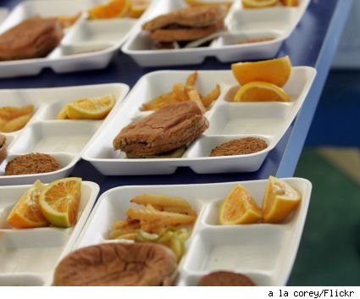
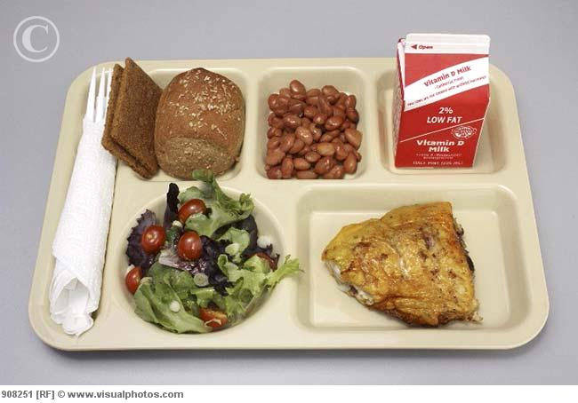
Rethinking School Food
Create new generations of knowledgeable consumers
Fashioning sustainable food chains through school food reform
Tapping the power of purchase
Pioneers of the school food revolution
From school to community food

Slide 21
The Power of the public plate
Most children in industrial endure school than enjoy it; a rite of passage to the adult world
The power of purchase can deliver a social, economic, and environmental dividend while promoting sustainability. Healthy eating is associated with behavioral improvements (in terms of concentration and learning capacity)
Three principles of sustainability development; human health, social justice, and environmental integrity

Slide 22
New generation with knowledgeable consumers
Healthy eating message faced with two obstacles; junk food message and getting the right information to the public to induce cultural change
The “whole school”: positive links between food, fitness, health, and physical and mental well-being
Overall we need knowledgeable consumers who care about the origin of their food

Slide 23
Food chain through food reform
So far more than 1000 schools from 38 states are buying fresh products from local farms
Local suppliers create important opportunities for economic development if they have the appropriate produce and infrastructure to distribute it

Slide 24
Pioneers of the school food revolution
The challenge is to synchronize all three reforms to have a mutual, synergistic effect
Creative procurement approach allows training sessions on nutrition and healthy eating for cooks, farmers brought into the classroom to tell how food is produced, and parents taken through demonstrations on healthy eating
A recent survey stated: 67% think school food tastes better, 88% like fresh food, and 77% of parents believe this is a good use of local council’s money
“shared willingness of going in a certain direction”

Slide 25
School food to community food
Creating new generations of knowledgeable consumer-citizens
Community food planning play a role in promoting the hallmarks (principles) of sustainability development

Slide 26
What Is Higher Education For Now?
“The ideas on which modern education worldwide is founded reflect a world that disappeared long ago.”(pg. 75)
“rapid technological change is now reshaping the social, cultural, and ecological landscape everywhere. In short order, humans are creating a different planet, arguably a different human nature,” (pg. 76)
What is Higher Education for Now? “.. the kind of education that enables students to live sustainably, competently, and decently in recognition of their dependence on the web of life.”(pg. 76)

Slide 27
The Development of Environmental Education
During 1977 the Tbilisi Declaration, which was organized by UNESCO and the U.N. Environment Programme, was signed by 66 countries which called for the inclusion of environmental education in their programs. (pg. 76)
The Tbilisi Declaration and similar documents which were all calling for change but they could not address the scale of the problem. People were still under the assumption and belief that the environment was too vast to be significantly affected by human actions.
Now we see a wide diversity of environmental education programs in the U.S.

Slide 28
Curriculum and Education
In the 1960s and 1970s is when the belief that the environment ought to be given special priority in the curriculum of higher education came of age with the creation of environmental studies programs at Williams College, Middlebury, and Brown University.
“In October 1990, Tufts University Jean Mayer convened a meeting of 22 university presidents and chancellors that culminated in the Talloires Declaration (this document included 10 goals, including leadership to increase awareness of environmental challenges, fostering environmental literacy throughout the campus, and changing operations to reduce environmental impacts.) By 2008, about 360 presidents in 40 countries had signed the Declaration.”

Slide 29
Through Curriculum and Education we have seen a great deal of progress towards change.
“Education for sustainability is flourishing because of many factors, including committed faculty, imaginative leadership, student activism, response to specific opportunities, and larger societal changes.” (pg. 79)
However we are experiences small bumps in the road. According to the National Wildlife Federation, between 2001 and 2008 “the amount of sustainability-related education [ in the U.S.] did not increase and may even have declined.” This conclusion is supported by global poll data that shows the majority of the public to be uninformed, sometimes misinformed, and otherwise confused about the fundamentals of ecology and science in general. (pg. 79)

Slide 30
Campus Design and Operations
Alongside efforts to increase ecological awareness and literacy through education. There are others who are aimed to change the “design” of campuses by improving energy efficiency, lowering carbon emissions, reducing waste, recycling, and building the high-performance buildings that have become mainstream virtually everywhere. (pg. 79)
At this time on the national level we see the emergence of the North American Association for Environmental Education for Sustainability in Higher Education (AASHE) which amplifies and coordinates otherwise disparate campus ecology efforts.

Slide 31
In the late 1990s is when we see rapid growth of the green building movement. The result has been an effort to reduce the environmental impacts of new construction on college campuses. The first substantially green building on a U.S. college campus was the at the Oberlin College, which is still the only entirely solar-powered, zero-discharge building on a U.S. college campus.
The second driver in the green campus movement has been increasing concern about rapid climate change. This large body of scientific evidence points out that climate is changing and humans are the culprits.

Slide 32
Future Initiatives
“Institutions of higher education must aim to create an ecologically literate and ecologically competent citizenry, one that knows how Earth works as a physical system and why that knowledge is vitally important to them personally and to the larger human prospect.” (pg. 81)
The most far-reaching example of national leadership in education is the government of Bhutan. They replaced the yardstick of “gross national product” with the one that measures “gross national happiness” (GNH) in 1972, the government is now sponsoring an effort to educate its citizenry for happiness, sustainability, justice, and peace.

Slide 33
Local Action
FGCU is as local as we get. Here we can see the efforts of Campus Design and Operations. FGCU has been awarded the highest level award by the U.S. Green Building Council’s Leadership in Energy and Environmental Design, or LEED.
The LEED rating system provides external verification that buildings are designed and built to save energy, conserve water, reduce CO2 emissions, improve indoor air quality, and demonstrate stewardship of resources.

Slide 34
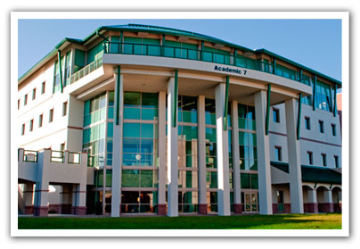

Slide 35
Works Cited
State of the World (Text)
http://treaties.un.org/Pages/ViewDetails.aspx?src=TREATY&mtdsg_no=IV-11&chapter=4&lang=en
http://leef-florida.org/
http://www.ohchr.org/Documents/Publications/FactSheet10rev.1en.pdf (this is from http://www.ohchr.org/EN/Pages/WelcomePage.aspx).
http://llr.lls.edu/volumes/v39-issue1/docs/westen.pdf

