Slide 1
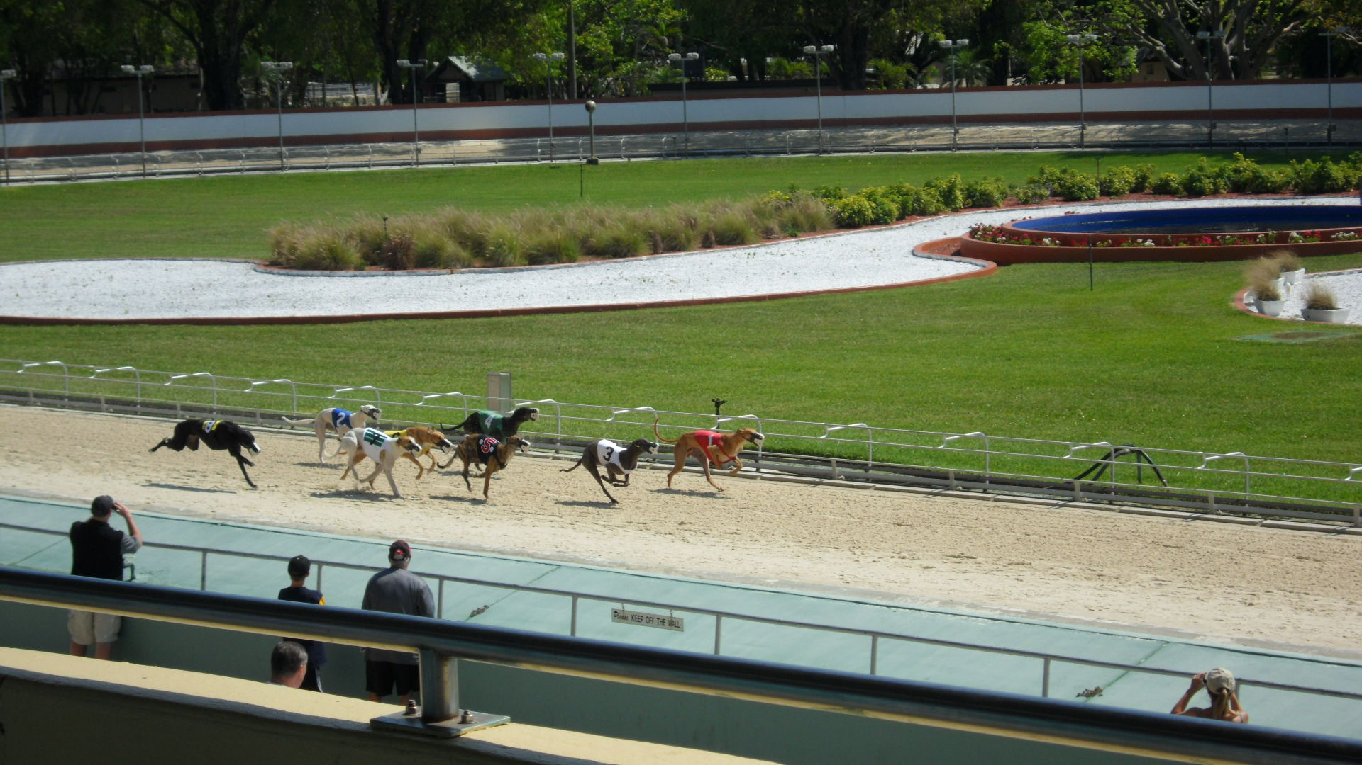
Racing for recycling
Bringing a more sustainable atmosphere to the Naples Fort Myers Greyhound Track
By: Jeremy Gianfagna

Slide 2
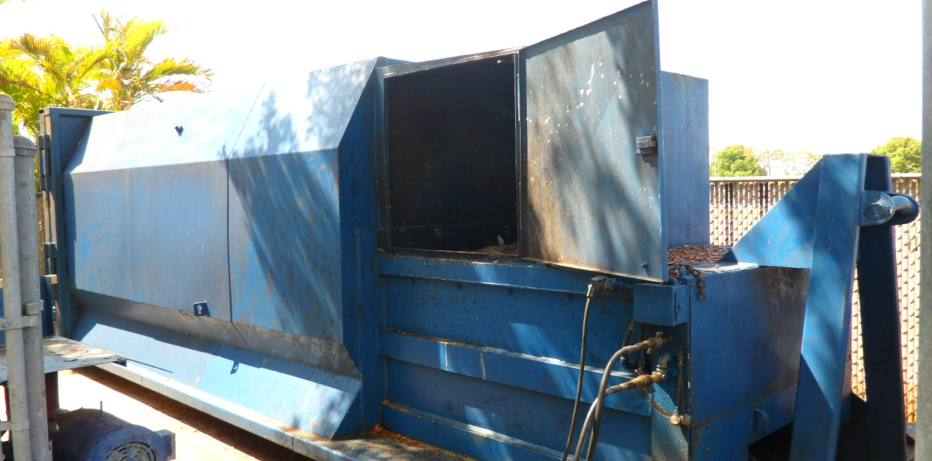
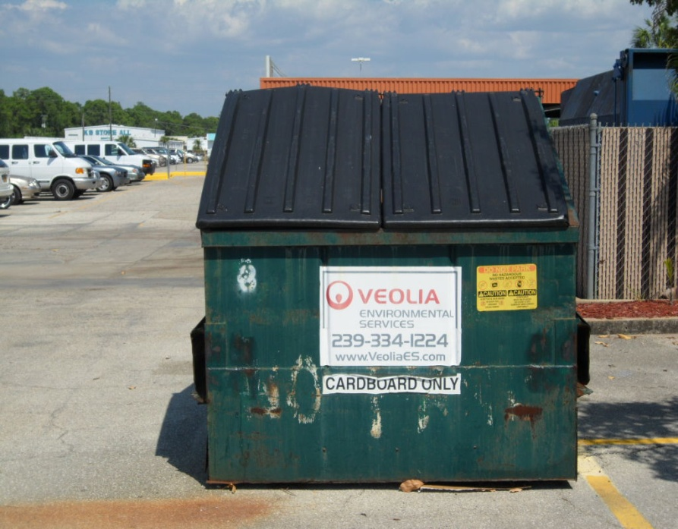
Before

Slide 3
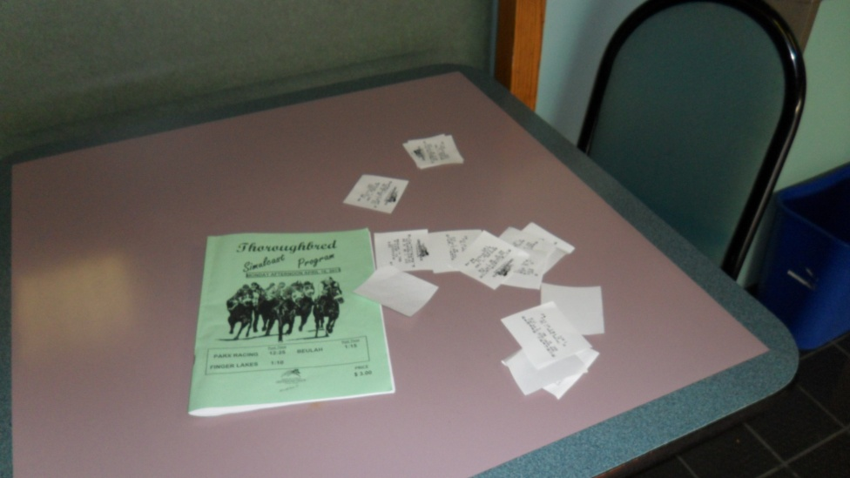
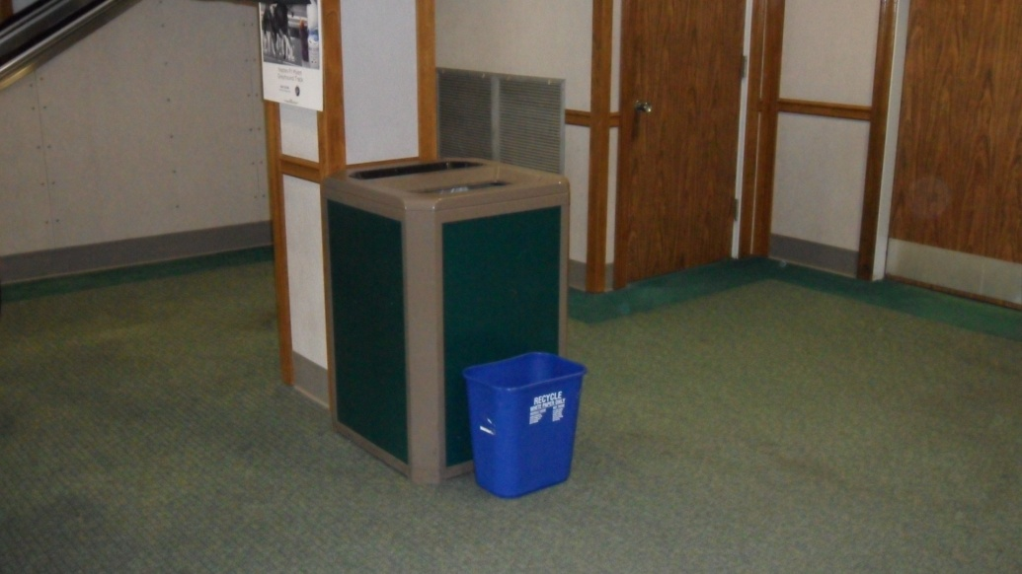
Indoor Help
Purchased twenty-two 14 in. indoor recycle bins for loose paper, ticket stubs, programs, and newspapers.
Should help in overall recycling of the fiber waste consumption at the dog track.
Before
After

Slide 4
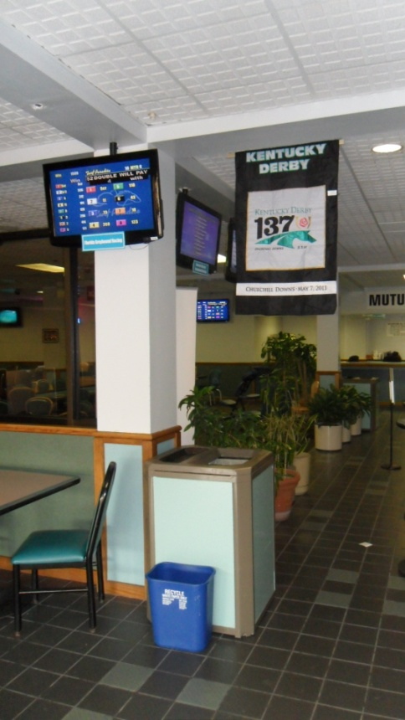
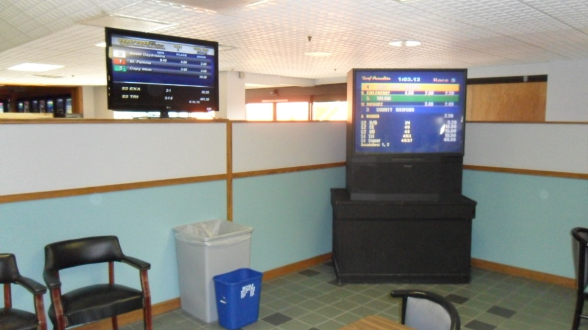
More Indoor Help

Slide 5
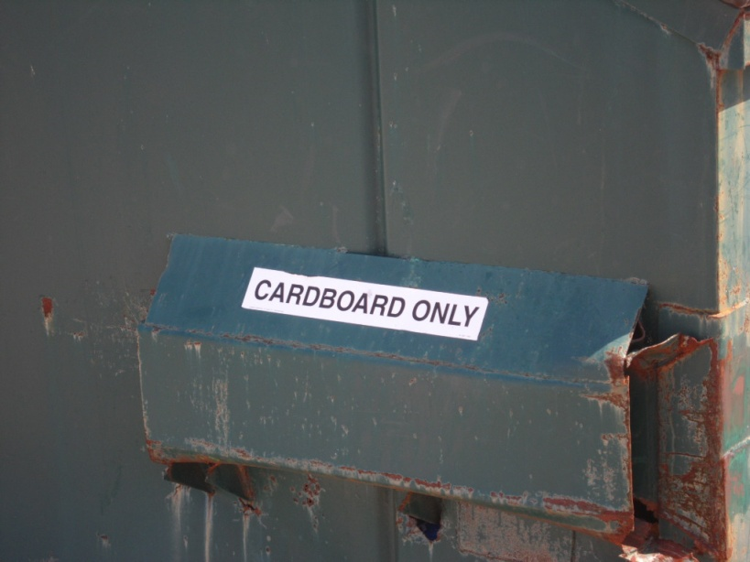
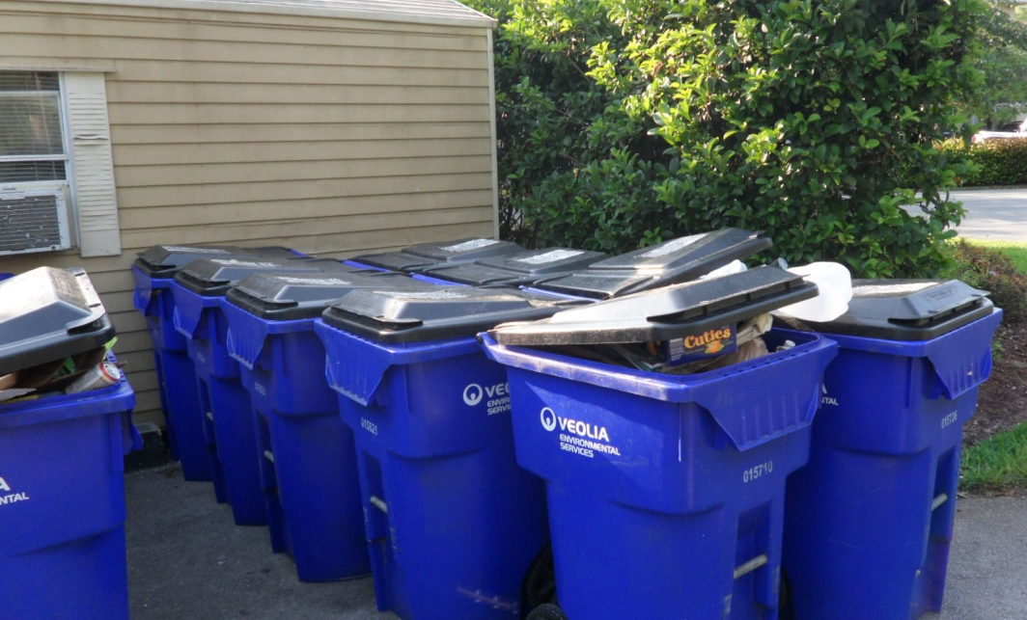
Outdoor Help
Purchased fourteen 90 qt. recycling bins for all glass, recyclable plastics, and left over cardboard.
Helped to make sure more than 50% of all waste leaving the dog track was being recycled

Slide 6
Project lives on
The dog’s waste was the last thing that I thought about as being waste coming from the dog track.
I am currently talking with the GM trying to find a company that can take the waste and do something productive with it rather than just keeping it in landfills.

Slide 7
The end

