Slide 1
Southwest Florida’s Energy
Cassie Fiorini
&
Saeger Morrison

Slide 2
Energy Sources
Fossil Fuels account for 80% of all the energy sources produced.
Coal: 25%
Natural Gas: 21%
Petroleum: 34%
Nuclear: 6.5%
Hydro: 2.2%
Biomass & Waste: 11%
Solar, geothermal, & wind: .4%

Slide 3
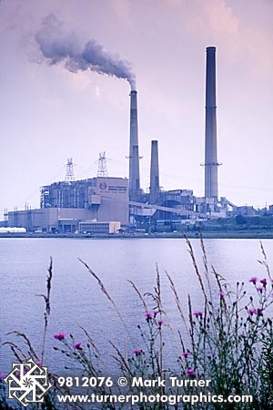
Traditional Energy Sources
Carbon Emissions for the United States:
Coal Power-
1.5 billion tons per year
Natural Gas Power-
237.270 million metric tons.
Petroleum Power-
100.320 million metric tons

Slide 4
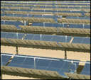
Alternative Energy Sources
Carbon Emissions:
Nuclear-
Hydro-
Biomass & Waste-
Solar, Geothermal, & Wind-
All Have Zero Carbon Emissions

Slide 5
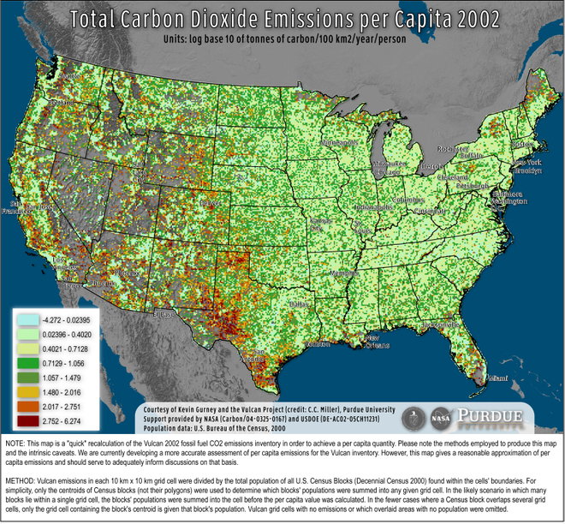
Carbon Emissions Across the Country

Slide 6
What are we Doing Locally?
FGCU is building a solar field.
If this project is successful it will be able to provide power for the entire campus, including housing.
Not only that, but over 30 years it should save the school $22 million.
+
=
Independent, carbon free energy.

Slide 7
Lee County Energy
Covanta Energy:
Recycles solid waste, and turns it into energy.
Zero carbon emissions.
Helps reduce space in landfills, increases landfills lifespan.

Slide 8
What does all this Mean?
So what about Carbon Emissions? What do they have to do with us here in South West Florida?
Carbon Dioxide gas being released into the atmosphere contributing to global warming.

Slide 9
Global Warming at a Local Level
We all know that the polar ice caps are melting, so what right? That’s thousands of miles away and has nothing to with us.
But what if I told you it has everything to do with you and me.
If those Ice Caps melt, the sea level will increase, just a five foot increase will place about 1/3 of Collier County underwater.

Slide 10
What Can We Do?
First off, we can try to conserve energy at home so that less energy has to be produced at the power plants.
Buy Energy Star appliances when old ones need replacing, keep you air conditioning a degree or two warmer, unplug electronics when not in use, use fluorescent light bulbs
It’s simple things like this that can make an impact.

Slide 11
Ways to Save Energy and CO2 Emissions.
http://video.about.com/housekeeping/Energy-Saving-Tips-for-Home.htm

Slide 12
What’s Happening Globally?
A great challenge for widespread adoption of renewable energy sources is fitting them into an energy system that was designed around fossil fuels, fuels that have the advantage of being concentrated and easily stored.
Electricity is the single most important element of today's energy system, essentials for lighting, cooling, electronics, and many industrial processes. Its role will only grow as new technologies allow grid electricity to be used for plus in hybrid cars and to heat and cool homes efficiently through ground source heat pumps.
Electricity also is the output of the largest and most easily replaced contributor to carbon emissions.

Slide 13
Electric Cars… Will it happen?
http://vcr.csrwire.com/node/7772

Slide 14
Estimates of Potential Contribution of Renewable Energy Sources
Energy Source | Potential Contribution
Solar water heaters Solar cells Solar power plants Wind Power Biomass Geothermal Heat Wave and ocean thermal energy | Could provide half the world’s hot water Could supply 10 percent of grid electricity in the United States by 2030 Seven states in U.S. Southwest could provide more than 7,000 gigawatts of solar generating capacity—nearly seven times U.S. electric from all sources. Could provide 20 percent of worlds electricity. 1 Billion tons could be available for energy conversion in the United States in 2025, replacing one third of current oil use. Could provide 100gigawatts of generating capacity in the U.S. alone Long-run contribution could be on same order of magnitude as current world energy use

Slide 15
What to Expect?
There are good reasons to think that the world may be on the verge of a major transformation of energy markets.
The interaction of advancing technology, private investment, and policy reform have led to a pace of change.
There were growing signs in 2007 that the years of political paralysis on climate change may be coming to an end, spurred by the warnings of scientists and the concerns of citizens.

Slide 16
Potential Game-Changing Political Developments in 2007
Twenty-seven major U.S. companies– from Alcoa and Dow chemical to Duke energy, General Motors, and Xerox– announced support for national regulation of CO2 emissions
The European Union committed to reducing its carbon dioxide emissions 20 percent below 1990 levels by 2020, and member states are ramping up their energy efficiency and renewable energy programs in order to achieve these goals.
China announced its first national climate policy, pledging to step up its energy efficiency and renewable energy programs and acknowledge that earlier policies were not sufficient.
Seventeen states in the United States moved toward adopting regulations on CO2 emissions, increasing pressure on the U.S. Congress, which was considering national legislation.
Brazil recognized the threat that climate change poses to the country’s economically crucial agriculture and forestry industries and signaled a new commitment to strengthening international climate agreements.

Slide 17
Works Cited
Ansolabehere, S. et al (2003). The Future of Nuclear Power: An Interdisciplinary MIT Study. Cambridge, MA: Massachusetts Institute of Technology.
Ansolabehere, S. et al (2007). The Future
of Coal: Options for a Carbon Constrained World. Cambridge, MA: Massachusetts Institute of Technology.
Cox, J. (2007, April 6). Southwest Florida’s future appears flooded. Naples Dailey News.

Slide 18
Works Cited
Energy Information Association (March 2008). U.S. Carbon Dioxide Emissions. Retrieved May 13, 2008 from http://www.eia.doe.gov/environment.html.
WINK News (May 5, 2008). Simply Green: Energy Audit Part 1. Retrieved May 13, 2008 from http://www.winknews.com/news/local/185734 74.html.
Miller, K ( 2008 May, 18). On southwest Florida coast, college going solar. Palm Beach Post.

Slide 19
Works Cited
Madrigal, A ( April 16, 2008). New High- Res Map of U.S. Per-Capita CO2 Emissions. Retrieved May 13, 2008 from http://blog.wired.com/wiredscience/200 8/04/new-high-res-ma.html

