Slide 1
Slides by
John
Loucks
St. Edward’s
University

Slide 2
Chapter 15, Part B Forecasting
Trend Projection
Seasonality and Trend

Slide 3
Linear Trend Model
If a time series exhibits a linear trend, curve fitting can be used to develop a best-fitting linear trend line.
Curve fitting minimizes the sum of squared error between the observed and fitted time series data where the model is a trend line.
We build a nonlinear optimization model to find the best values for the intercept and slope of the trend line.

Slide 4
Linear Trend Model
The linear trend line is estimated by the equation:
T_{t} = b₀ + b₁t
where: T_{t} = linear trend forecast in period t
b₀ = intercept of the linear trend line
b₁ = slope of the linear trend line
t = time period

Slide 5
Linear Trend Model
Nonlinear Curve-Fitting Optimization Model
s.t.
T_{t} = b₀ + b₁t t = 1, 2, 3, … n
There are n + 2 decision variables.
The decision variables are b₀, b₁, and T_{t} .
There are n constraints.

Slide 6
Linear Trend Model
Example: Auger’s Plumbing Service
The number of plumbing repair jobs performed by
Auger's Plumbing Service in the last nine months is
listed on the right.
Month Jobs
Month Jobs
Forecast the number of
repair jobs Auger's will
perform in December
using the least squares
method.
March 353
August 409
April 387
September 399
May 342
October 412
June 374
November 408
July 396

Slide 7
Linear Trend Model
Example: Auger’s Plumbing Service
The objective function minimizes the sum of the squared error.
Minimize { (353 – T₁)² + (387 – T₂)² + (342 – T₃)²
+ (374 – T₄)² + (396 – T₅)² + (409 – T₆)²
+ (399 – T₇)² + (412 – T₈)² + (408 – T₉)² }

Slide 8
Linear Trend Model
Example: Auger’s Plumbing Service
The following constraints define the forecasts as a linear function of parameters b₀ and b₁.
T₁ = b₀ + b₁1 T₆ = b₀ + b₁6
T₂ = b₀ + b₁2 T₇ = b₀ + b₁7
T₃ = b₀ + b₁3 T₈ = b₀ + b₁8
T₄ = b₀ + b₁4 T₉ = b₀ + b₁9
T₅ = b₀ + b₁5

Slide 9
Trend Projection
Example: Auger’s Plumbing Service
The solution to the nonlinear curve-fitting optimization model is:
b₀ = 349.667 and b₁= 7.4
T₁ = 357.07 T₆ = 394.07
T₂ = 364.47 T₇ = 401.47
T₃ = 371.87 T₈ = 408.87
T₄ = 379.27 T₉ = 416.27
T₅ = 386.67

Slide 10
Trend Projection
Forecast Accuracy
Trend
Forecast
Forecast
Error
Absolute
Error
Squared
Error
Abs.%
Error
Month
Jobs
Mar.Apr.
MayJun.
Jul.
Aug.
Sep.
Oct.
Nov.
353
387
342
374
396
409
399
412
408
357.07
364.47
371.87
379.27
386.67
394.07
401.47
408.87
416.27
-4.07
22.53
-29.87
-5.27
9.33
14.93
-2.47
3.13
-8.27
0.00
4.07
22.53
29.87
5.27
9.33
14.93
2.47
3.13
8.27
99.87
16.54
507.75
892.02
27.74
87.11
223.00
6.08
9.82
68.34
1838.40
1.15
5.82
8.73
1.41
2.36
3.65
0.62
0.76
2.03
26.53
Total

Slide 11
Trend Projection
Forecast Accuracy

Slide 12
Nonlinear Trend Regression
Sometimes time series have a curvilinear or nonlinear trend.
A variety of nonlinear functions can be used to develop an estimate of the trend in a time series.
One example is this quadratic trend equation:
T_{t} = b₀ + b₁t + b₂t²
Another example is this exponential trend equation:
T_{t} = b₀(b₁)^{t}

Slide 13
Nonlinear Trend Regression
Example: Cholesterol Drug Sales
Consider the annual revenue in millions of dollars
for a cholesterol drug for the first ten years of sales.
This data indicates an
overall increasing trend.
A curvilinear function
appears to be needed to
model the long-term
trend.
Year Sales
Year Sales
1 23.1
6 43.2
2 21.3
7 59.5
3 27.4
8 64.4
4 34.6
9 74.2
5 33.8
9 99.3

Slide 14
Quadratic Trend Equation
Model Formulation

Slide 15
Quadratic Trend Equation
Model Solution
This model can be solved with Excel Solver or LINGO.
The optimal values are:
b₀ = 24.182, b₁ = -2.11, b₂ = .922
Sum of squared errors = 110.65
MSE = 110.65/10 = 11.065
The fitted curve is: T_{t} = 24.182 – 2.11 t + .922 t ²

Slide 16
Exponential Trend Equation
Model Formulation

Slide 17
Exponential Trend Equation
Solution
This model can be solved with Excel Solver or LINGO.
The optimal values are:
b₀ = 15.42, b₁ = 1.20
Sum of squared errors = 123.12
MSE = 123.12/10 = 12.312
The fitted curve is: T_{t} = 15.42(1.20)^{t}
Based on MSE, the quadratic model provides
a better fit than the exponential model.

Slide 18
Seasonality without Trend
To the extent that seasonality exists, we need to incorporate it into our forecasting models to ensure accurate forecasts.
We will first look at the case of a seasonal time series with no trend and then discuss how to model seasonality with trend.

Slide 19
Seasonality without Trend
Example: Umbrella Sales
Year | Quarter 1 | Quarter 2 | Quarter 3 | Quarter 4
1 | 125 | 153 | 106 | 88
2 | 118 | 161 | 133 | 102
3 | 138 | 144 | 113 | 80
4 | 109 | 137 | 125 | 109
5 | 130 | 165 | 128 | 96
Sometimes it is difficult to identify patterns in a time series presented in a table.
Plotting the time series can be very informative.

Slide 20
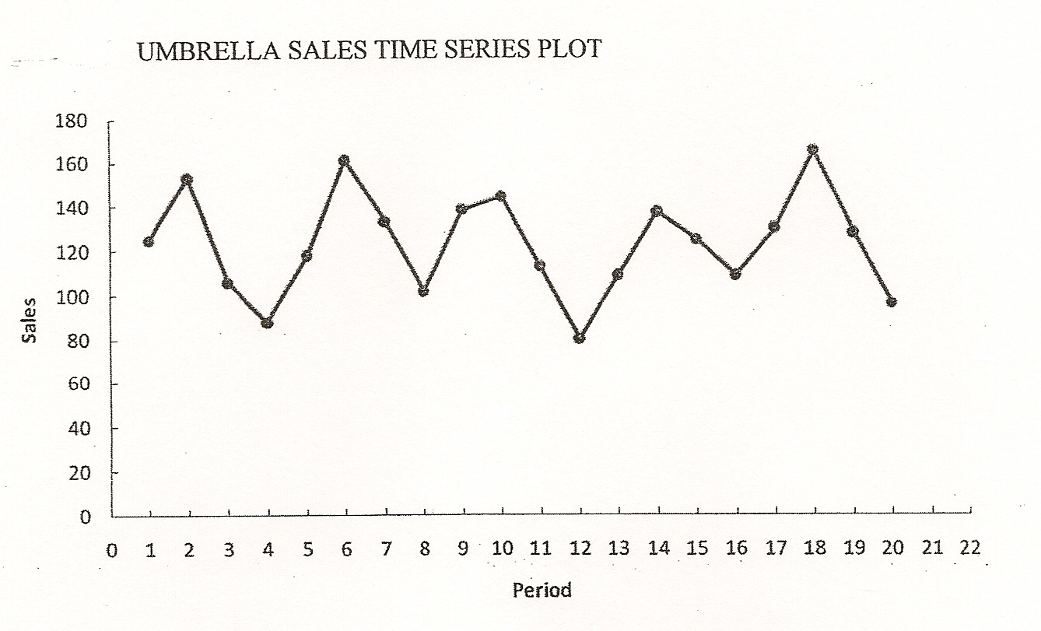
Seasonality without Trend
Umbrella Sales Time Series Plot

Slide 21
Seasonality without Trend
The time series plot does not indicate any long-term trend in sales.
However, close inspection of the plot does reveal a seasonal pattern.
The first and third quarters have moderate sales,
the second quarter the highest sales, and
the fourth quarter tends to be the lowest quarter in terms of sales.

Slide 22
Seasonality without Trend
We will treat the season as a categorical variable.
Recall that when a categorical variable has k levels, k – 1 dummy variables are required.
If there are four seasons, we need three dummy variables.
Qtr1 = 1 if Quarter 1, 0 otherwise
Qtr2 = 1 if Quarter 2, 0 otherwise
Qtr3 = 1 if Quarter 3, 0 otherwise

Slide 23
Seasonality without Trend
General Form of the Equation is:
Optimal Model is:
The forecasts of quarterly sales in year 6 are:
Quarter 1: Sales = 95 + 29(1) + 57(0) + 26(0) = 124
Quarter 2: Sales = 95 + 29(0) + 57(1) + 26(0) = 152
Quarter 3: Sales = 95 + 29(0) + 57(0) + 26(1) = 121
Quarter 4: Sales = 95 + 29(0) + 57(0) + 26(0) = 95

Slide 24
Seasonality without Trend
Model Formulation

Slide 25
Seasonality and Trend
We will now extend the curve-fitting approach to include situations where the time series contains both a seasonal effect and a linear trend.
We will introduce an additional variable to represent time.

Slide 26
Seasonality and Trend
Example: Terry’s Tie Shop
Business at Terry's Tie Shop can be viewed as
falling into three distinct seasons: (1) Christmas
(November and December); (2) Father's Day (late
May to mid June); and (3) all other times.
Average weekly sales ($) during each of the
three seasons during the past four years are shown on the next slide.

Slide 27
Seasonality and Trend
Example: Terry’s Tie Shop
Season
Year
1 2 3
1
2
3
4
1856 2012 985
1995 2168 1072
2241 2306 1105
2280 2408 1120
Determine a forecast for the average weekly
sales in year 5 for each of the three seasons.

Slide 28
Seasonality and Trend
There are three seasons, so we will need two dummy variables.
Seas1_{t} = 1 if Season 1 in time period t, 0 otherwise
Seas2_{t} = 1 if Season 2 in time period t, 0 otherwise
General Form of the Equation is:

Slide 29
Seasonality and Trend
Model Formulation

Slide 30
Seasonality and Trend
Optimal Model
The forecasts of average weekly sales in the three seasons of year 5 (time periods 13, 14, and 15) are:
Seas. 1: Sales₁₃ = 797 + 1095.43(1) + 1189.47(0) + 36.47(13)
= 2366.5
Seas. 2: Sales₁₄ = 797 + 1095.43(0) + 1189.47(1) + 36.47(14)
= 2497.0
Seas. 3: Sales₁₅ = 797 + 1095.43(0) + 1189.47(0) + 36.47(15)
= 1344.0

Slide 31
End of Chapter 15, Part B

